Slide 1
ANS Northeastern Section Chapter Meeting
Chris Colbert
Chief Strategy Officer
May 17, 2018

Slide 2
Providing scalable advanced nuclear technology for the production of electricity, heat, and water to improve the quality of life for people around the world

Slide 3
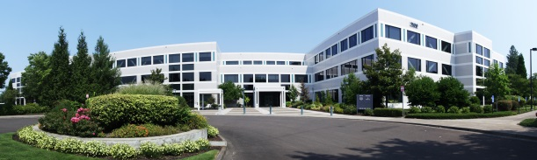
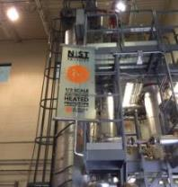

Who is NuScale Power?
Initial concepts had been in development and testing since the 2000 (U.S. DOE) MASLWR program.
NuScale Power was formed in 2007 for the sole purpose of completing the design and commercializing a small modular reactor – the NuScale Power Module™.
Fluor became lead investor in 2011.
  In 2013, NuScale won $226M in matching funds in a competitive U.S. DOE Funding Opportunity.
Design Certification Application was completed
in December 2016 and accepted for U.S. NRC
review in March 2017– ON SCHEDULE!!
Phase 1 of U.S. NRC Review completed April 2018 – ON SCHEDULE!!
In April 2018, NuScale won $40M in matching funds in a competitive U.S. DOE Funding Opportunity
Current investment > $720M
NuScale Engineering Offices Corvallis
One-third scale NIST-1 Test Facility
NuScale Control Room Simulator

Slide 4
NuScale Plant Design
4

Slide 5
Pressurized Water Reactor Basics
Containment
Pressurizer
Steam
Generator
Reactor Pressure Vessel
Steam
Generator
Reactor
Core
Reactor Coolant Pump
Reactor Coolant Pump
Notes:
These represent the basic major components of a pressurized water reactor, and most of these components can be found in the NuScale design, but in a significantly different configuration.
In the NuScale Power Module, the steam generators and pressurizer have been designed internal to the Reactor Pressure Vessel. CLICK
This eliminates the need for Reactor Coolant Pumps, reactor coolant loops, and their associated RPV connections. CLICK

Slide 6
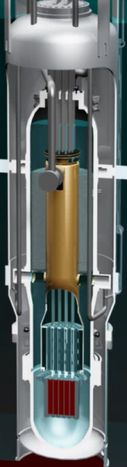
NuScale Small Modular Reactor
Containment
Pressurizer
Steam Generators
Reactor Pressure Vessel (RPV)
Reactor Core
Notes:
With the reactor core, steam generators, and pressurizer all internal to the reactor pressure vessel, and without reactor coolant pumps and loops,
a much smaller containment is needed.
(CLICK) This is the general construction of the NuScale Power Module.
The RPV is flooded all of the way into the pressurizer area during normal operation, and the control rods are withdrawn from the reactor core.

Slide 7
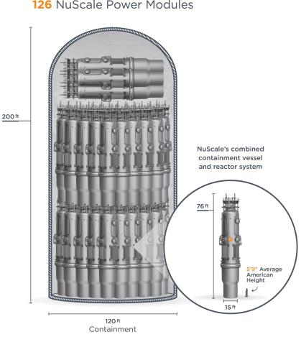
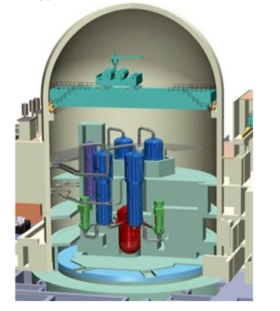
Size Comparison
Comparison size envelope of new nuclear plants
currently under construction in the United States.
Typical Pressurized Water Reactor
*Source: NRC
*Source: U.S. NRC

Slide 8
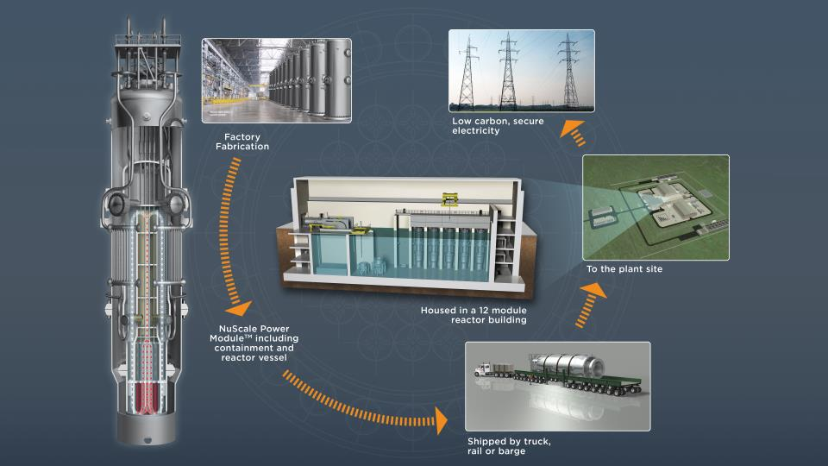
A New Approach to Construction and Operation

Slide 9
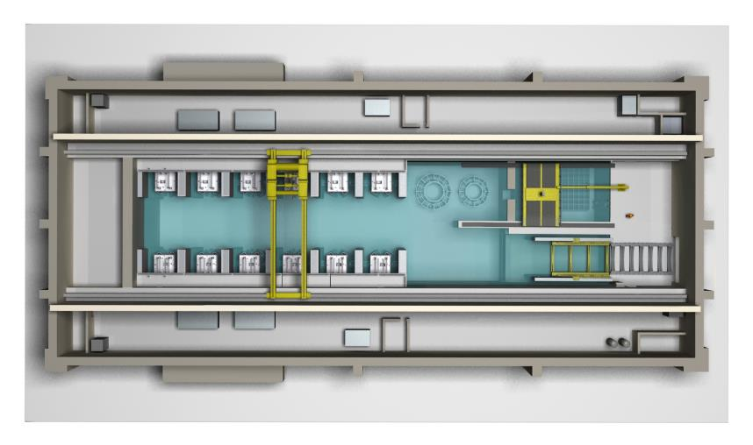
Reactor Building Overhead View
Module Import Trolley
Refueling Machine
Reactor Building Crane
NuScale Power Module
Reactor Pool
Fuel Pool
Reactor Vessel Flange Tool
Containment Vessel Flange Tool

Slide 10
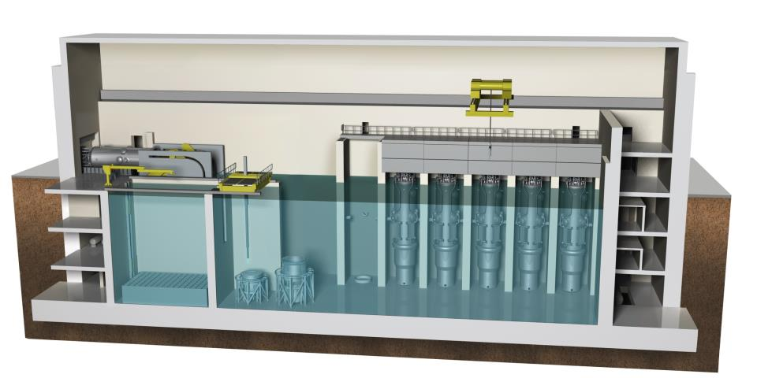
Reactor Building Cross Section
Reactor Building houses NuScale Power Modules, Fuel Pool, and Reactor Pool
Reactor Building Crane
Biological Shield
Refueling Machine
Fuel Pool
Reactor Pool
NuScale Power Module
Reactor Vessel Flange Tool
Containment Vessel Flange Tool
TM

Slide 11
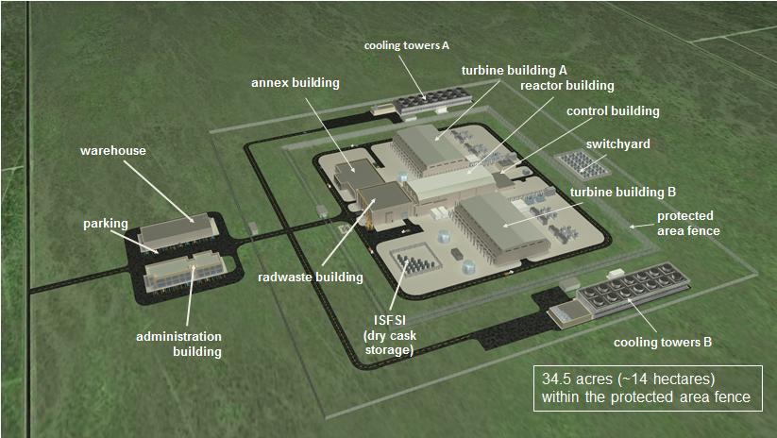
Site Layout
cooling towers A
turbine building A
annex building
reactor building
control building
warehouse
switchyard
turbine building B
parking
protected area fence
radwaste building
ISFSI
(dry cask storage)
administration building
cooling towers B

Slide 12
NuScale Plant Safety
12

Slide 13
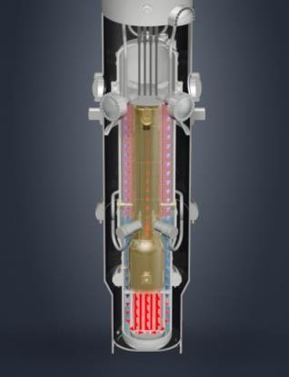
Simplicity Enhances Safety
All safety equipment needed to protect the core is shown on this picture
Natural Convection for Cooling
Passively safe, driven by gravity, natural circulation over the fuel
No pumps, no emergency generators
Seismically Robust
System submerged in a below-ground pool of water in an earthquake and aircraft impact resistant building
Simple and Small
Reactor core is 1/20th the size of large reactor cores
Integrated reactor design - no large-break loss-of-coolant accidents
Defense-in-Depth
Multiple additional barriers to protect against the release of radiation to the environment
Conduction – heat is transferred through the walls of the tubes in the steam generator, heating the water (secondary coolant) inside them to turn it to steam. Primary water cools.
Convection – energy from the nuclear reaction heats the primary reactor coolant causing it to rise by convection and natural buoyancy through the riser, much like a chimney effect
Gravity – colder (denser) primary coolant “falls” to bottom of reactor pressure vessel, cycle continues
160 MWt Reactor Power Module
Steel containment has >10 times pressure rating of a typical PWR
Water volume to thermal power ratio is four times larger than typical PWR

Slide 14
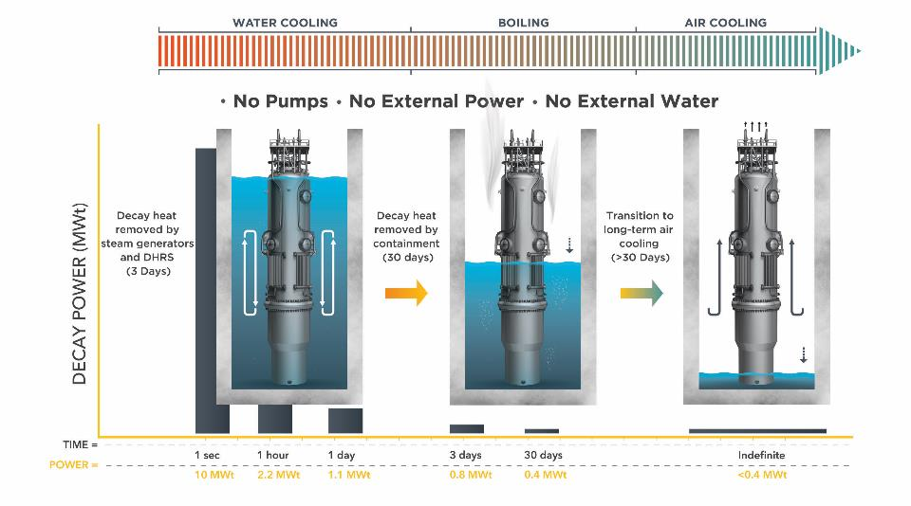
Innovative Advancements to Reactor Safety
Nuclear fuel cooled indefinitely without AC or DC power*
30 days is a minimum based on very conservative estimates.
*Alternate 1E power system design eliminates the need for 1E qualified batteries to perform ESFAS protective functions – Patent Pending

Slide 15
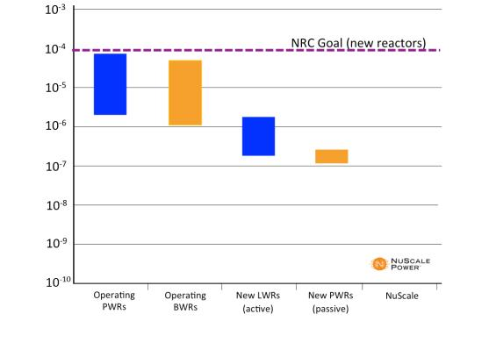
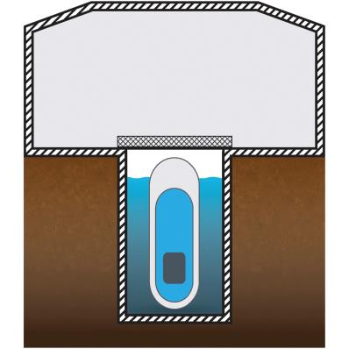
Reducing Plant Risk
Risk = (frequency of failure) X (consequences)
Reactor Building
Biological
Shield
Core Damage Frequency
Reactor Pool
Ground level
Pool Structure
And Liner
Containment
Reactor
Vessel
3 x 10⁻¹⁰/mcyr
Fuel Clad
Probability of core damage (Full Power) due to NuScale reactor equipment failures is
1 Event per Module every ~3 Billion Years
Four additional barriers to release of radioactivity from a NuScale plant.

Slide 16
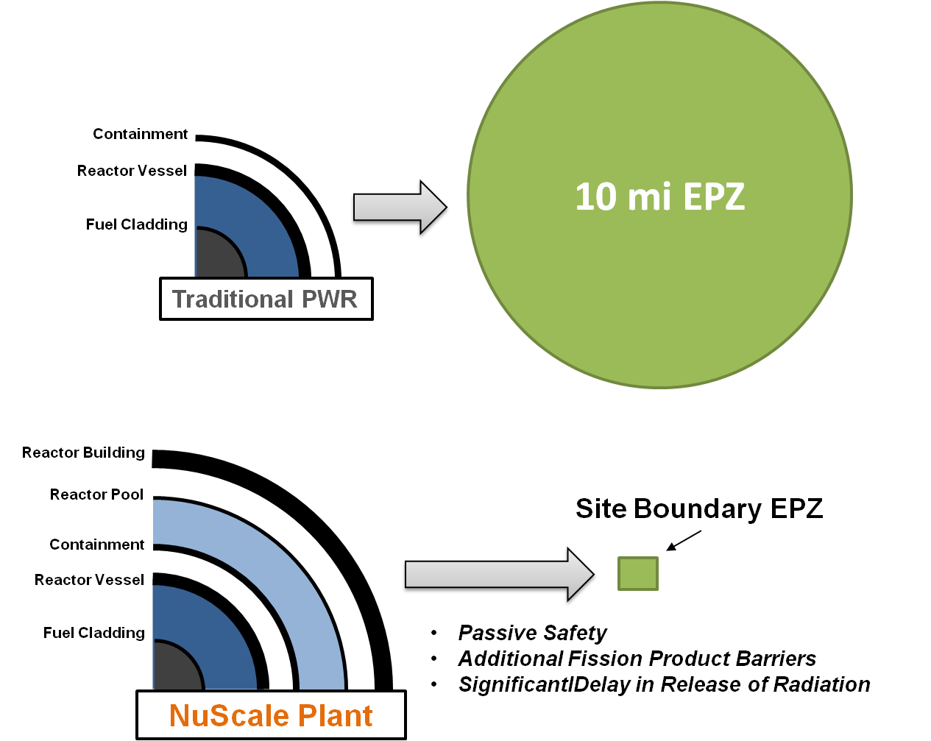
Strong Safety Case - Smaller EPZ
The licensee must have pre-determined protective action plans in place for a large publicly accessible area.
Virtually no publicly accessible area is subject to protective action planning by the licensee.
l

Slide 17
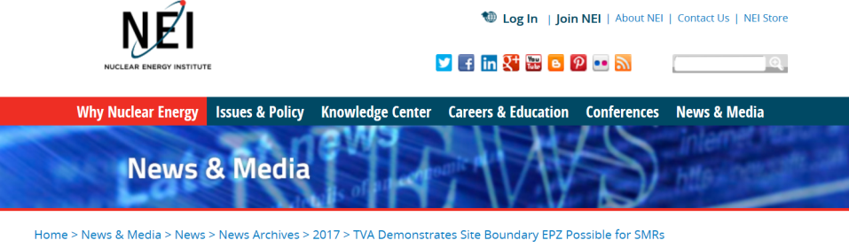
NEI Press Release
(September 7, 2017)
TVA Demonstrates Site Boundary EPZ Possible for SMRs
TVA analysis adds information on Clinch River early site permit application
Shows any accident radiological impact would be limited to within site boundary
Analysis provides basis for exemption from 10-mile EPZ in regulatory breakthrough
https://www.nei.org/News-Media/News/News-Archives/2017/TVA-Demonstrates-Site-Boundary-EPZ-Possible-for-SM

Slide 18
Testing Programs
18

Slide 19

Reactor Qualification Test Plan
The NuScale testing program is guided by the Reactor Qualification Test Plan
Summarizes tests planned in support of design certification, first-of-a-kind-engineering and product commercialization
Supports reactor safety code development, validation, reactor design, and technology maturation to minimize technology risk
Structured risk-based process used to identify and prioritize required tests
Focuses on features unique to an integral pressurized water reactor
Includes information for project planning (test descriptions and requirements, etc.)
Living document that is periodically updated to reflect changes in risk or priority
Have committed over $67 million in testing related activities
~ $70M additional testing for FOAK components
NuScale Reactor Qualification Test Plan
PL-1103-3463
(49 Test Programs)
Including:
Nuclear Fuel Mechanical
Nuclear Fuel Thermal Tests
Reactor Vessel Internals FIV
Control Rod Drive Mechanism Tests
Steam Generator Mechanical
Steam Generator Thermal Tests
RXM Manufacturing Demo
Valve Testing
Instrument Sensors
Module Protection System Prototype
Upper Module Mock-up
Module Assembly Tools
Integral System Tests
Advanced Manufacturing
Component Seismic Tests

Slide 20
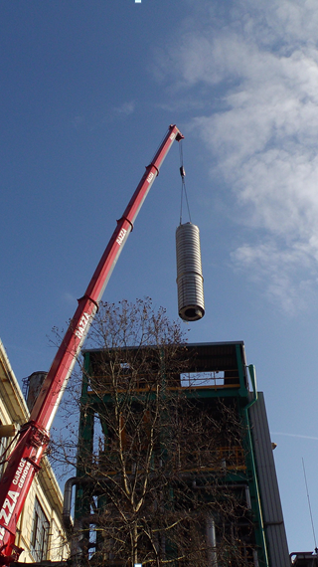
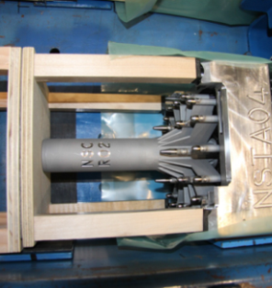
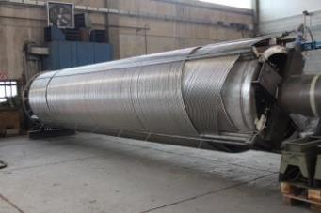
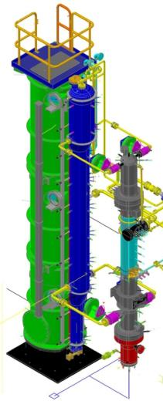
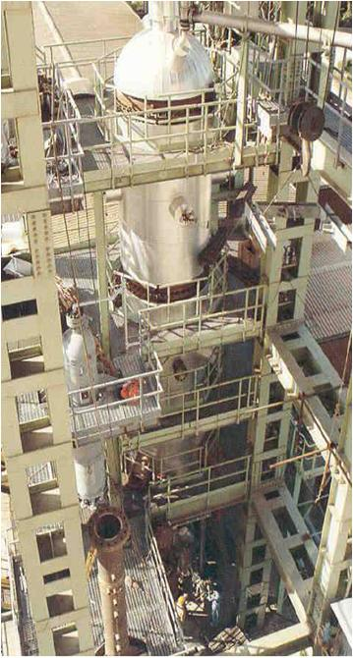
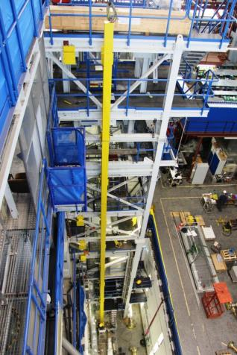
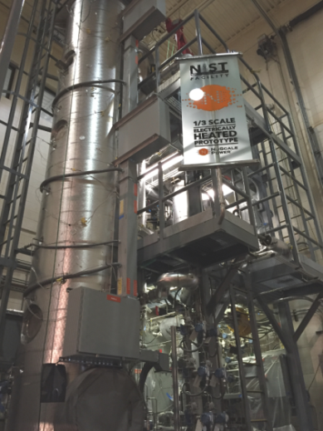
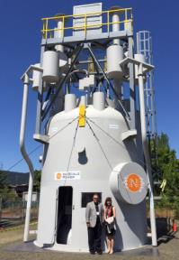
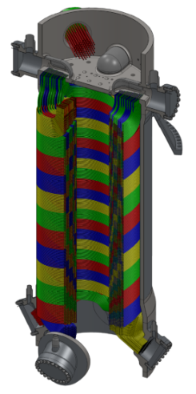
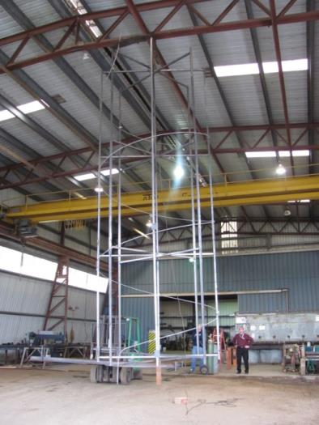
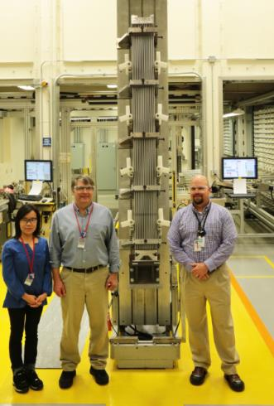
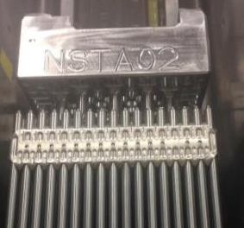
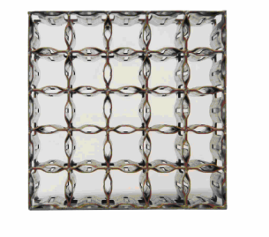
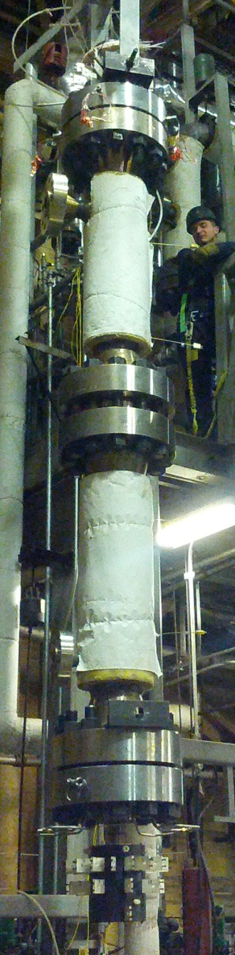
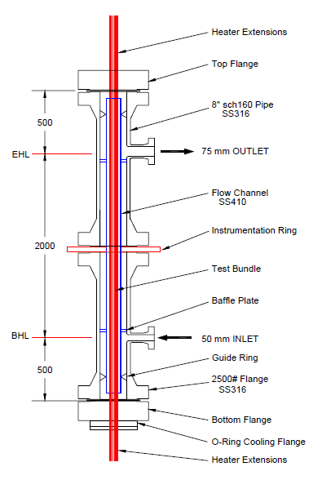
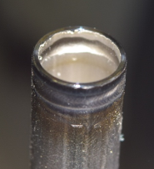
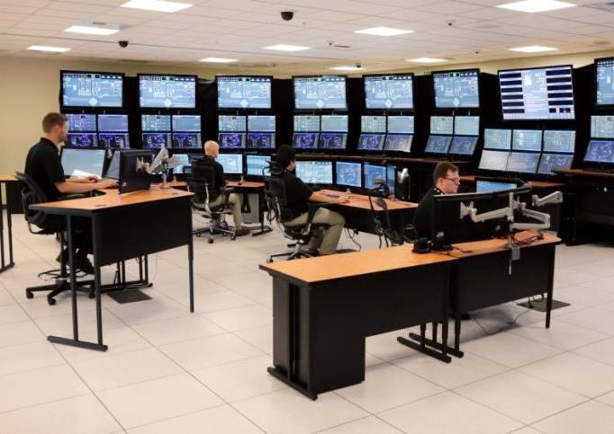
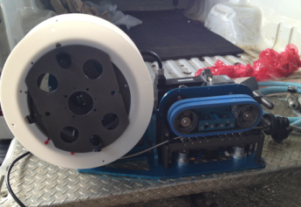
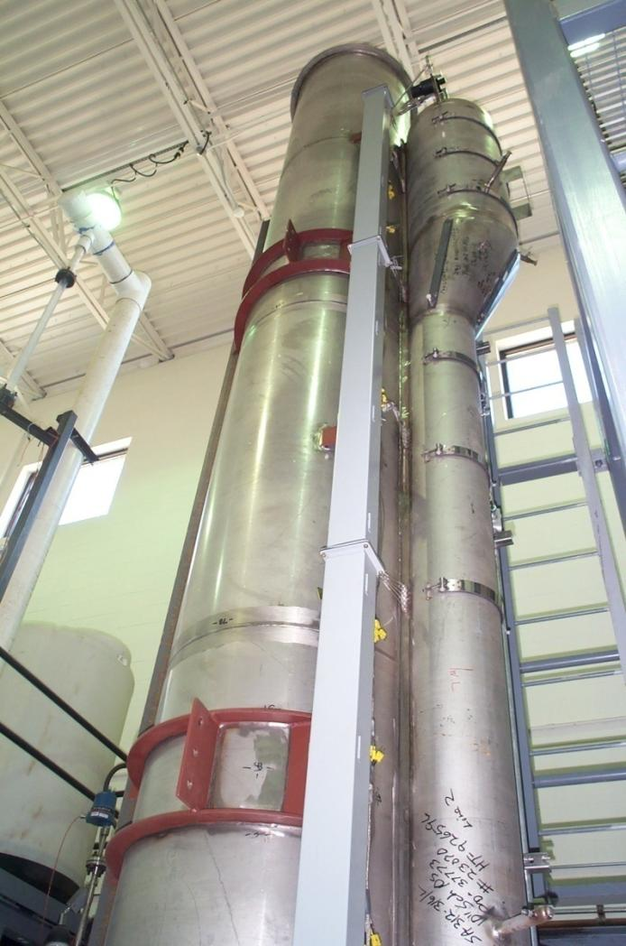
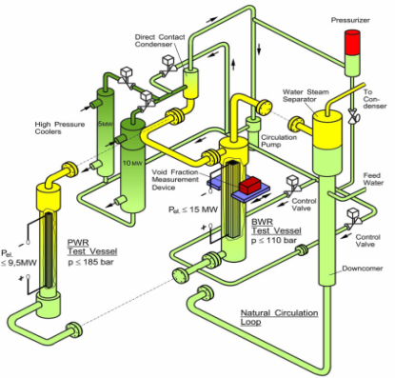
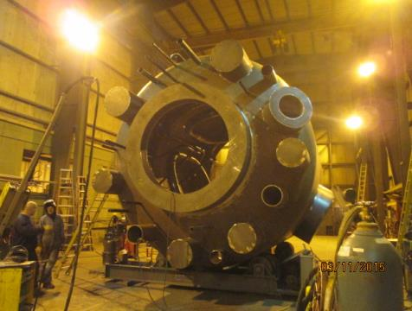
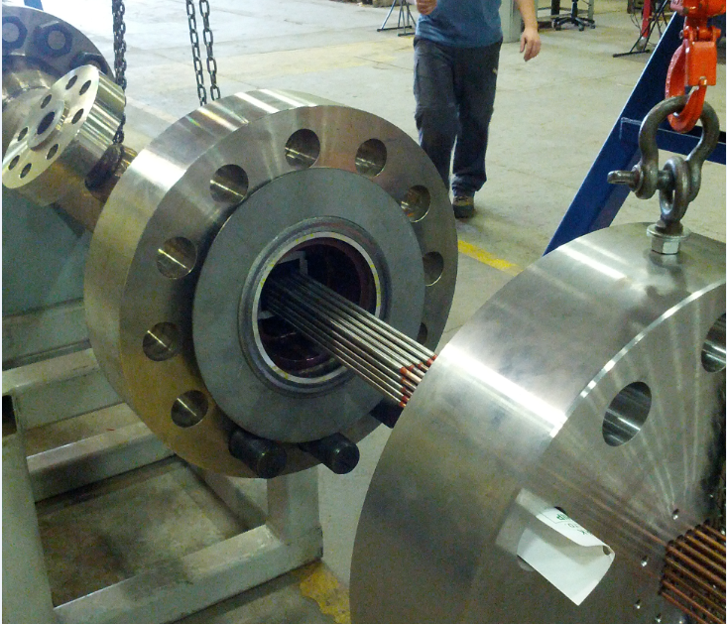
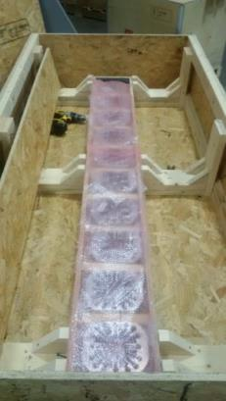
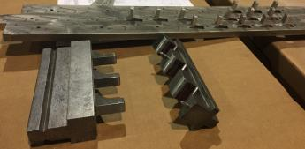
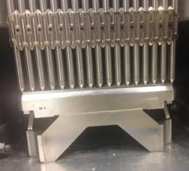
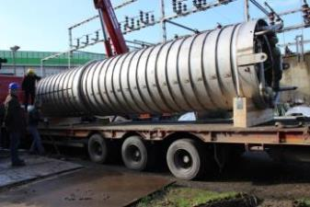
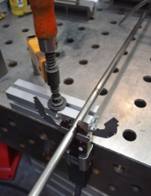
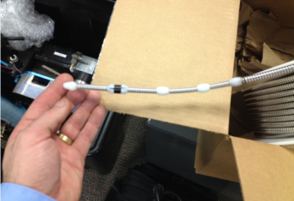
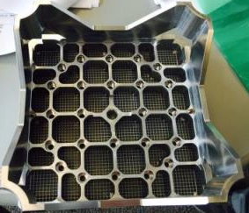
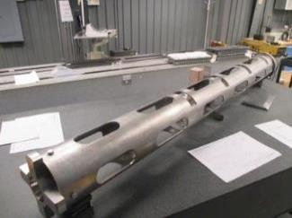
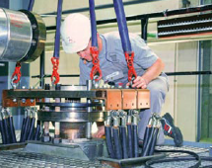
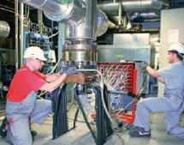
NuScale Test Programs
Full-Scale SG Tube Inspection Mock-Up, Corvallis, Oregon
NuScale Integral System Test Facility, OSU, Corvallis, Oregon
NuScale 12-Module Control Room Simulator, Corvallis, Oregon
Full-Scale Upper Module Mock-Up, Oregon Iron Works, Oregon
Control Rod Assembly Drop Tests, Erlangen, Germany
SG Flow Induced Vibration Tests, AREVA, Erlangen, Germany
NuFuel HTP-2 Critical Heat Flux Tests, AREVA, Karlstein, Germany
Critical Heat Flux Tests
Stern Lab, Canada
NuFuel HTP-2 Mechanical Test
Richland, Wa
Helical Coil SG Tests
SIET Piacenza, Italy

Slide 21
Research Initiatives
21

Slide 22
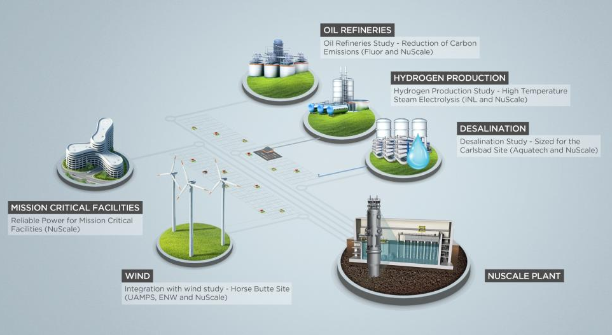
NuScale Diverse Energy Platform (NuDEP) Initiative
SAFE
SMALL
SCALABLE
FLEXIBLE
RELIABLE

Slide 23
Design Certification Status

Slide 24
NuScale Baseline DC Review
Completed DCA
12/31/16
P3 - ACRS review of SER w/OIs
8/27/19
P5 - ACRS review Adv SER w/no OIs
6/23/20
Rulemaking
Jan 2021
P1 – PSER and RAIs
4/16/18
2017
2018
2019
2020
2021
NRC Accepted
3/15/17
P2 – SER w/OIs
5/16/19
P6 – FSER
9/08/20
Design Certified
Jan 2021
P4 - Adv SER w/no OIs
12/12/19
Total projected duration for NRC
review and approval - 46 months
Notes:
Why pre-app? Short review.

Slide 25
DCA Review At-A-Glance
Review progressing well
  Phase 1 was completed ahead of schedule – April 13
  Phase 3 ACRS meetings beginning (Ch 8 and 7)
  Fewer questions than prior DCAs
    1,306 final and supplemental RAIs
    1,042 responses submitted
    Average response time 60 days, 89% within 60 days
  28 of 35 licensing audits completed
  5 of 15 topical reports (LTRs) approved
  Total cost of review at high end of forecast
Improved management of NRC review
  Management plans for “key issues”
  RAI review metrics
25

Slide 26
Summary
Overall NuScale’s DCA review is going well
No obvious major impediments to approval
NRC is executing its published schedule
NuScale meeting its commitments to NRC
NRC engagement constructive
Have controls in place to monitor progress

Slide 27
First Plant Deployment

Slide 28
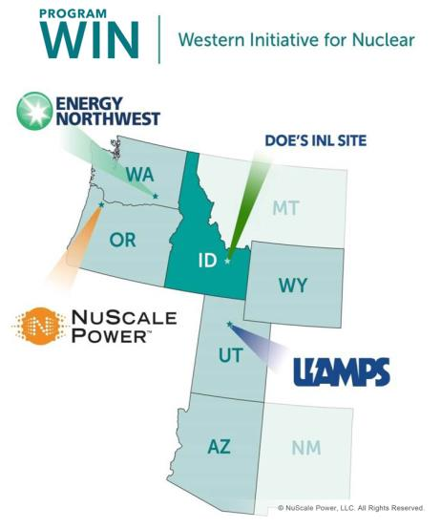
Progress with First Deployment: UAMPS CFPP
Utah Associated Municipal Power Systems (UAMPS) Carbon Free Power Project (CFPP) will be first deployment
Preferred location within the Idaho National Laboratory (INL) site
A 12-module plant (600 MWe gross)
DOE awarded $16 million in cost sharing to perform site selection, secure site and water, and prepare combined operating license application to NRC
2026 commercial operation
Power Sales Contracts (UAMPS)
  22 participants (78 MW) have approved PSCs, three members have withdrawn;
  9 participants (~84 MW) remaining in original CFPP study group. Public meetings being held.
  Six additional entities have expressed interest in joining CFPP
  Target is 150 MW by August 2018.
  Potential lease for DOE JUMP module
28
Notes:
Slide No.: 28
Identification: First Deployment: UAMPS CFPP
Text: The first Customer, Status
Graphic Concept: Pictures, Timeline
Comment: Verify and Update text and graphics as appropriate
Responsible:
New Data:
New Data Source:
Slide Notes:

Slide 29
Acknowledgement & Disclaimer

