Slide 1
Advanced Reactors Research at
MIT-NRL
Lin-wen Hu
Director, Research and Services

Slide 2
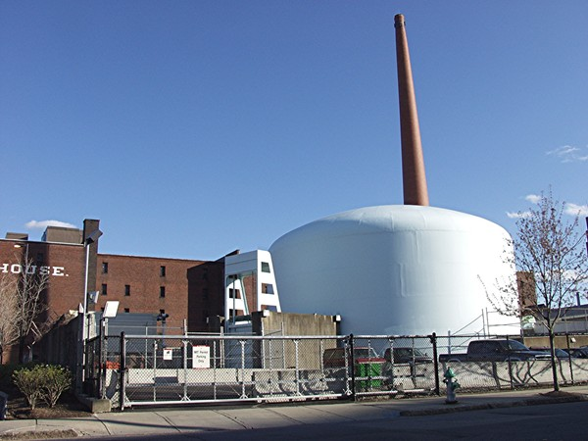
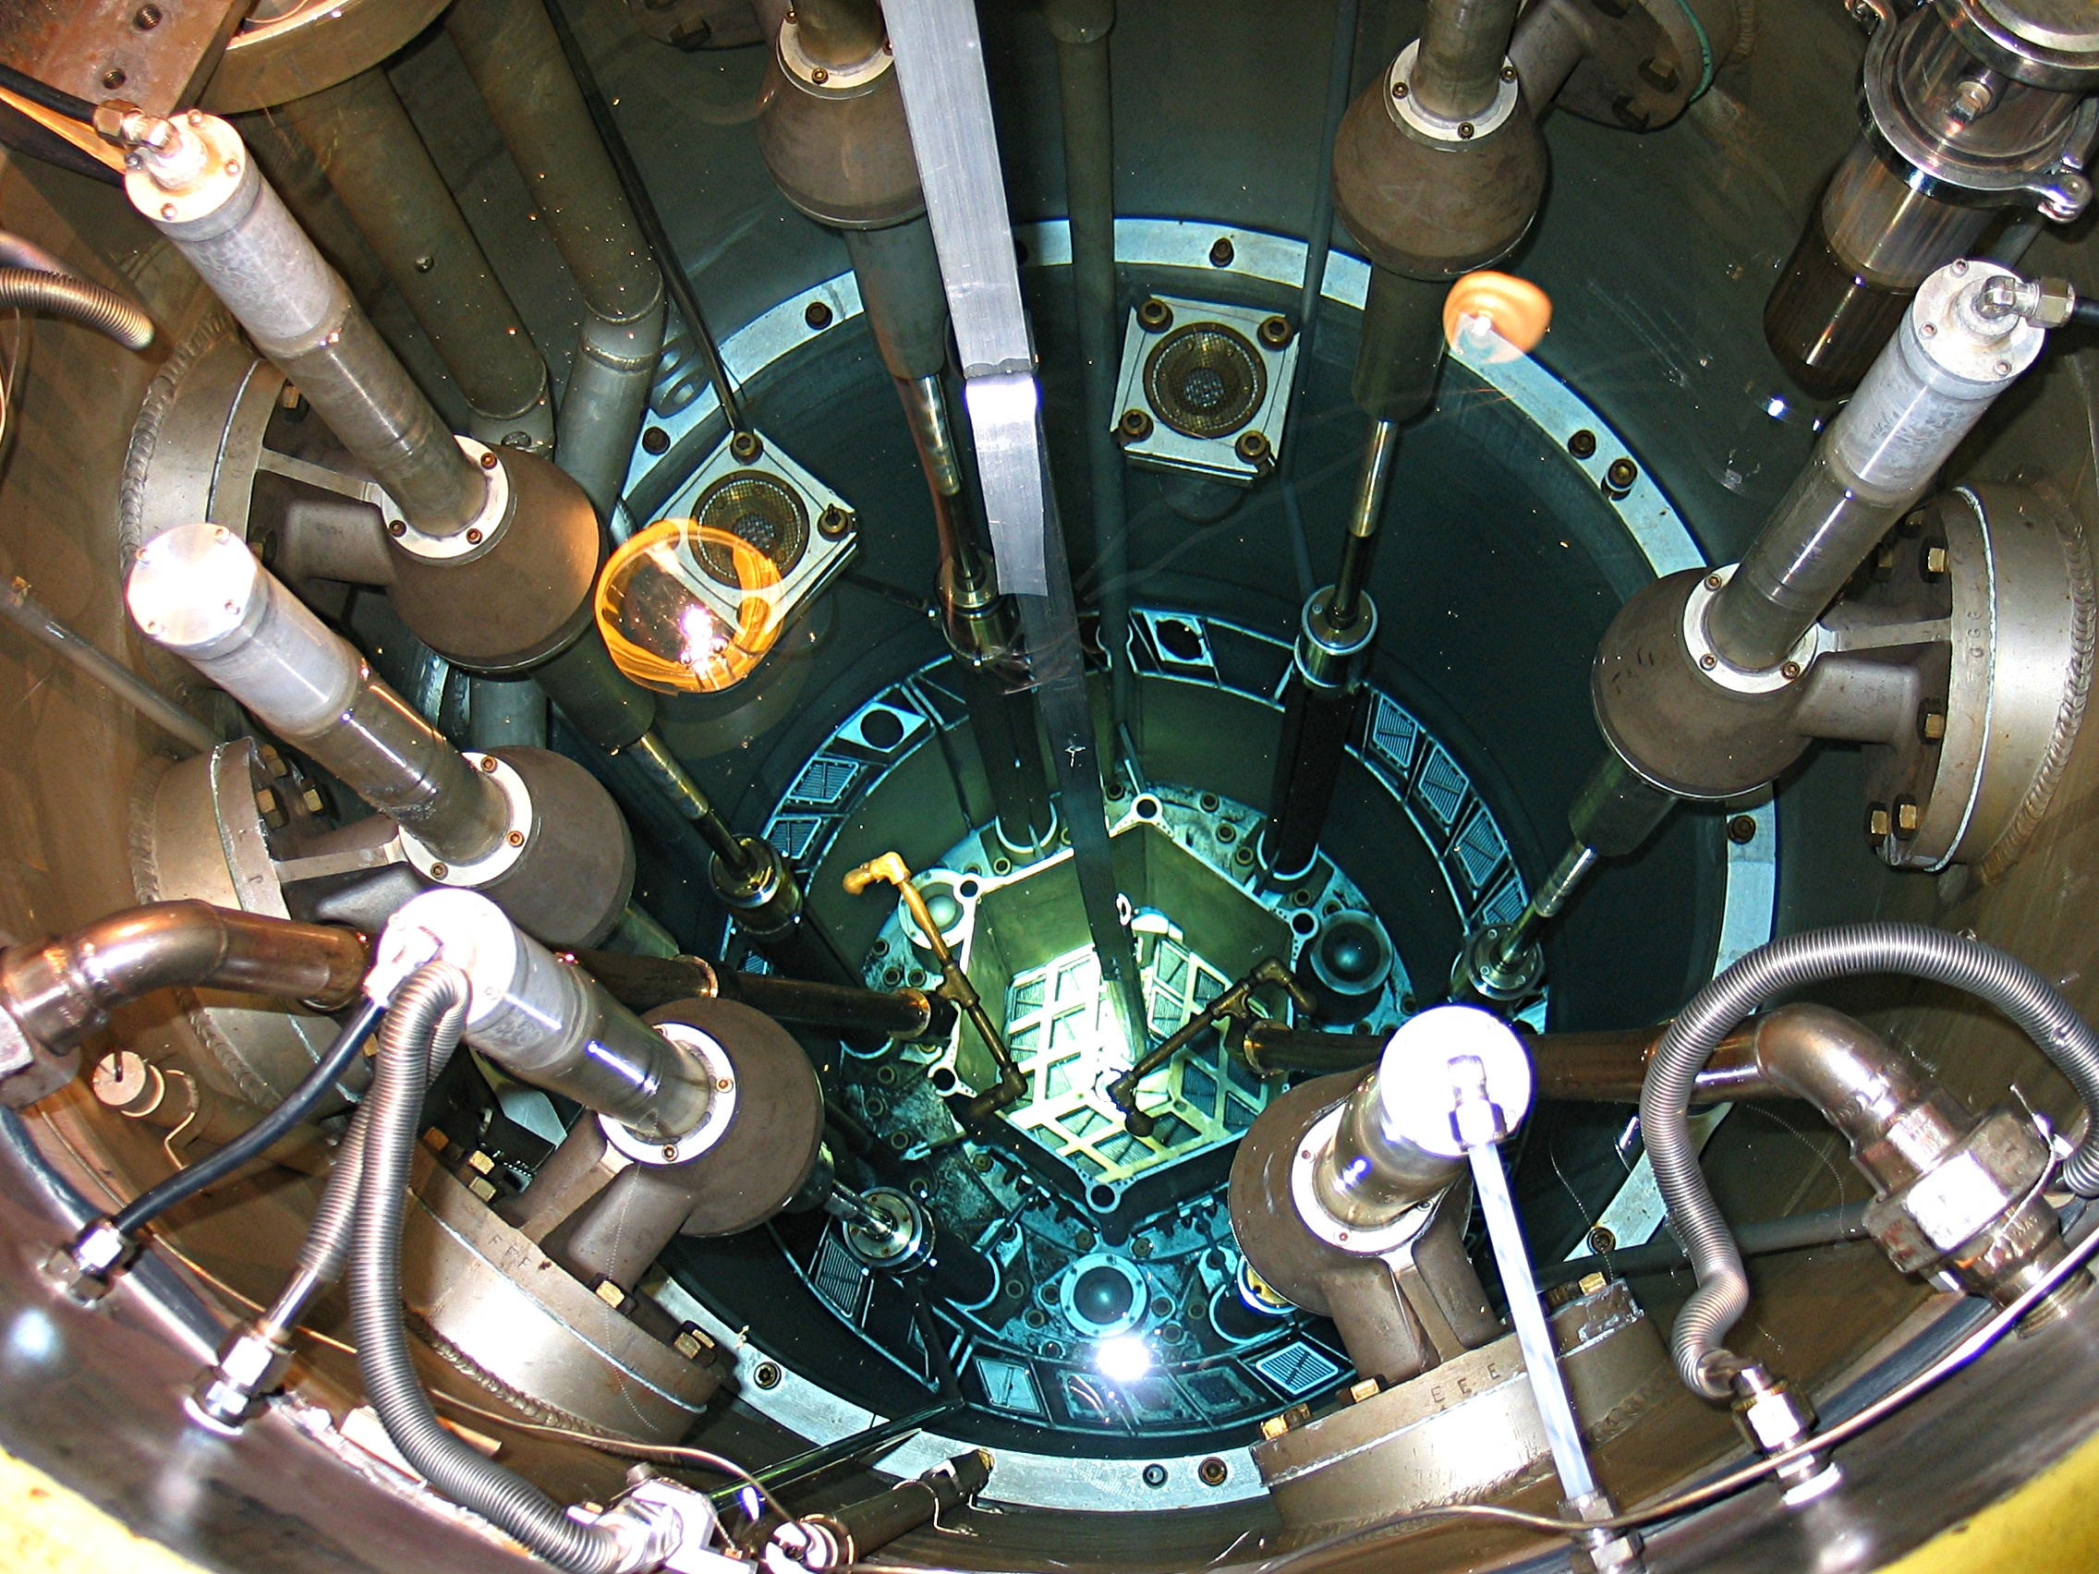
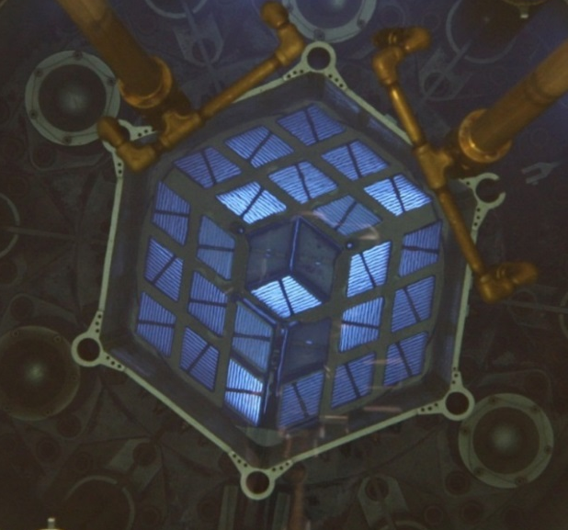
MIT Nuclear Reactor Laboratory
MIT-NRL is an interdepartmental laboratory with missions in nuclear technology applications, neutron science research, and training/education.
Primary facility is MIT Reactor (MITR), a multi-purpose research reactor owned and operated by MIT. A partner facility of DOE’s Nuclear Science User Facilities (NSUF).
Constructed in 1958 (MITR-I), upgraded in 1975 (MITR-II) with new core tank and housing
Uprated from 5 MW to 6 MW_{th} in 2010 (2nd largest university reactor in US).
Compact core with power density similar to a LWR. Operates 24/7, 10-week cycles
Tank-type, light water cooled and moderated, D₂O and graphite reflector.
Excellent track record in in-pile irradiation experiments including LWR loop, fuel, high-temperature materials, and advanced instrumentations.

Slide 3
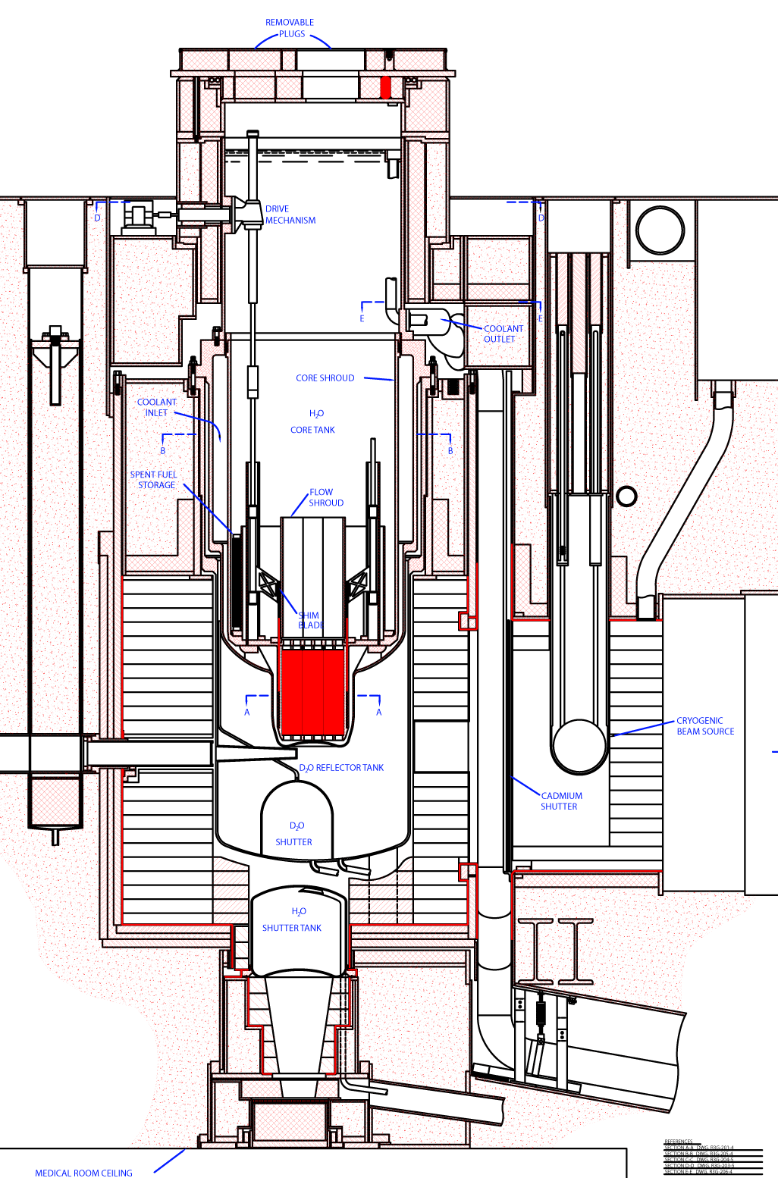
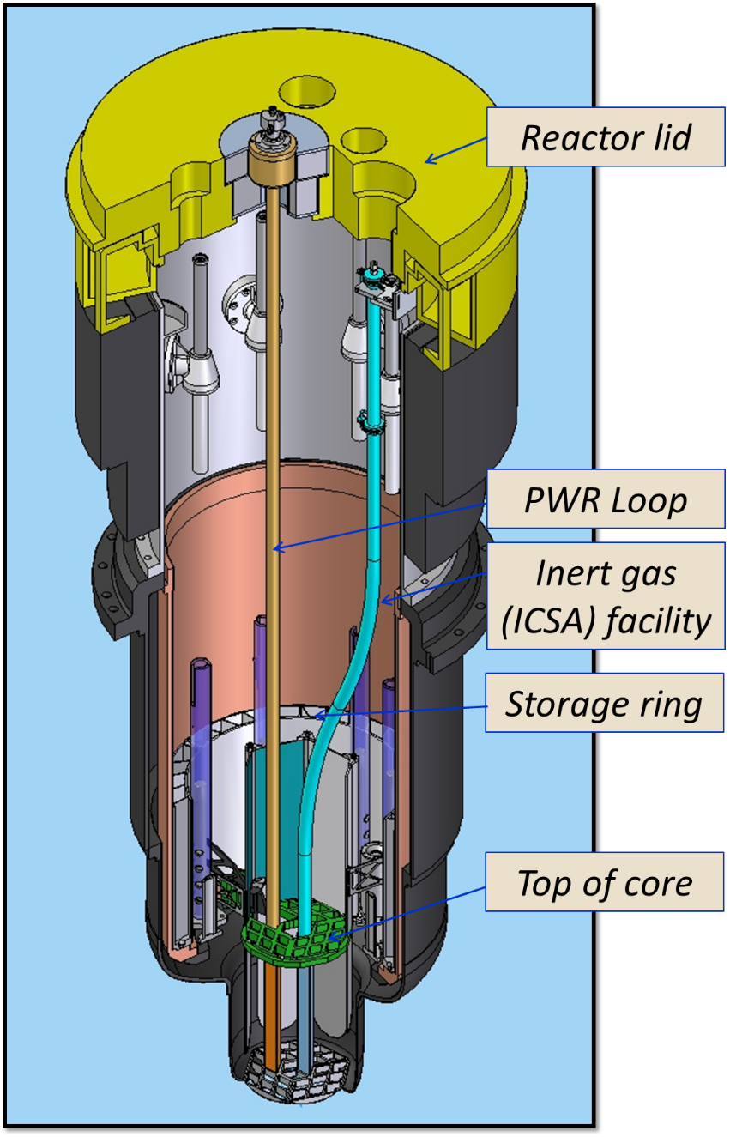
MITR Cross-Section

Slide 4
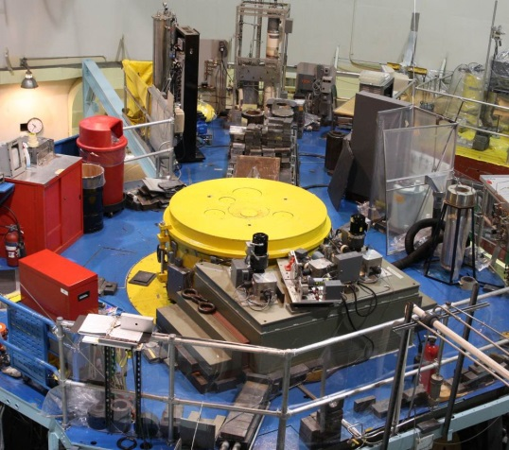
Reactor Top View

Slide 5
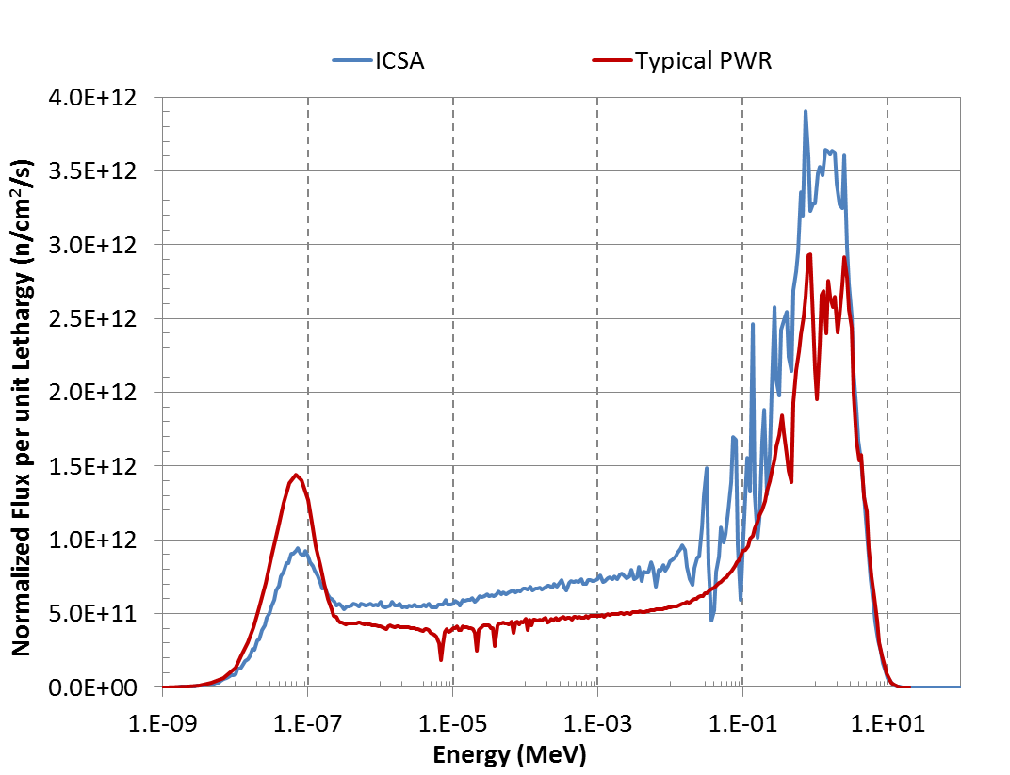
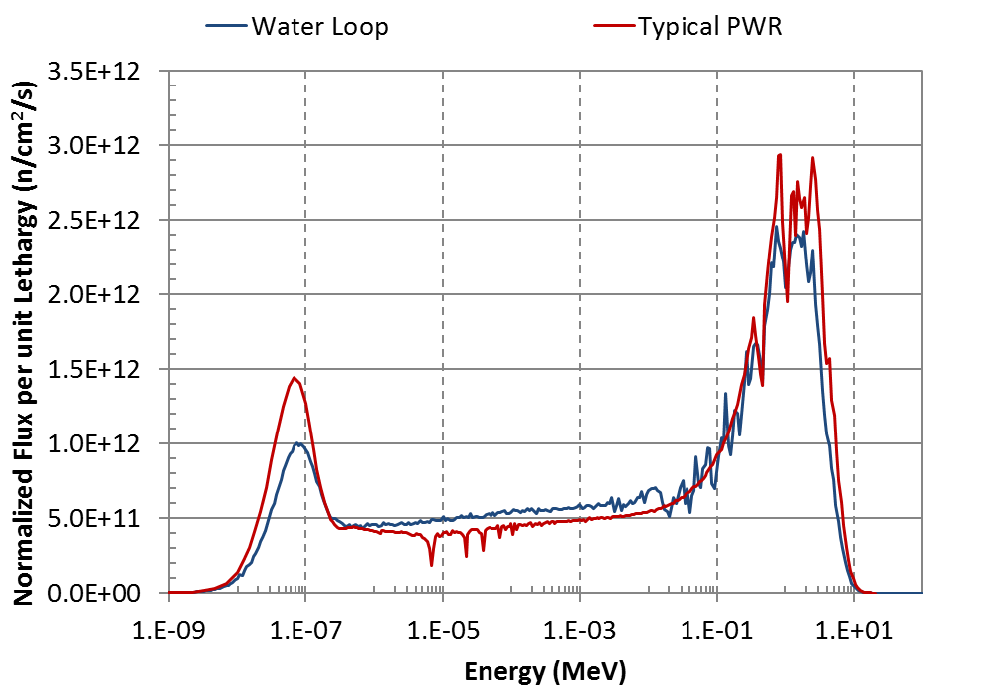
Neutron Flux and Spectrum
Facility | Size | Neutron Flux (n/cm2-s)
In-core | 3 available Max in-core volume ~ 1.8” ID x 24” long | Thermal: 3.6x10¹³ Fast: up to 1.2x10¹⁴ (E>0.1 MeV)
Beam ports | Various radial: 4” to 12” ID | Thermal: 1x10¹⁰ - 1x10¹³ (source)
Vertical irradiation position | 2 vertical (3GV) 3” ID x 24” long | Thermal: 4x10¹² - 1x10¹³
Through ports | One 4” port (4TH) One 6” port (6TH). | Avg thermal: 2.5x10¹² to 5.5x10¹²
Pneumatic Tubes | One 1” ID tube* (1PH1) | Thermal: up to 8x10¹²
 | One 2” ID tube* (2PH1) | Thermal: up to 5x10¹³
Fission Converter Beam Facility (FCB) | Beam aperture ~ 6” ID | Epithermal: ~ 5x10⁹
Thermal Beam Facility (TNB) | Beam aperture ~ 6” ID | Thermal: up to 1x10¹⁰
Fast flux is ~ 20% of ATR

Slide 6
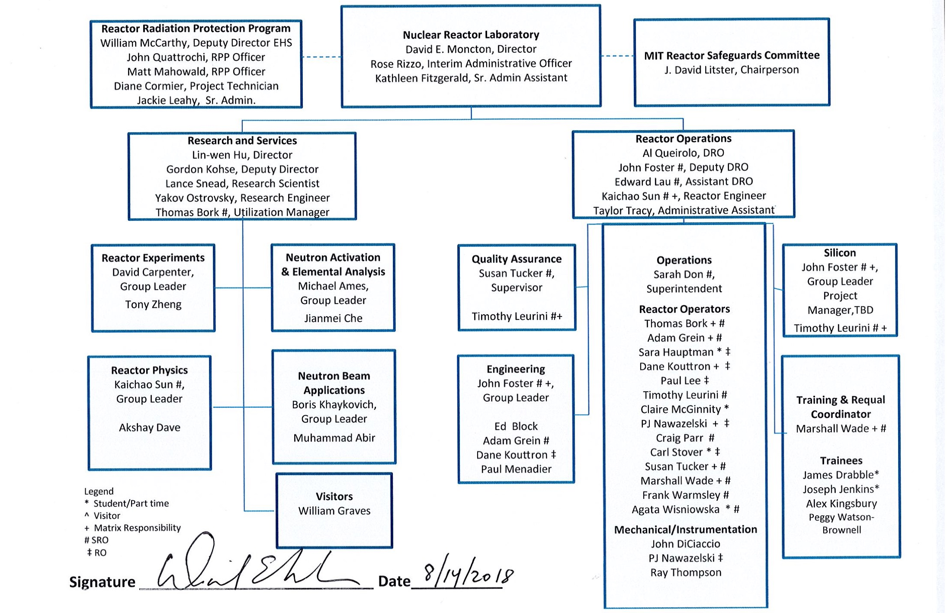
Expanding Research Group
Since 2006, NRL research and services division has grown to 13 staff (10 PhDs)

Slide 7
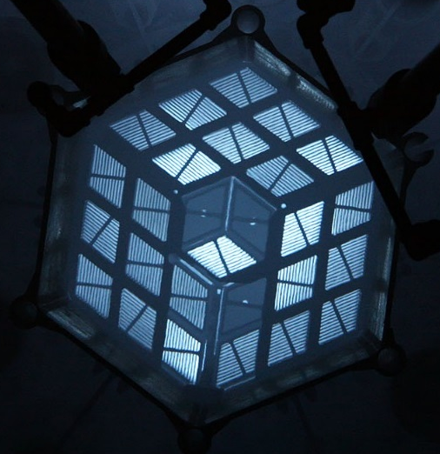
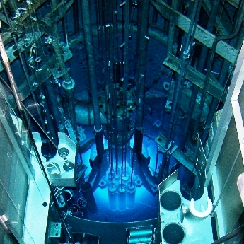
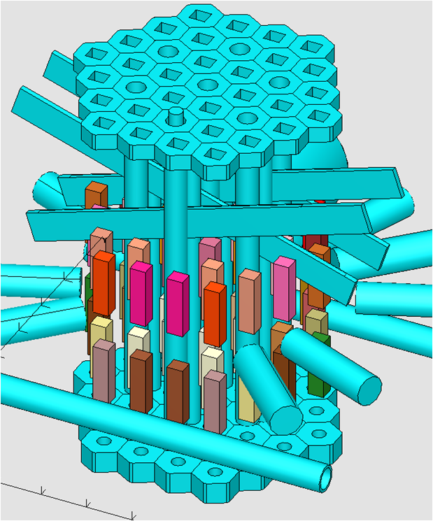
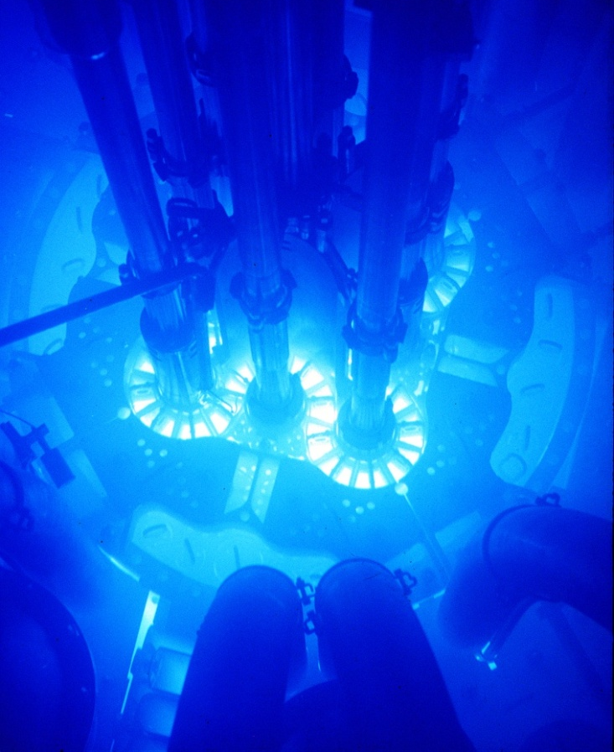
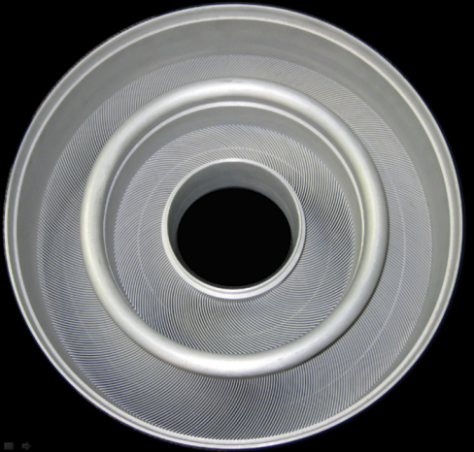

High Performance Research Reactors
MITR, 22-27 Elements
MURR, 8 Elements
NBSR, 30 Elements
ORNL/HFIR
Annular
Element Pair
(540 plates)
INL/ATR
40 Elements

Slide 8
Integrating to National Programs
MITR offers complementary capability to DOE reactors and plays an important role in national programs such as Nuclear Science User Facilities (NSUF) and new irradiation experiment demonstration.
DOE NEAC “Assessment of Missions and Requirements of a New U.S. Test Reactor”, Feb. 2017

Slide 9
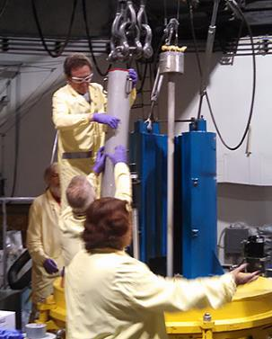
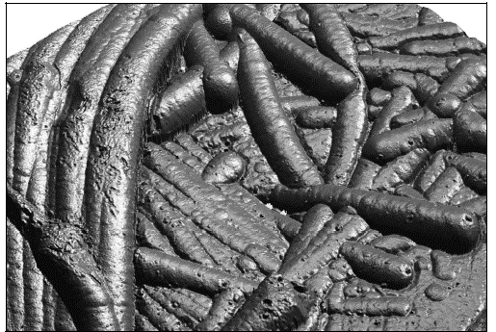
NRL Research
New sensors
  Fiber-optics
  Crack-length
  Ultrasonic
New materials
  Fuels (UZrH, metallic)
  Ceramics (SiC, carbon fiber, MAX-phase)
  Metals (zirconium, 3D-printed steels)
  Coolants (liquid flibe salt, lead bismuth)
Neutron optics
  Neutron lenses
  Radiography
Focus
neutrons

Slide 10
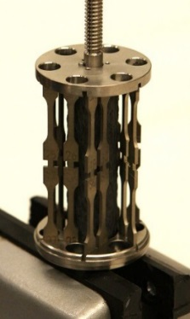
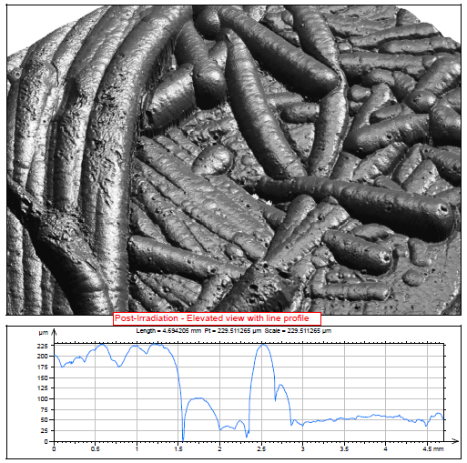
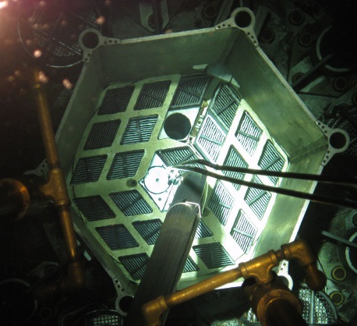
In-Core Materials Irradiation
Materials in Extreme Environments
Accident tolerant cladding
Advanced fuels
Liquid salts
Very high temperatures
3 in-core positions dedicated to experiments
General facilities for specimen capsules
  PWR/BWR conditions in water loop
  Inert gas up to 850°C
Customized facilities for high temperatures (>1300°C) and exotic materials (e.g. fluoride salts, fissile materials up to 100 gm U-235)
Common measurements: corrosion, swelling, property changes, activation, radiolysis

Slide 11
Recent In-Core Experiment Highlights

Slide 12
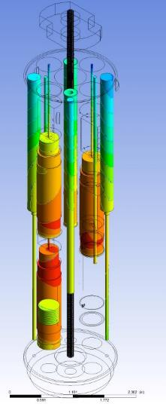
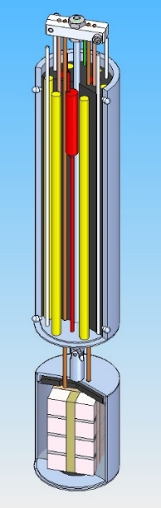
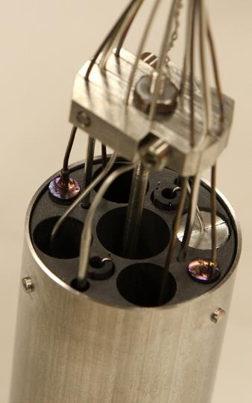
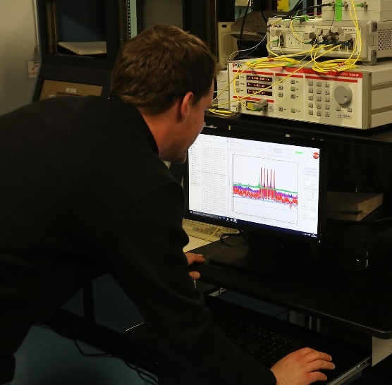
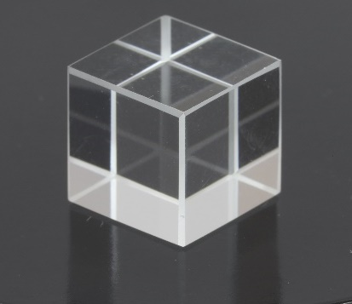
Radiation-Hardened Ultrasonic Sensors
Collaboration with INL and Pennsylvania State University,
  Six different ultrasonic transducers
  Real-time response as a function of flux, temperature, fluence
Miniaturized neutron and gamma detectors also successfully tested
Follow-up collaboration with INL, CEA, University of Pittsburgh, and AFO Research
  Includes optical glasses and radiation-hardened fiber optics

Slide 13
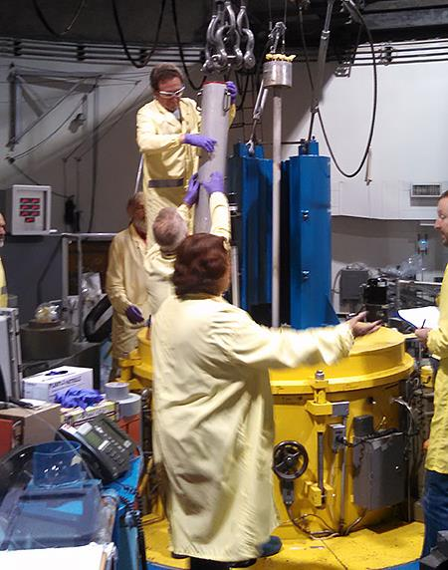
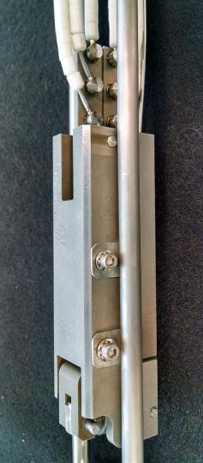
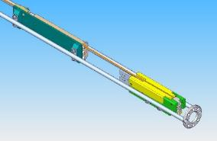
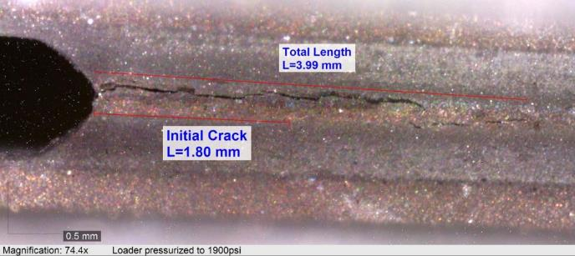
In-Core Crack Growth Monitors
Collaboration with INL to adapt an in-core crack growth measurement technique from the Halden Reactor Project (Norway).
  Crack growth is actively controlled, and the crack length measured in real-time
Successful demonstration provides a path forward to deployment in US test reactors.
  High-pressure miniature bellows development (3000 psi in-core)
  Establishing new test protocols
  Observation and mitigation of significant radiation-induced signal noise (including new saturation phenomena)
MITR operating flexibility key to achieving desired test evolution

Slide 14
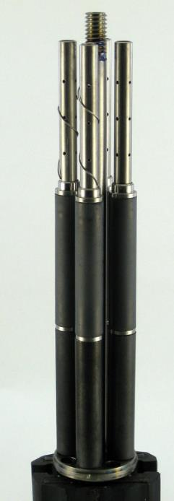
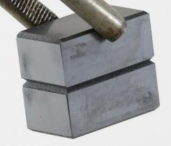
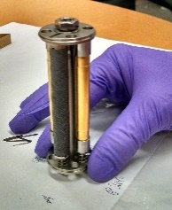
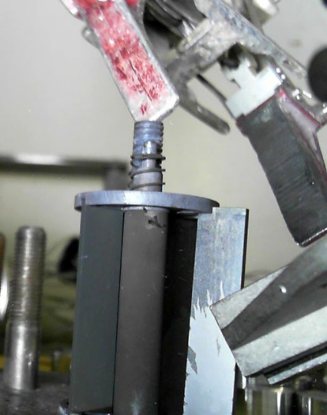
Ongoing Contributions to
Accident Tolerant Fuel Development
The MITR water loop is one of the primary irradiation test beds for SiC/SiC_{f}, hybrid (composite on metal alloy) and coated clad materials and sealing techniques
  Many of these materials have been exposed to irradiation in prototypical coolants for the first time
PWR or BWR conditions with a wide range of B/Li and dissolved gas concentrations , zinc injection, ¹⁶N suppression additives
Collaboration with Westinghouse, CTP, General Atomics, and Oak Ridge National Laboratory, as well as MIT NSED faculty and staff (Mike Short, Ju Li, Koroush Shirvan)

Slide 15

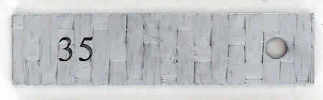
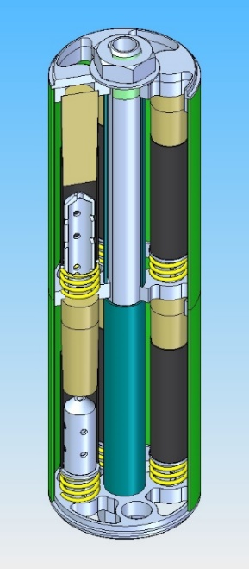
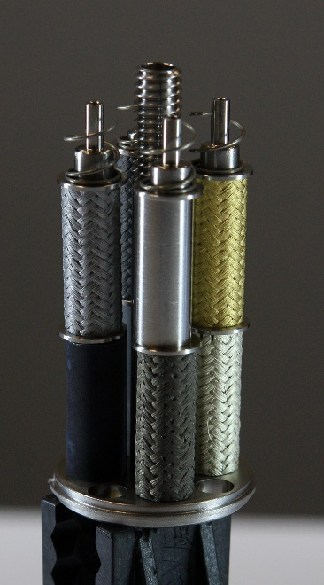
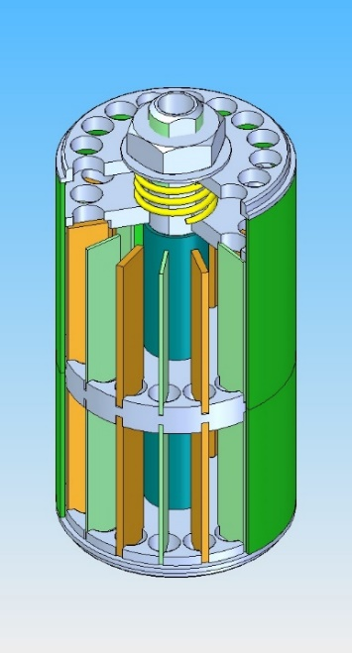
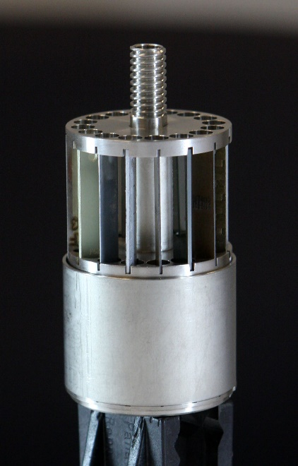
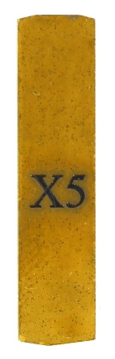
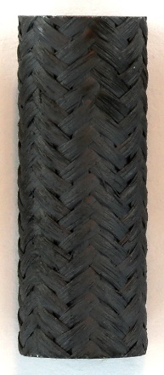
COATI
CTP and ORNL Accident Tolerant Irradiation
New silicon carbide metal-coated materials at 290°C and 1500 psi in the water loop
Follow-on to HYCO ICSA irradiation of similar materials

Slide 16
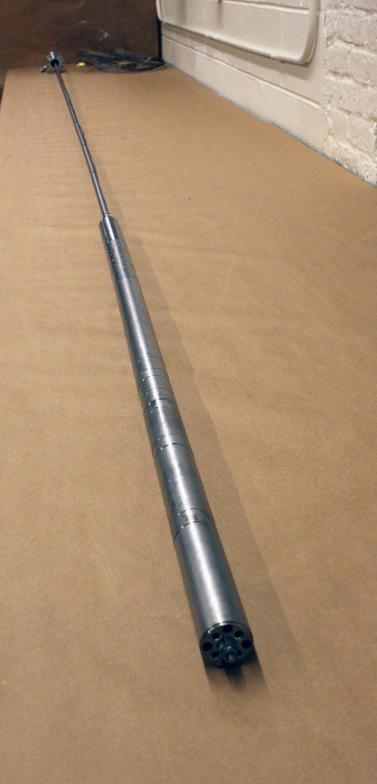
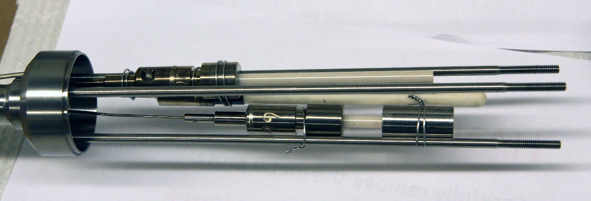
LWR In-Core Electrochemical Potential
COATI contains 3 ECP probes
  Real-time measurement of the electrical potential between a passive electrode and the structure of the loop
Probes are located near the core to capture the local corrosion environment (radiolysis)
Experimental probes able to withstand high temperature, pressure, PWR chemistry

Slide 17
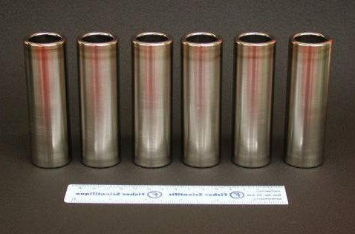
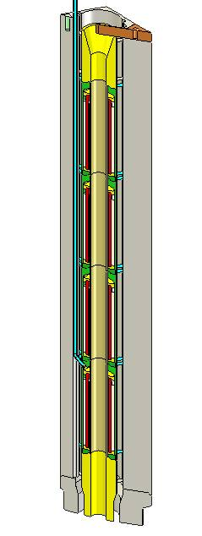
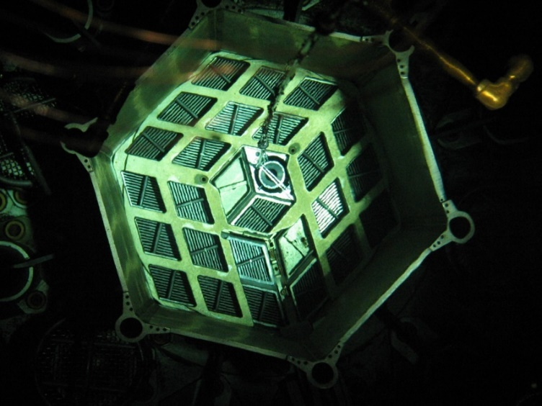
I&EC Annular Fuel Irradiation
Investigation into performance of internally- and externally-cooled (I&EC) annular fuel
5% enriched vibration-packed (VIPAC) powdered UO₂/U fuel with zircaloy clad manufactured by AECL
110 kW/m LHGR, clad temperature <400°C

Slide 18
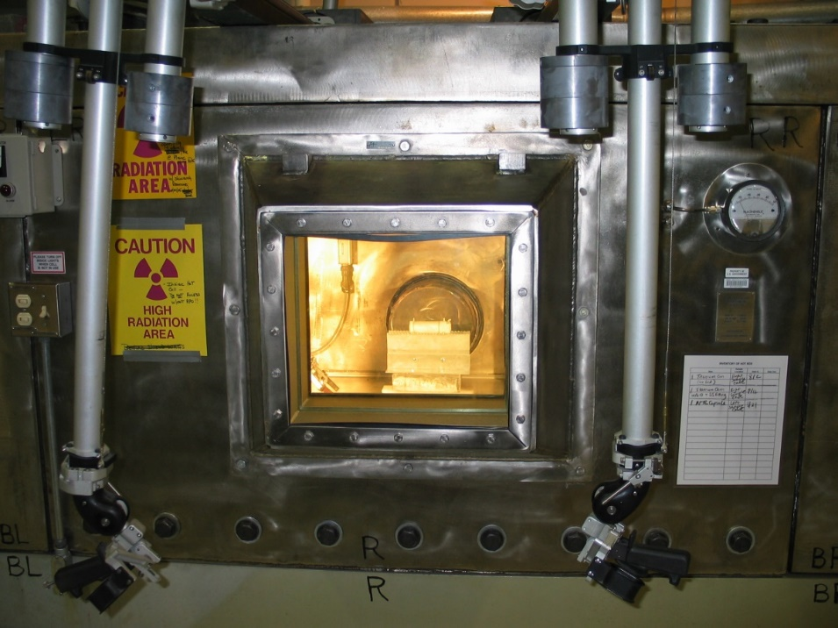
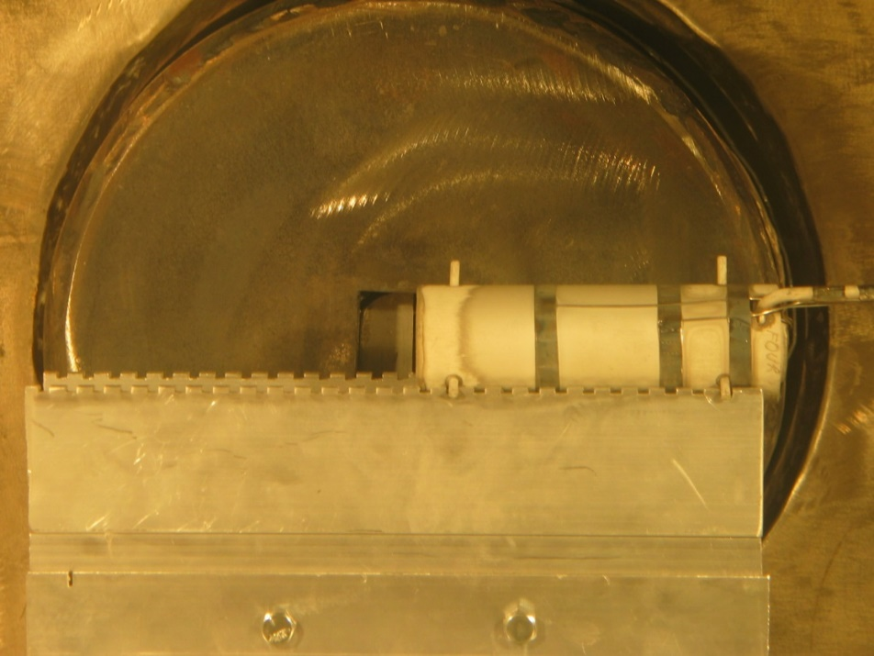
AFI Post Irradiation Examination
After irradiation and cooling, capsules transferred to reactor Hot Box
Non-destructive examination using gamma spectroscopy
  Evaluation of fuel powder migration/sintering
  Estimate burnup
  Estimate fission gas release

Slide 19
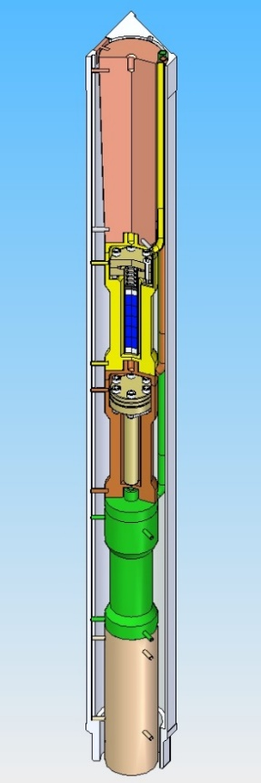



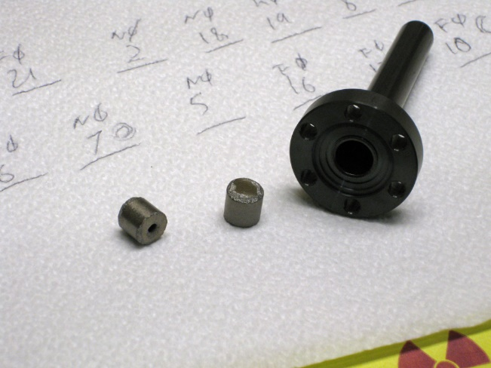
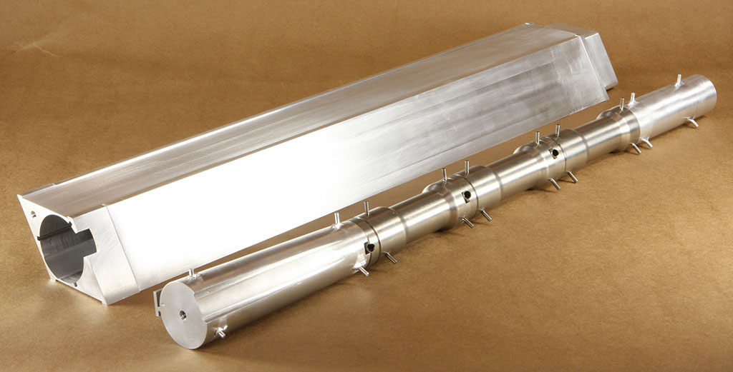
Hydride Fuel Irradiation
University of California, Berkeley project selected by the ATR-NSUF for irradiation at the MITR
Investigating the use of U-Zr-H fuel with zircaloy cladding in light-water reactors
    19.75% enriched fuel is bonded inside cladding with lead-bismuth eutectic
    Improved thermal conductivity leads to lower fuel temperature, fission gas release
    Good neutronics properties

Slide 20
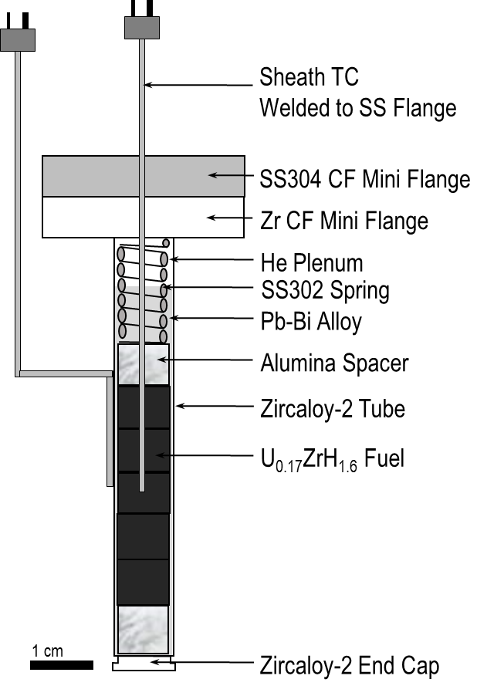


HYFI Rodlet Assembly
Fuel pellets produced at UCB (Kurt Terrani, Don Olander) from TRIGA fuel supplied by INL
Pellets loaded into pre-oxidized zircaloy rods at UCB and back-filled with LBE
Fuel centerline and cladding surface thermocouples installed at MIT
Measure fuel rod temperatures and calculate thermal conductivity in real-time

Slide 21




Fluoride Salt Irradiation and PIE
Crucial to reviving and expanding the technology base from the ORNL Molten Salt Reactor Experiment (MSRE)
Joint project with the Chinese Academy of Sciences
Activation products (e.g. tritium, ¹⁶N, ¹⁹O)
Radiolysis products and chemistry changes (fluorine, hydrogen chemistry)
Irradiation-enhanced corrosion

Slide 22


Three Flibe Irradiations Completed at NRL
FS-1
2 fluoride redox potentials
Added graphite and C/C coupons
Tritium and salt interaction with fuel compact graphite
Cracking performance of TRISO particles
300 hours at 700°C
First in-core irradiation of MSRE flibe in 60 years
1000 hours at 700°C
TRISO, Hastelloy, SS316, and SiC corrosion specimens
Flibe is 99.995% ⁷Li; still substantial tritium release
FS-2

Slide 23



Fluoride Salt Irradiation #3 (FS-3)
Large matrix of graphite and C/C specimens (95)
Applying lessons learned
  More fluoride capture options/protect instrumentation
  Electrical guard heating
  Hydrogen injection system
MSRE enriched flibe cleaned at UW-Madison, analyzed at MIT via NAA
Flibe and specimens loaded into graphite crucibles at UW
Dried in furnace at MIT, then assembled into nickel capsule under helium

Slide 24


FS-3 Irradiation Results
Experiment operated in core for 960 hours at 700°C – 100% nuclear heating
Average reactor power 5.5 MW
Collected tritium from primary and secondary encapsulations
Successfully recovered from early unrelated reactor scram and ~1 hour shutdown
>90% tritium release to cover gas
  >99% insoluble at capture
  2/3 release from capsule gas stream

Slide 25


Fluoride Salt Tritium Permeation (FS-4)
Use MITR thermal neutron beam (3GV) to continuously generate tritium in flibe salt at 600-700C
  Vertical position for improved access, flux
  Electrical heating complemented with nuclear
Investigate steady-state tritium diffusion through metals, barrier coatings
  Salt contact on inside surface
Thermal neutrons
45 cm tall
~1x10¹³ n/cm²-s

Slide 26




Fluoride Salt Tritium Permeation (FS-4)
External tube furnace allows tritium diffusion testing in the absence of neutron or gamma irradiation
Quartz barrier prevents tritium release at high temperature
Multiple test sections can be quickly installed
  Bare 316SS
  Alumina coated (with intermediate coatings) 316SS
Three days of operation at low power
  100-200kW with natural flibe produces sufficient tritium
  620°C flibe temperature
  He/H2 purge gas in four independent flow systems
Order of magnitude reduction in tritium permeation with “first-effort” alumina coating

Slide 27

TREAT – INL Transient Test Reactor
A graphite-moderated, graphite-reflected, air-cooled reactor
  Steady-state operation up to 100 kW
  Pulsed operation up to 18,000 MW
Fueled with 93.1% enriched UO₂ particles finely dispersed in graphite
TREAT core has maximum of 361 fuel assemblies (19 x 19)

Slide 28
TREAT IRP
Collaboration with Oregon State University, University of Michigan, and INL on instrumentation and benchmarking in support of the TREAT restart
Irradiations in the MITR test sensors and produce data to support code benchmarking
  TREAT steady-state equivalent <100 kW
  Positive and negative reactivity insertion transients
Follow-on irradiation with identical setup in TREAT (M8CAL test position)
Fission wire
  Natural uranium, U/Cd
Activation wires/foils
  Al-Co, Fe, Fe-Ni-Cr, Nb, Ti, Cu-Au
Self-Powered Detectors
  Gamma (platinum), Neutron (vanadium)
Miniature Fission Chambers
  Enriched uranium in metal rods
Micro-Pocket Fission Detectors
  Uranium and thorium in a metal rod
First university-led experiment completed in June 2018.
MPFD
Mini FC

Slide 29



Shipment to INL-TREAT
Irradiated Experiment Test Assembly (from MIT to INL)
Irradiated Activation Wires (from TREAT to INL Counting Lab)

Slide 30




Installations
Arranging Cables
Loading Instrumentation Assembly into TREAT M8CAL Core
Experiment Top View
Complete Shielding

Slide 31


Data Acquisitions
Inside Reactor Building
Outside Control Room

Slide 32





Activation Wires
Wires
Pulling Out Wire Capsule
Retrieving Wire Capsule
Opening up Capsule and Retrieving Wires

Slide 33


TREAT Experiment

Slide 34
FHR/MSR Development and
Integrated Experiments

Slide 35
Recent Interest in Molten Salt Reactors
MIT-UCB-UW concept: Fluoride Salt-Cooled High-Temperature Reactor (FHR)
  2 DOE-funded IRPs (3-years each) $12.5M
Simultaneous IRP led by Georgia Tech on FHR technology and licensing ($5M)
ORNL (SmAHTR)
Chinese Academy of Sciences / SINAP TMSR Program
  $400M R&D investment with aggressive schedule
  Fixed and liquid fuel designs
  Collaboration with MIT started in Oct 2015 ($2.1M)
Commercial Interests
  TerraPower
  Terrestrial Energy
  Elysium Energy
  Kairos Power
Fusion – ARC (liquid blankets)

Slide 36




10 MWth Transportable FHR (TFHR)
Prismatic assembly with TRISO fuel particles
Full 3-dimensional CFD modeling
Design Features
10 MWth with ~ 5-yr fuel cycle
Compact core ~ 2-m diameter
Tranportable by air, rail or truck
Flibe salt coolant 600-700 °C
High efficiency air Brayton cycle
18 prismatic fuel assemblies
6 control rods and 12 safety rods
Center coolant down-comer
> 10-year fuel cycle optimization in progress
200 cm

Slide 37




TFHR Demonstration
- A Novel MITR-Driven Subcritical Facility
Graphite
& Concrete Shield
Six FHR Fuel Block Design
72 cm
MITR
Core
Plenum
Gas
Window
Subcritical TFHR Core
D₂O Reflector
60 cm
D₂O Reflector
36 cm
Graphite Reflector
An MIT Reactor Driven Subcritical Facility is designed to demonstrate Transportable Fluoride-salt-cooled High-temperature Reactor (TFHR).
A subcritical system with k_{src} of 0.98 is expected to generate
1 MW thermal power ~ 60% average power density.
Licensed as an MITR experimental facility, not as a new reactor.
A cost-effective integrated experiment facility suitable for code validation, operation, maintenance, instuments, and component testing. The novel concept reduces risks for licensing a full-scale demonstration reactor.

Slide 38

Subcritical Facility Design
Not to scale
16 wt% ²³⁵U Enrichment
Fission Power Deposition
The design is two absorber rods working as a group. The subcritical system contains two groups
(4 absorber rods).
One absorber rod group could reduce the system fission power by a factor of four. Another halve is achieved by inserting the additional group.
No Rods (k_{src} = 0.98241)
Power = 1.44 MW
+ 2 Rods (k_{src} = 0.90131)
Power = 0.37 MW
+ 2 Rods (k_{src} = 0.79607)
Power = 0.20 MW

Slide 39

Pre-conceptual design of TFHR-SE
Subcritical Experiment (SE) provides a cost-effective, low risk, accelerated pathway to prototype or commercial demonstration of TFHR.
Pre-conceptual design completed, next step is engineering design ~$2M
Construction cost ~$10M-$20M if fuel and flibe salt provided by DOE, similar arrangement as the current DOE-NE university reactors program.
Potential in-kind contributions from participating organizations, such as pumps, instrumentations, specialized materials etc.
Research results obtained from SE will benefit other types of FHR developments.

Slide 40
High-Impact Research Areas
The MITR is an irreplaceable national asset. Its experimental capabilities and engineering expertise put it among the leading test reactors in the world, and it is uniquely located at a leading technical university.
MITR irradiations of accident tolerant fuel clad candidates, new fuel types, and advanced irradiation-hardened sensors for research and eventual power reactor application are critical to the development of these technologies (fission)
MITR is poised to be the first reactor to use the new U-10Mo high density LEU fuel. The HEU-to-LEU fuel conversion licensing process, start up experience, fuel performance and validation/benchmark data will directly support global nuclear non-proliferation goals. (fission; nuclear security)
MITR is the only reactor in the world that has performed flibe salt irradiation and handling since the MSRE. Proposed subcritical facility will be a major research facility that offers DOE/industry/university opportunity to further advance FHR/MSR development. Tritium generation in flibe may also support fusion blanket tritium production research (fission; fusion)
Applications of neutron optics and compact X-ray can demonstrate advanced nuclear materials characterization (fission; fusion)

Slide 41

Thank You!

Slide 42
Low Enrichment Uranium Fuel Conversion

Slide 43
LEU Fuel Conversion Objectives
Objectives are to convert to LEU (<20% U-235) fuel by maintaining core housing structure, fuel element outer geometry, neutron flux, and fuel cycle performance of the current 6 MW HEU core.
The fuel matrix, high-density monolithic U-10Mo, was selected for all U.S. High Performance Research Reactors (ATR, HFIR, NBSR, MURR, MITR).
High-density U-10Mo LEU fuel is currently scheduled to be qualified by 2025, and available for MITR to be converted in 2027.

Slide 44
High Performance Research Reactors
MITR, 22-27 Elements
MURR, 8 Elements
NBSR, 30 Elements
ORNL/HFIR
Annular
Element Pair
(540 plates)
INL/ATR
40 Elements

Slide 45
U.S. Research and Test Reactors
31 RTRs currently operating in the U.S., mostly < 1 MW reactors on university campuses.
High Performance Research Reactors have different missions:
  ATR (DOE): Dedicated fuel and materials irradiation tests
  HFIR (DOE): Isotope production, neutron scattering, some materials irradiation.
  NBSR (NRC): Neutron scattering
  MURR (NRC): Radioisotopes and pharmaceuticals commercial production, NAA research.
  MITR (NRC): Advanced materials/sensors/fuel irradiation tests; neutron science, education/training/public outreach, commercial production of silicon doping.
Three high-power reactors are federal funded facilities (DOE, Department of Commerce/NIST); MURR is the largest commercial radiopharmaceutical production facility.

Slide 46






U.S. High Performance Research Reactor
Conversion Program Pillars
Reactor Conversion
Element Design & Conversion Implementation
Fuel Qualification
Conversion
Fuel
Fabrication Capability
Develop & Deploy
Fabrication
Fuel
Development
Irradiation Testing, Qualification
& PIE
Cross-Cutting
Risk, QA, Shipping & Backend
Defense Nuclear Nonproliferation

Slide 47
MITR LEU Conversion Status
Preliminary Safety Analysis Report (PSAR)
  PSAR revision approved by LEU subcommittee
  PSAR re-submission to NRC by November 2018
LEU core conversion cycles analysis
  Full 3-D core analysis showed satisfactory neutronic performance
  Significant margin to ONB during conversion cycles
Completed engineering drawings of LEU fuel element
FY19 Tasks
  Response to PSAR RAI
  Development of LEU fuel specifications and fabrication tolerances
  Startup planning and Startup Test Plan for SAR Appendix

Slide 48
LEU Fuel and Core Design
 | HEU (UAl_{x}) | LEU – Baseline (U-10Mo) | LEU – 2014 New (U-10Mo)
Enrichment | 93.15% | 19.75% | 19.75%
Operating Power | 6 MW | 7 MW | 7 MW
Nominal Flow Rate | 2000 gpm | 2400 gpm | 2400 gpm
Plates per Element | 15 | 18 | 19
Fuel Density (gU/cm3) | 1.54 | 15.3 | 15.3
U235 per element (g) | 508 | 831 | 968
Fuel Meat Thickness | 0.76 mm | 0.51 mm | 0.64 mm (F-plate) 0.43 mm (Y-plate) 0.33 mm (T-plate)
Cladding Thickness | 0.38 mm | 0.25 mm | 0.30 mm (F-plate) 0.41 mm (Y-plate) 0.46 mm (T-plate)
Plate Thickness | 1.52 mm | 1.02 mm | 1.24 mm
Fins on Cladding | Yes | Yes | No
FYT element

Slide 49




HEU v.s. LEU Fuel Element Design
Current HEU Design
15-Plate U-Al_{x}
Finned plates
Single fuel thickness
LEU 19B25 Design
19-Plate U-10Mo
Un-finned plates
Three fuel thicknesses

Slide 50

Detailed LEU Fuel Element Design
ANL and MITR staff are working together to develop engineering drawings for LEU fuel element.

Slide 51

U-10Mo Blistering Temperature v.s. Burnup
The blister temperature correlations (burnup dependent) of the U-10Mo monolithic alloy fuel are proposed by INL.
The blister threshold temperature at the lower bound of the 95% confidence interval (-2σ) is determined to be 350 °C, assuming the maximum fission densities of the LEU fuel for the MITR are 5.0×10²¹ fission/cc (end plate).
All the peak fuel temperatures under various LOFA and RIA conditions are well below.
Fuel temperature limit reduces from
450 °C (HEU) to 350 °C (MITR-LEU)

Slide 52
NRL Research and Services Highlights
FY2018

Slide 53
Reactor Experiments Highlights (FY18)
Completed 3 in-core experiments during FY18
  WATF-PWR loop for Accident Tolerant Fuel Cladding (Sponsored by Westinghouse)
  ICSA lead-out capsule ULTRA-2 for Ultrasonic sensor and self-powered detectors (sponsored by NSUF)
  TREAT instrumentation test #2
4th Flibe salt irradiation experiment (FS-4) for tritium transport study demonstrated in graphite reflector vertical beam port (funded by DOE-NEUP)
  First-of-its-kind experiment to study tritium transport and permeation barrier
  Highly relevant to Fluoride salt-cooled High-temperature Reactor (FHR) tritium control and tritium breeding for fusion program ARC
NRL staff completed first university-led experiment at INL TREAT Facility.
Neutron diffractometer usage increases in the area of nuclear materials characterization.

Slide 54

Westinghouse Accident Tolerant Fuel Test
Ongoing irradiation test in the water loop at PWR conditions
  Includes SiC-SiC composite and coated Zircaloy™ clad material
  Post-irradiation examination includes weight, dimensions, seal integrity, tube burst testing, and microscopy
Also includes “piggy-back” testing of wireless sensor prototype, additive manufactured (3D-printed) material and crud-resistant coatings

Slide 55



Westinghouse Accident Tolerant Fuel Test
Operated August 2017-July 2018
  223 days at temperature, 1144 MWd
  PIE ongoing

Slide 56

ICSA ULTRA-2
Collaboration with INL, CEA, University of Pittsburgh, and AFO Research
  Includes optical glasses and radiation-hardened fiber optics
  Follow-up to ULTRA ultrasonic and self-powered detector irradiation
Located in ICSA with 2-capsule train
  Lower capsule 550°C with 16 optical glass cubes
  Upper capsule 650°C with 3 ultrasonic transducers and 6 sheaths for fiber probes (1-4 fibers per sheath)

Slide 57





ICSA ULTRA-2
Operated May 2017-April 2018
  201 days at temperature, 1143 MWd
  Capsules moved to Hot Box for disassembly
Ce-doping before/after:
Yb-doping before/after:
UPitt fibers wavelength shift, but maintains intensity
CEA fibers wavelength and intensity shift

Slide 58
TREAT (MITR test)
Second test of advanced neutron and gamma detectors in-core
  First test had difficulties with electrical noise, sealing, fit of dummy element, and loading of activation capsules
  Fabricated new dummy element and activation capsules
  Worked with KSU and INL to decrease noise
Testing sensors for possible incorporation in TREAT test vehicles
  Noise profile (environmental, radiation, thermal)
  Dynamic range (shutdown to saturation)
  Response (sensitivity, equilibration time, hysteresis)
Active Sensors
  Multi-Pocket Fission Detector (MPFD)
  Self-Powered Gamma Detector (SPGD) – four versions
  Self-Powered Neutron Detector (SPND)
  Miniature Ion Chamber
  Thermocouples (K, T, and N-type)
Activation Materials
  Iron wire
  Titanium wire
  Niobium foil
  Al-0.2Co wire
  Cu-2Au ingots
  Vanadium blanks
  Uranium

Slide 59


TREAT (MITR test)
Completed all planned tests in one week
  Substantial reduction in noise
  Good signals from sensors except for MPFD and mini ion chamber
Simultaneous pneumatic activation analysis to check reactor power linearity
Used to compare to TREAT tests conducted in June
Blade Drop
SCRAM

Slide 60
Reactor Experiments Outlook (FY19-FY20)
Three advanced sensors irradiation experiments and two Rapid Turnaround Experiments (RTE) awarded by DOE-NSUF are being planned for FY19-FY20. Two industry experiments are being planned (WATF-2B and TerraPower)
Demand has increased from both DOE (through NEUP/NSUF/GAIN programs, national labs) and industry (TerraPower, KairosPower, Westinghouse).
8 Letter-of-Intents submitted to use MITR through FY19 DOE-NEUP solicitations, reflecting MITR’s ease-of-access to university and industry researchers and track-record in project execution.

Slide 61
Increasing collaboration with NSED Faculty
Current projects with NSE faculty:
  Exelon project on crud-resistant cladding (Mike Short)
  Cryo-thimble for materials research (Mike Short)
  Radiation-Induced Magnetism for measuring radiation dose (Mike Short)
  Measurement of void fraction using neutron radiography (Matteo Bucci)
  Neutron Transmutation Doping of Superlattices Structure (Mingda Li)
  Accident Tolerant Fuel (Koroush Shirvan)
  Graphite pile re-started for education and research (Kord Smith and Ben Forget)
  Fluoride salt-cooled High-temperature Reactors IRP (Charles Forsberg)
  Tritium permeation barrier (Ju Li)

Slide 62
NRL Seed Program
Program offers MIT faculty and researchers cost-free access to MITR irradiation facilities, PIE and NAA services and instruments, and NRL staff support to cultivate new research area and obtain early data for pursuing external funding.
Six projects have been awarded since summer 2017
  Radiation-Induced Magnetism for measuring radiation dose (Mike Short, NSED)
  Measurement of void fraction using neutron radiography (Matteo Bucci, NSED)
  Effect of neutron irradiation in integrated photoic devices (A. Agarwal, MSED)
  Neutron Transmutation Doping of Superlattices Structure (Mingda Li, NSED)
  Neutron-based mapping of hydrogen diffusion (Cem Tasan, MSED
  Neutron computed tomography scanning of cave deposits for fluid inclusions (David McGee, EAPS)
Labor, irradiation, and instrument usage charges is estimated ~$50K each project.

Slide 63


MITR Fuel
Plate-type fuel 15 plates per element, highly enriched uranium (HEU) aluminide, longitudinal finned clad to enhance heat transfer.
Compact hexagonal core ~ 52 cm in diameter and ~ 73 cm in height
27 rhomboid-shaped fuel positions, divided into three radial rings. Three in-core positions available for advanced fuel, materials, sensors, and instrumention irradiation tests.
MITR is one of five High Performance Research Reactors in the U.S. awaiting to convert to high-density LEU fuel.
Conversion study is supported by DOE/NNSA, Office of Materials Management and Minimization (M3).

Slide 64
Other Utilization and Training Activities

Slide 65

Inside the Containment Dome
Many experiments surround the outer surface of the 5-ft thick concrete shield.
Full containment with airlocks.
Photo by Edward Lau

Slide 66
Safety Features of MITR
Operates at atmospheric pressure and primary coolant temperature up to 55 °C.
Full containment operates at slightly negative pressure with airlocks.
Small fission product inventory compared to commercial nuclear reactors.
Decay removal via natural circulation within core tank.
Low power operation <100 kW natural convection mode without top lid allows easy accessibility for reactor physics tests.

Slide 67

Inside the Control Room
Continuous monitoring of reactor power; water temperatures, flow rates, pressures; and radiation levels.
Out of range parameters can shut down the reactor automatically.
Control room manned by NRC licensed reactor operators.

Slide 68




Training Students as Reactor Operators
Identifying core components
Practicing startup-up checks
Practicing a reactor startup
Tracing the cooling systems in the equipment room

Slide 69




NTD Silicon
Neutron transmutation doping (NTD) is the process by which non-radioactive impurity isotopes are created by thermal neutron. This technique is typically used for doping silicon.
Si crystals grown and sent to MITR-II
NTD doping of Si ingots at MITR-II
Si shipped to manufacturer where it is cut into wafers and patterned
Si is used to make semi-conductors used in high current and voltage electronics
Notes:
Neutron transmutation doping (NTD) is the process by which non-radioactive impurity isotopes are created in a material by thermal neutron. This technique is typically used for doping silicon when control of spatial uniformity is important.
The figure shows Silicon being processed for making semiconductors.

Slide 70

Producing High Performance Semi-Conductor Materials
Active Zone
Neutron Transmutation Doping (NTD) transmutes Si-30 to P-31 via thermal neutrons .
NTD Silicon is needed in specialty electronic and microelectronic applications:
digital image processing, industrial control and instrumentation, hybrid cars,
high-power & high-frequency transmission, solar power panels, thyristors, etc.

Slide 71



Neutron Activation Analysis
Neutron Activation Analysis (NAA) is typically performed at the NRL by:
3. Placing the samples on High Purity Germanium (HPGe) detectors to . . .
1. Placing the samples in a polyethylene ‘rabbit’.
4. measure the gamma spectrum of the radio-isotopes produced in step 2
2. Irradiating the samples with neutrons in the MITR
5. Calculating the mass of the elements of interest originally present in the sample.
An example activation chain for the analysis of mercury:
¹⁹⁶Hg + n →¹⁹⁷Hg → ¹⁹⁷Au + γ (77.3 keV)

Slide 72

Fighting Cancer: Radioisotopes for Medical Use
Gold seeds are activated for use in treating prostrate cancer

Slide 73

Neutron Physics Experiments
Thousands of MIT undergraduates have participated in lab courses at the MIT Reactor

Slide 74




Capabilities: Irradiations
Thermal neutron beam room
Beam ports
Dry irradiation locations
Pneumatic tubes/rabbits
Automated NTD silicon system
Hot cell and hot box facilities

Slide 75


Capabilities: Labs
Neutron activation analysis - High-efficiency gamma spectroscopy and scintillation lab
Neutron radiography
Prompt gamma analysis
X-ray fluorescence spectroscopy

Slide 76


Capabilities: Labs
Optical profilometry - 1.6µm x 12nm resolution
Scanning electron microscopy with EDS
Xenon-flash thermal diffusivity analyzer
New PIE lab in restricted area.

Slide 77


Advanced Instrumentation Irradiation
Each facility provides multiple lead-outs for sensors
Real-time measurements for comparison
with modeling and quick access to data
Characterize sensors and materials
in-situ with controls during irradiation
Additional testing and observation
during post-irradiation examination
Thermal conductivity
Crack growth
Ultrasonics
Fiber optics
Recent
Instrumentation Development

Slide 78



Beam Ports
Provides a straight beam of neutrons for many different uses
  Student experiments and classes
  Medical treatment
  Imaging
  Semiconductor production

Slide 79
Recent In-Core Experiments
Pressurized Water Loop
Fuel Tests
ACI
SiC LWR cladding in PWR conditions
BSiC
SiC channel box and guide tubes
WATF
Accident-tolerant cladding and coatings
ICCGM
Actively-loaded real-time crack growth monitor
COATI
ATF SiC coated plates and tubes with ECP
HYFI
U-Zr-H LWR fuel rods with liquid metal bonding
AFTR
Internally- and Externally-Cooled Annular Fuel
Inert Gas
HTIF
Ceramics and TRISO >1400
Drexel
MAX-phase materials at 300-700°C in inert gas
LUNA
Fiber optics at 700°C
ULTRA
Ultrasonic transducer and self-powered detector test
ULTRA 2
Ultrasonic and fiber optic sensors at 800°C
HYCO
ATF SiC coated plates and tubes at 320°C
TREAT
Neutron and gamma transient benchmark
Fluoride Salt
FS-1
FHR coupons in flibe at 700°C and tritium capture
FS-2
Additional
coupons, salt, and activation sampling
FS-3
FHR and SINAP ceramics, guard heating

Slide 80







HYCO – Hybrid Composites
Collaboration with Oak Ridge National Laboratory for Accident Tolerant Fuel materials development
60 metal and ceramic specimens irradiated at 320°C in the ICSA (helium)
Undergoing PIE in NRL hot cells prior to shipment to ORNL

Slide 81

LEU Equilibrium Fuel Cycles
Fresh fuel elements will be added into B-ring and stay for 3 cycles. (Exceptions for A-2 Position)
3-cycle-old B-ring elements will be flipped and reshuffled to C-ring positions. They will stay in C-ring for 5 more cycles.
C-ring elements will be rotated once before their 4th (2nd last) C-ring cycle.
[5-6-7-
8-4-5]
[7-8-4
5-6-7]
[8-4-5
6-7-8]
[4-5-6-
7-8-4]
[2-3-1-
2-3-1]
[6-7-8-
4-5-6]
[3-1-2-
3-1-2]
[1-2-3-
1-2-3]
[6-7-8-
4-5-6]
[4-5-6-
7-8-4]
[2-3-2-
3-2-3]
[3-1-2-
3-1-2]
[8-4-5
6-7-8]
[7-8-4
5-6-7]
[1-2-3-
1-1-2]
[2-3-1-
2-3-1]
5-cycle-old C-ring elements are discharged.
[5-6-7-
8-4-5]
[3-1-1-
2-3-1]
[1-2-3-
1-2-3]
[5-6-7-
8-4-5]
[7-8-4
5-6-7]
[8-4-5
6-7-8]
Numbers in the figure indicate cycle index for fuel element at each in-core position, e.g., “1” represents loading of a fresh element. At “4”, the element will be shuffled to a C-ring position. “8” is the last cycle of each element. The different colors of the numbers intend to illustrate the path of several fuel elements
[4-5-6-
7-8-4]
[6-7-8-
4-5-6]
Notes:
Numbers in the figure indicate the “cycle index” for the fuel element at each in-core position. The “cycle index” describes how many cycles the fuel element has been used. For example, “1” corresponds to a fresh element, “2” means the second cycle in its lifetime, …, “8” is the last cycle for a fuel element. The color code indicates the path of individual fuel elements move in their 1/3 section of the core.

Slide 82


Path to Equilibrium (Part 1)
Each cycle contains a 10-week depletion period (7 MW) and a 3-week cooling time (for refueling and outage activities).
Cycle 1
Cycle 2
f: flip
r: rotate

Slide 83


Path to Equilibrium (Part 2)
Equilibrium cycles require fuel consumption of 12 Elements / Year,
assuming reactor availability of 77%.
Cycle 3
Cycle EQL

Slide 84

Shim Bank Height (SBH)
Depletion Mesh: 16 axial / 10 radial / 4 lateral Nodes per Fuel Element
Min. Shutdown Margin: 1.42% Δk/k (Blade No. 4 and Reg. Rod are Out)

Slide 85
U-235 and Pu-239 Mass
Depletion Mesh: 16 axial / 10 radial / 4 lateral Nodes per Fuel Element

Slide 86
Fission Density Limit (Conservative)
According to the analysis of transition cores, the maximum heat flux in equilibrium cycles for a calculation node (¹/₁₆ in axial and ¼ in lateral of a fuel plate) is 53.6 W/cm². This indicates a maximum node fission power of 503.5 W.
The upper bound of peak fission density is assumed to occur at a node, which generates fission power at the maximum rate of 503.5 W all through its life time. This is a highly unlikely scenario and an extremely conservative assumption.
The life time of 8 fuel cycles (560 power days) leads to 24.36 MJ fission energy release.
For an End Plate, a Middle Plate, or a Full Plate node, such a fission energy release can be converted to 4.86E+21, 3.72E+21, and 2.53E+21 fissions/cc fission density.
Even with such an extremely conservative approach, the maximum values are still well bounded by the developed U-10Mo fuel fission density limits.
Fission Density | F (Full) Plate | Y (Intermediate) Plate | T (Thin) Plate
Conservative Approach | 2.53E+21 | 3.72E+21 | 4.86E+21
Limit | 3.6E+21 | 4.4E+21 | 5.0E+21

Slide 87

Fission Density - Best Estimate Analysis
Fission density calculations for life time (8 cycles: 3 at B-ring and 5 at C-ring)
Node size is ¹/₁₆ in axial and ¼ in lateral of a fuel plate
Unit: fission/cc | F-plate | Y-plate | T-plate
ML-134 | 1.84 × 10²¹ | 2.38 × 10²¹ | 2.82 × 10²¹
ML-135 | 1.88 × 10²¹ | 2.49 × 10²¹ | 2.97 × 10²¹
ML-136 | 1.97 × 10²¹ | 2.57 × 10²¹ | 3.04 × 10²¹
ML-137 | 1.94 × 10²¹ | 2.29 × 10²¹ | 2.50 × 10²¹
ML-138 | 1.92 × 10²¹ | 2.24 × 10²¹ | 2.46 × 10²¹
ML-139 | 1.87 × 10²¹ | 2.21 × 10²¹ | 2.41 × 10²¹
Limit | 3.6 × 10²¹ | 4.4 × 10²¹ | 5.0 × 10²¹

Slide 88
STAT7 Verification using RELAP5
STAT7 is an ANL computer code for thermal hydraulics analysis of plate-type fuel reactors
  Steady-state analysis for multiple coolant channels, cladding, and fuel core to account for both axial and lateral (stripes) power distributions.
  Statistical uncertainty propagation capability allows for explicit treatment of fabrication and operational uncertainties to determine LSSS.
  Iterations can be automated over a range of operating parameters.
Coolant
Clad Outer
Fuel Centerline
STAT7 temperature results have excellent agreement to widely used REALP5 predictions

Slide 89


STAT7 Methodology
Using LSSS and hot quarter-elements identified by STAT7.
ONB probability is set as 0.135% (slight margin to one side 3σ)
Each power iteration has 25 batches with 4000 samples each.

