Slide 1
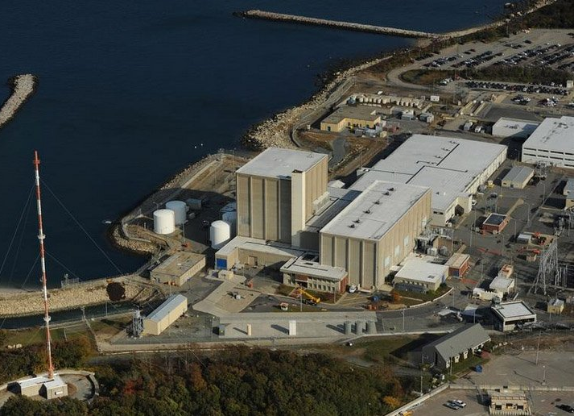
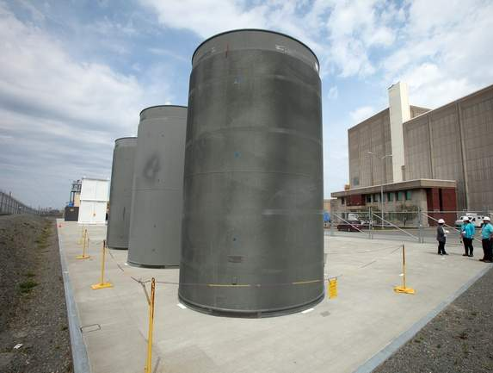
American Nuclear Society – New England March 24, 2020
Notes:
Landing Slide

Slide 2
Introduction
Patrick O’Brien
Manager, Communications and Government Affairs

Slide 3
Decommissioning

Slide 4
Pilgrim Shutdown Background
May 31 - Plant shut down for the final time after 47 years of safe, reliable operations
June 9 - Station safely removed all fuel from the reactor to the spent fuel pool
June 20 - Phase 1 staffing plan in place (270 employees)
August 22 - NRC approved license transfer to Holtec
August 26 - Sale from Entergy to Holtec finalized
August 26/27 – Site employees transitioned to CDI

Slide 5
Holtec Decommissioning Plan
Decommission the plant in approximately 8 years, as opposed to Entergy’s 60-year Safstor plan
Use the existing expertise at the site to help facilitate clean-up and restoration of the property
Allow for economic reuse of the site decades early, helping the community
Safely protect the fuel until it can be moved to our proposed interim storage facility or national final repository

Slide 6
Project Milestones
Construct new Independent Spent Fuel Storage Installation and move all fuel from the pool to the pad
Perform Site Characterization
Prepare and Plan for Demolition
Reactor Vessel Segmentation
Demolition
Waste Management
Site Restoration

Slide 7
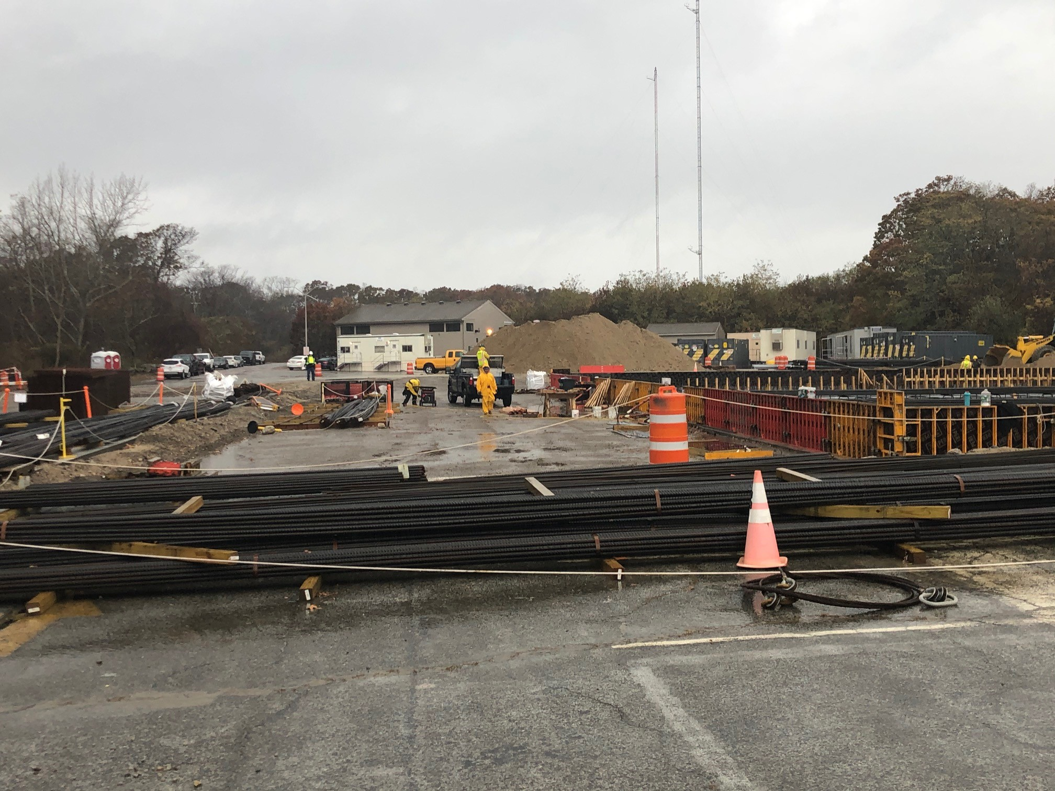
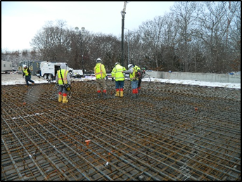
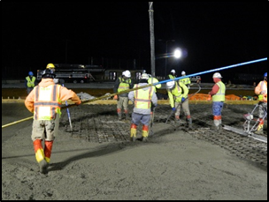
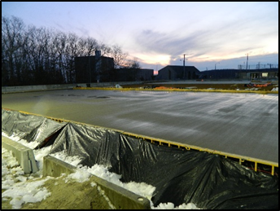
Project Work to Date –ISFSI Pad

Slide 8
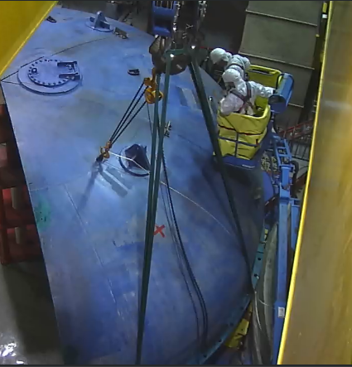
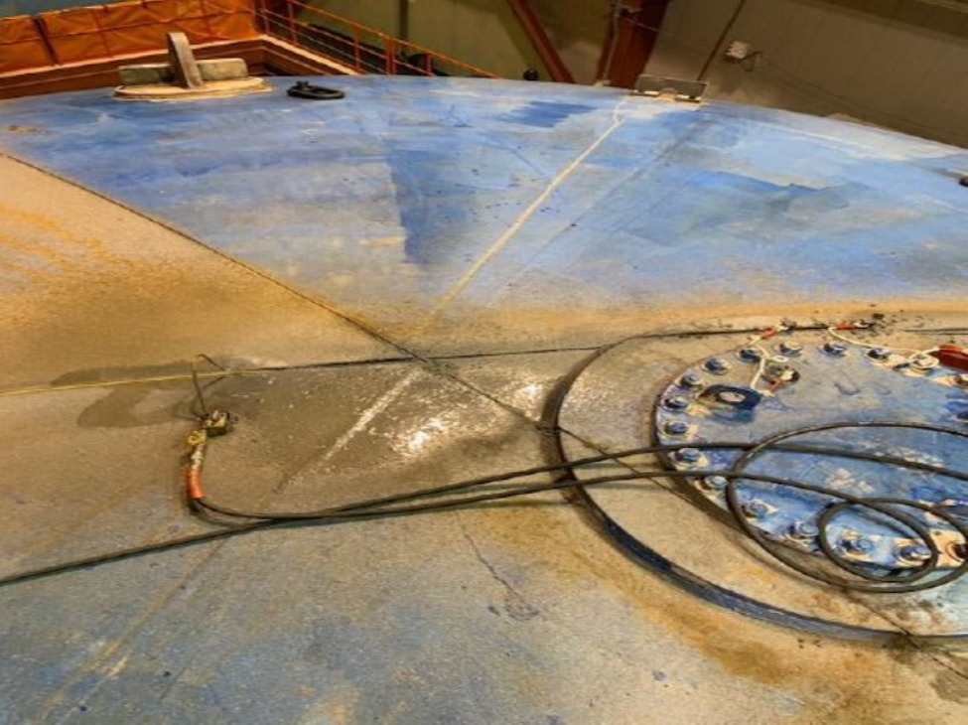
Work Progress – Refuel Floor
Containment Head – Cutting and Rigging

Slide 9
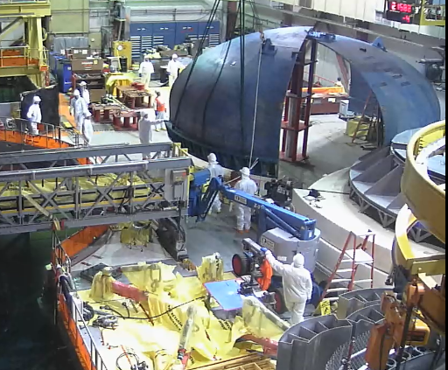
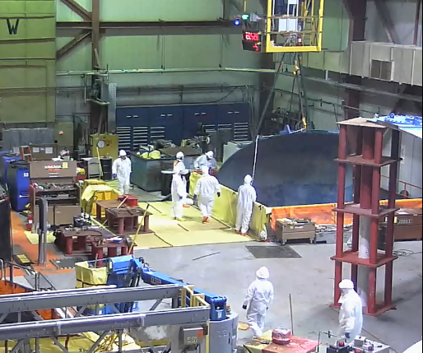
Work Progress – Refuel Floor
Containment Head –Rigging and Moving

Slide 10
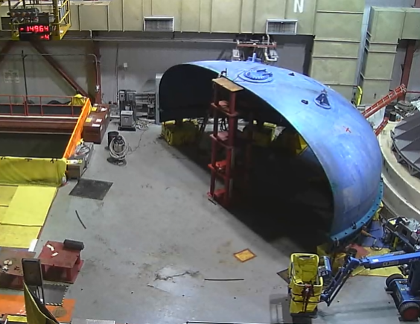
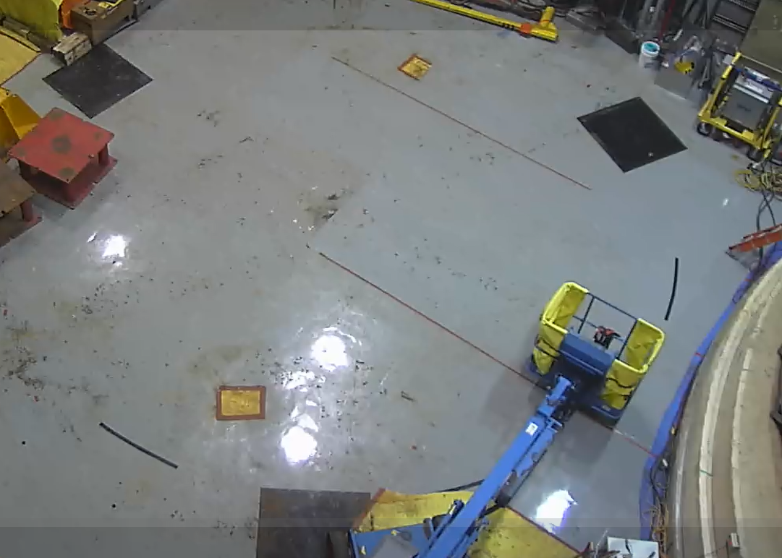
Work Progress – Refuel Floor
Containment Head movement completed 2/20

Slide 11
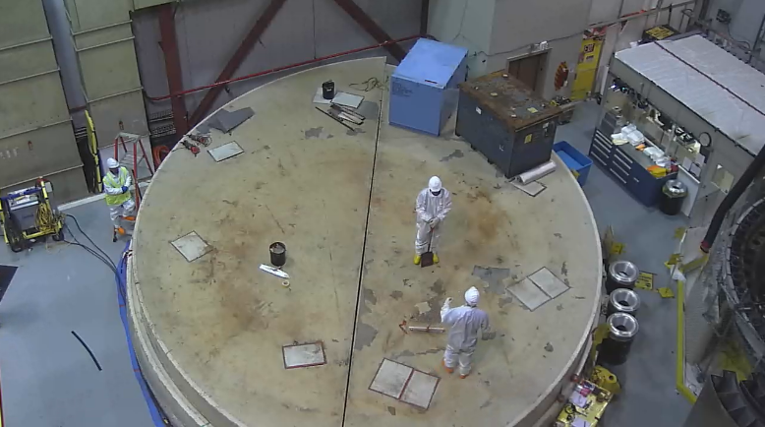
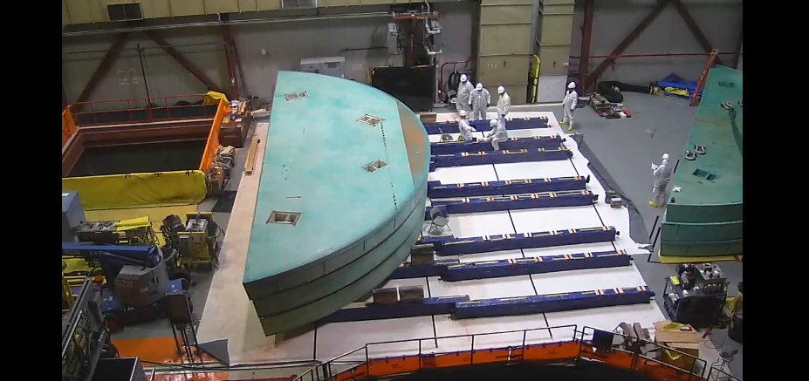
Work Progress – Refuel Floor
Reactor Shield Block Cutting & Painting

Slide 12
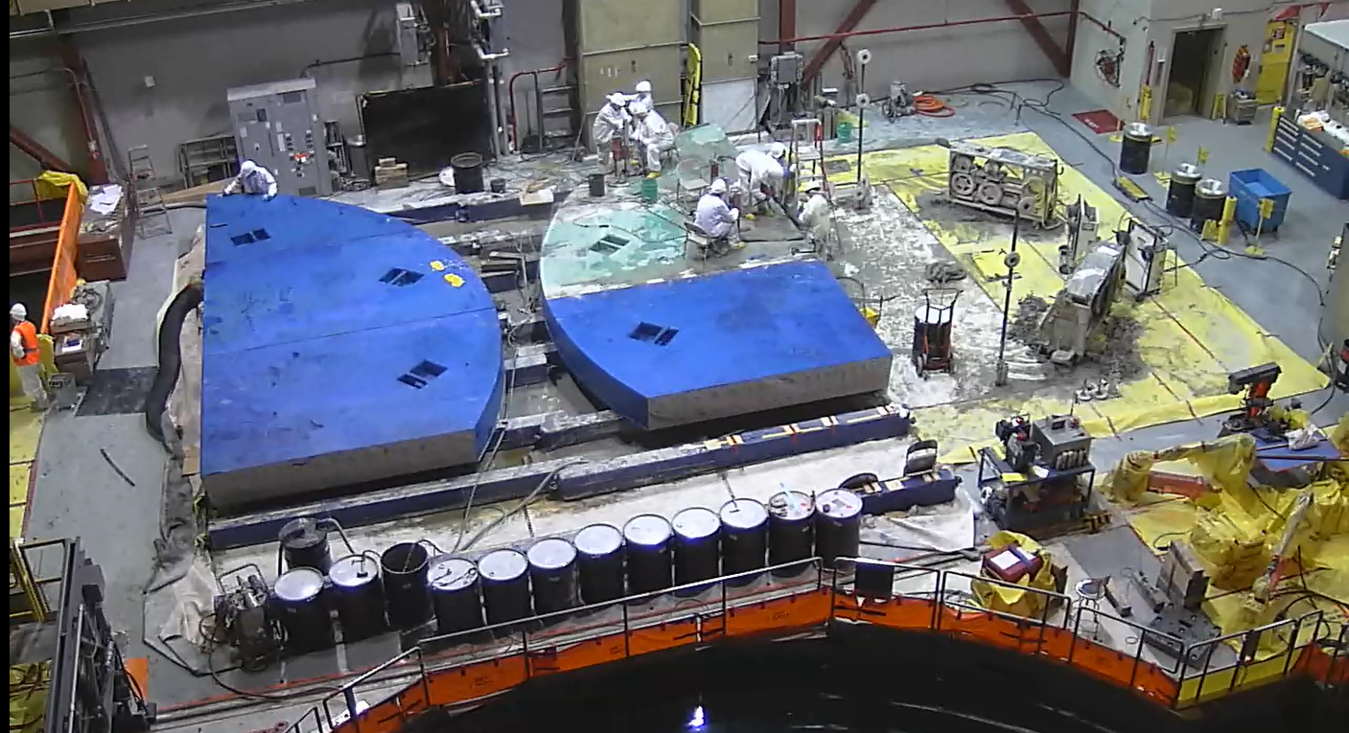
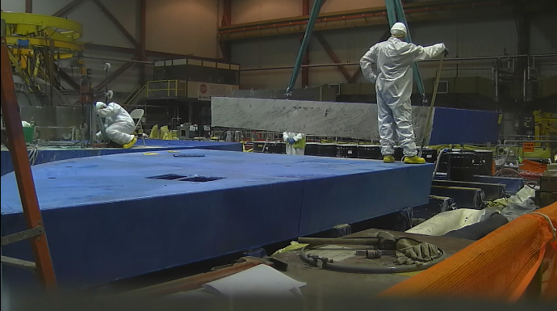
Work Progress – Refuel Floor
Reactor Shield Block Removal – Completed 3-18-20

Slide 13
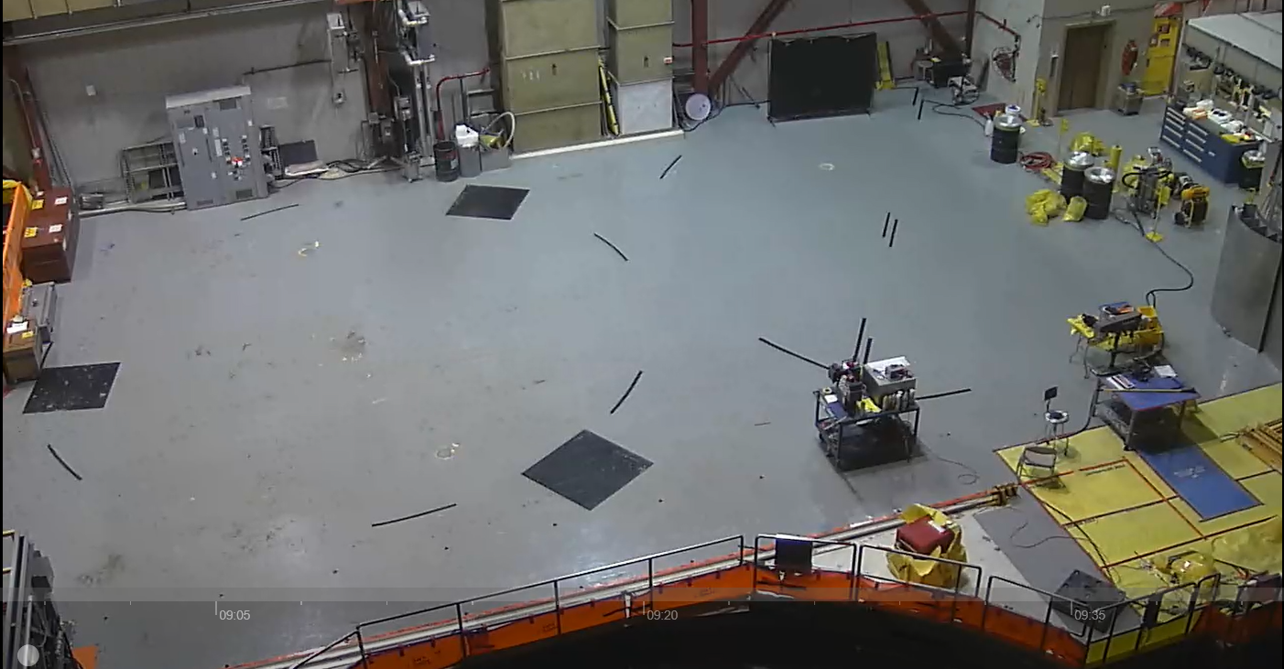
Work Progress – Refuel Floor
Refuel Clean-up and Preparation for Spring Fuel Campaign – 3-23

Slide 14
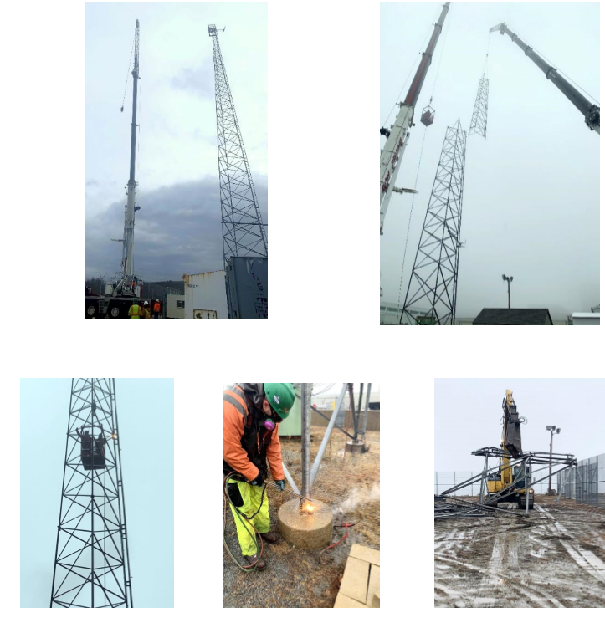
Work Progress -Exterior
160’ Meteorological Tower removed
Completed safely with thorough pre-job planning, dropped object prevention, and employee engagement
Lowered to the ground in four sections and mechanically sheared by an excavator and disposed of in roll-off container
Completed in one day

Slide 15
Local and State Interaction

Slide 16
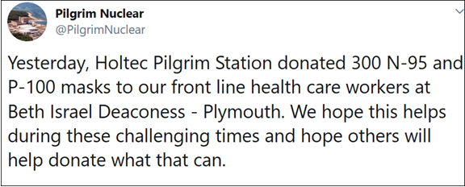
State and Local Interactions
Two team members serve on the Massachusetts Nuclear Decommissioning Citizens Advisory Panel
Regular meetings with Town of Plymouth Select Board, Town Manager and appropriate staff
Quarterly meetings with State officials including State Rep., Chair and Vice Chair of the NDCAP
Continue to work closely with MEMA and local Emergency Planning communities
Committed to working with Plymouth on final land disposition
Working on a settlement agreement with the Massachusetts Attorney General
Support state and local community needs: Mass State Police K-9, Plymouth 400/Red Cross, Beth Israel Deaconess Hospital Plymouth

Slide 17
Hindsight, Could Shutdown Have Been Avoided?

Slide 18
Questions?

Slide 19
Thank You!
Feel Free to Contact Me with Additional Questions:
Patrick O’Brien Manager, Communications and Government Affairs Office: 508-830-8280
Mobile: 508-494-4254
p.obrien@cdi-decom.com www.cdi-decom.com

