Slide 1
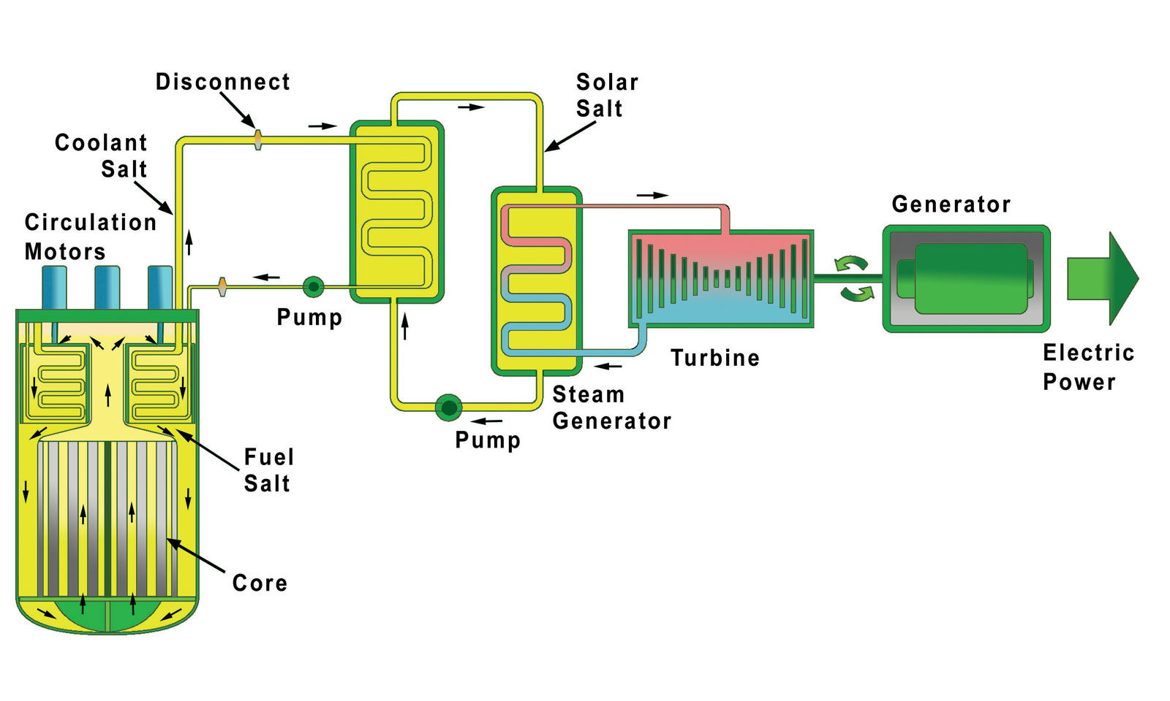
Molten Salt Reactors
Back to the future
Louisiana Nuclear Society
Rowland Linford
March 19, 2019

Slide 2
What is a molten salt reactor?
A molten salt reactor (MSR) is a type of nuclear reactor that uses liquid fuel instead of the solid fuel rods used in conventional nuclear reactors.
Why Are They Such a Hot Topic?
High temperature operation for hydrogen generation and other process heat.
Low pressure operation making radiation containment easier during transient conditions.
Generate less high level waste.
No fuel manufacturing.
Potential to “burn” fuel wastes and use alternate fuels easily.
Better stability and safety

Slide 3
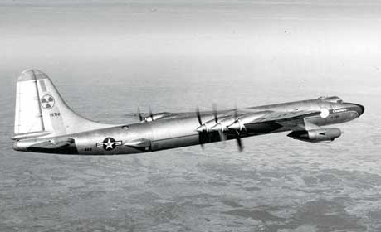
History
Aircraft Applications first major scale experiment
Aircraft Reactor Experiment late 1940’s
Extremely long range bombers in the air at all times
Very high power density and power levels needed for thrust
ARE reactor operated for 100 hours (1954)
Na-Zr-U molten fuel pumped though Be blocks
Sodium secondary fluid
Inconel piping and structural material
Achieved temperatures of 860⁰ C and 100 MWh energy
Operating reactor (89 flights) flown in a Convair B-36 aircraft (not as an engine)
Key issues were weight and crew shielding
Other reactor tests run in INEL produced successful engines
ICBM capability and development killed the aircraft nuclear programs

Slide 4
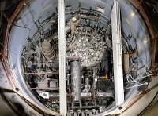
Molten Salt Reactor Experiment
Operated at Oak Ridge 1965 to December 1969
Follow-on effort from ANP to develop commercial MSR power plants
Alvin Weinberg key leader in the effort at ORNL
Design
10-MW power - thermal spectrum core (actually 8MW due to design error)
Single carrier fluid design
Mixture of enriched LiF-BeF₂-ZrF₄(“ﬂibe”)
Combined with ThF₄ and/or UF₄ fuel
Unclad pyrolytic graphite moderator Structural and piping was Hastelloy-N (nickel alloy)
Secondary coolant was molten LiF-BeF2
_{No online fuel processing}

Slide 5
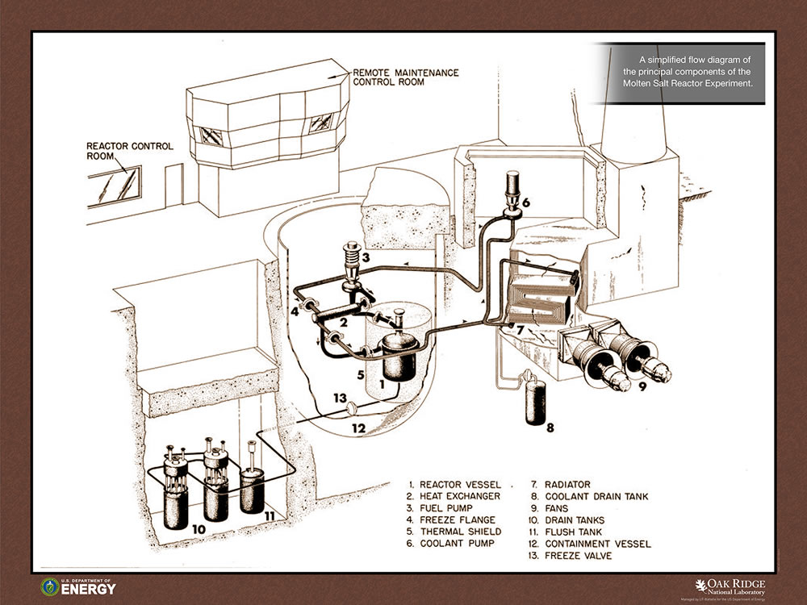
MSRE Schematic

Slide 6
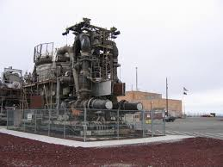
_{MSRE Operating Experience}
MSRE was a successful experiment
Operation was reliable
Radioactive liquids and gases were contained
Corrosion could be limited effectively with Hestalloy
UF salts were stable and compatible with other materials
Single-fluid system worked
Operation was acceptable with ²³³U, ²³⁵U or ²³⁹Pu
U could be removed completely by fluoridation
Did not include online reprocessing
What happened next
Modest effort until 1980
1000 MWe MS Breeder was designed
LiF-BeF₂ – ThF₄ - UF₄ fuel salt
Secondary coolant NaF-NaBF₄
Effort stopped to focus on LMFBR
ANP Engine at EBR-1 Site

Slide 7
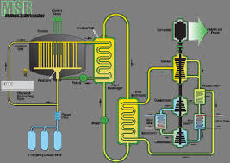
Current Day Overview
Decisions, decisions, decisions
What applications and options are important
Who is involved
What is the cost? How is it financed/developed?
What are limiting issues for full-scale application?
What is a comprehensive safety analysis?
What are the problems for site rehabilitation after end-of-life.
Non-proliferation issues.
What fuel, Th or U?
May be an issue independent of MSR
One of several concepts: Brayton cycle 40-44% efficiency

Slide 8
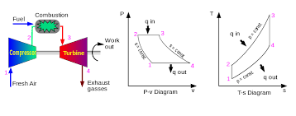
Brayton Cycle Operation
High Temperature yields better efficiency and more applications

Slide 9
MSR Advantages
Walk-away safe
The core is already melted
Negative temperature and void coefficients
Lower fissile and radioactive inventory
Low pressure operation - near atmospheric
Freeze plugs melt at high temperatures dumping the core to subcritical “tanks”
No operator action needed for fuel dumping
High temperature operation
Broadens process applications such as hydrogen generation
Raises efficiency to 40-44% range compared to LWRs at ~32-34%
Can be used to “burn” existing spent fuel (about 96% of the waste for LWRs)
Smaller amount of waste material
More efficient nuclear fuel usage
No solid fuel assembly
Online refueling
Waste not useful for future weapons applications
Fuel conversion and breeding easier with continuous reprocessing

Slide 10
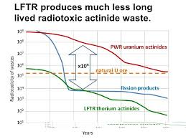
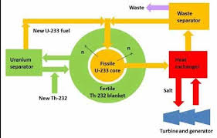
Important Features of MSRs
Radiotoxic Waste Perspective
Thorium Conversion Single Salt Concept

Slide 11
Development Issues and Design Questions
Molten salt reactor (MSR) verses high temperature reactor (FHR)
FHR
Has a solid core structure with fluorine salt coolants
Achieves higher temperatures than the MSR
Higher power densities than gas cooled high temperature designs
Requires fuel fabrication
Retains the passive safety features
What fuel design: TRISO pebbles or rodded fuel
MSR
Operates in broad range of neutron energy spectrum (burns, converts and breeds)
Minimized wastes from fission but serious irradiation of components by circulated fuel
Burns actinides in spent fuel as a recycled fuel function
No fuel assembly required
Two salt system verses single salt system for conversion or breeding advantages

Slide 12
Development Issues and Design Questions
Salt types
Lithium salts require enriched Li-7 to eliminate tritium generation
Good news natural lithium is 92.4% Li-7
Bad news – it still needs to be enriched to 99.99%
Worse news – US would need to scale up production or purchase abroad (Russia or China?)
Fluoride salts
Good heat transfer, better energy retention than water, low vapor pressure at temperature, inert to key metals
Require close monitoring to remain in a reduced state and avoid corrosion
Have small neutron cross sections
Melts at about 459⁰C and boils at about 1430⁰C
LiF-NaF-KF melts at 454⁰C and boils at 1570⁰C but absorbs more neutrons
Cl may be a good replacement for F but requires almost pure Cl³⁷
Beryllium
Toxicity is not desirable
Avoiding it would require higher temperatures
Full scale system may turn up other corrosion issues

Slide 13
Development Issues and Design Questions
Mobile fission products plating out – inventory accountability issues
Remote maintenance required due to high temperatures and high radiation
How to control tritium production elimination
Some fairly complex chemistry to remove actinides (cleanup of bred fuel for reuse)
Online fuel processing development
Thorium or Uranium Cycle development

Slide 14
World Supplies of Uranium and Thorium
Thorium | tonnes
Brazil | 632,000
Australia | 595,000
USA | 595,000
Egypt | 380,000
Turkey | 374,000
Venezuela | 300,000
Canada | 172,000
Russia | 155,000
South Africa | 148,000
China | 100,000
Norway | 87,000
Greenland | 86,000
Finland | 60,000
Sweden | 50,000
Kazakhstan | 50,000
Other countries | 1,725,000
World total | 6,355,000
Uranium | tonnes | %
Kazakhstan | 842,200 | 14%
Canada | 514,400 | 8%
Russia | 485,600 | 8%
Namibia | 442,100* | 7%
South Africa | 322,400 | 5%
China | 290,400 | 5%
Niger | 280,000* | 5%
Brazil | 276,800 | 5%
Uzbekistan | 139,200* | 2%
Ukraine | 114,100 | 2%
Mongolia | 113,500 | 2%
Botswana | 73,500* | 1%
Tanzania | 58,200* | 1%
USA | 47,200 | 1%
Jordan | 43,500 | 1%
Other | 280,600 | 4%
World total | 6,142,600

Slide 15
Breeding New Thorium Fuel
Non-proliferation issue of breeding new fuel (also an issue with Uranium-Plutonium cycle)
Thorium fuel application requires breeding or conversion since ²³³U does not exist in nature
²³³U is produced from ²³²th by a neutron absorption becoming ²³³Pa that decays to ²³³U
($n+$ ²³²th ²³³Pa+β ²³³U)
Pa removal highly desirable due to high absorption cross section
²³³Pa decays with a 27 day half-life before becoming ²³³U
Pure ²³³U is a ready-made nuclear weapons grade material
Inventory tracking of fissile isotopes is difficult due to the core circulation and plate-out of of the fuel actinides
NOT A PROBLEM FOR OPERATIONAL TRANSIENTS OR FOR BURNING OR CONVERSION WHERE THE ²³³U STAYS IN THE FUEL!

Slide 16
Who is playing and What Designs
China SINAP and US cooperation on solid fuel designs
China MSR design
Russia actinide recycler and transmuter (MOSART/MARS)
European community/Netherland SAMOFAR
US AHTR and FHR and LFTR, Thorcon, Southern Co MCFR, GE Hitachi
UK MOLTEX SSR
Canada Terrestrial Energy
Transatomic Power TAP
Japan Fuji
Denmark Seaborg SWaB
Elysium Industries US/Canadian
India MSBR

Slide 17
Chinese Program (SINOP)
Technology R&D
Includes fuel fab, online salt reprocessing, technology of pyro processing
Corrosion and material lifetime evaluation for development reactors
Reactor design development for experimental and demo systems
Develop design, safety analysis and technical standards
Develop high temperature applications and hydrogen production
Very complete R&D to develop the design, design processes and manufacturing of MSRs
About 400 staff level
Developing two test reactors TMSR-Sf1 and TMSR-LF1 for solid fuel and liquid fuels

Slide 18
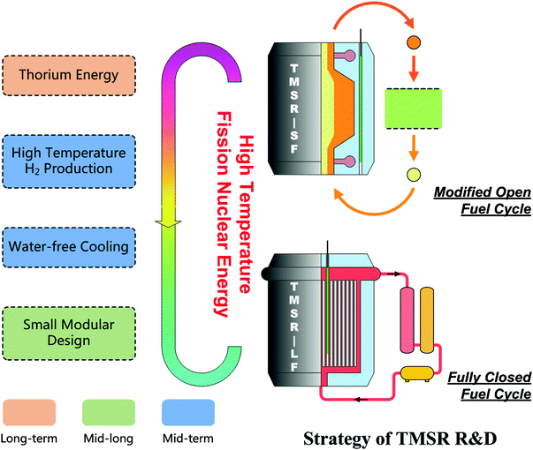
SF1 Design Parameters
Power 10MWt
Lifetime 20year
Operation time 100 EFPD for single batch of fuel
Average power density 4.0 MW/m3
Fuel element / abundant / 235U load 6cm ball / 17.0% /15.6 kg Coolant（1stloop，2ndloop）FLiBe（99.99%Li7 ，FLiNaK Structure material N alloy, graphite
Reactor coolant inlet temperature 600⁰C
Reactor coolant outlet temperature 650⁰C
Vessel temperature / pressure design 700⁰C / 0.5MPa (abs.) Vessel upper cover temperature designed <350⁰C
1st/2ndloop coolant flow rate 84 kg/s / 150kg/s
Cover gas/ pressure Ar/ 0.15MPa(abs.)

Slide 21
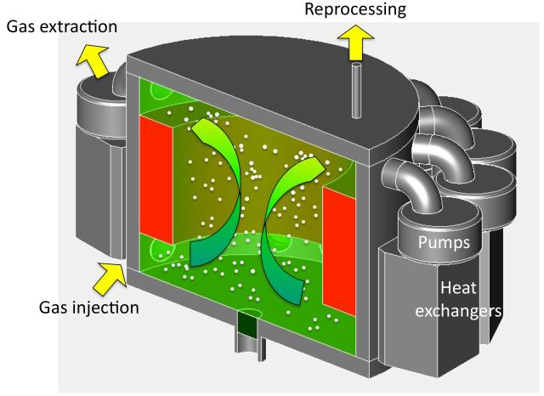
European Community Program
Safety Assessment of the Molten Salt Fast Reactor (SAMOPAR)
Prove safety concepts of Thorium in the breeding mode
Advanced experimental and numerical methods
Break though in safety and optimal waste management
Only one in which the Pa-233 can be stored in a hold-up tank to let it decay to U-233.
11 participants and is mainly undertaken by universities and research laboratories

Slide 22
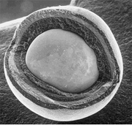
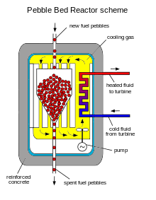
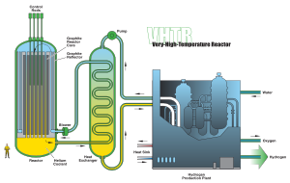
US Design and Development: FHR
FHR a high-temperature reactor that can conceptually have an outlet temperature of 1000 °C
Core design can be graphite prismatic blocks or graphite pebble form but is designed to be a burner
Operates with liquid salt coolant
Pebble form of the fuel is called TRISO
Spherical fuel pebble with several regions
Center is uranium oxide, carbide or UCO covered by layers of carbon materials
There are four layers of carbon, a dense layer of pyrolytic carbon and finally silicon carbide surrounding the uranium fuel
Advantages
High temperature
Low Pressure operation
High power density
High thermal efficiency
Passive safety systems
Better retention of fission products if an accident occurs
TRISO Fuel Pebble
FHR Reactor

Slide 23
Liquid Fluoride Thorium Reactor and FLiBe LFTR
Both designs are two-fluid MSRs
One fluid is the fuel and the other is the fertile fluid
Rapid power changes possible so they can load follow
Inexpensive to build and operate
LFTR
Breeding is done in a blanket with FLiBe and ThF as fertile material
Pa-233 captured and allowed to decay to U-233
U-233 converted to fuel and returned to the reactor
FLiBe LFTR
Uses FLiBe as the salt for both fuel and breeding
Breeding salt includes Th
Fuel salt circulates through graphite “logs”
Secondary loop coolant is BeF₂-NaF

Slide 24
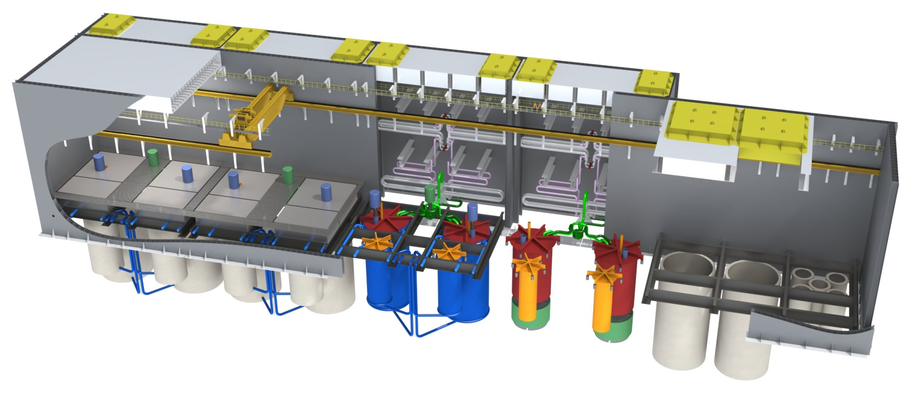
ThorCon
Underground siting
Scale up of the MSRE reactor
Block assembly in a factory and shipped to site
Four year change-out cycle of key components
Walk-away safety by draining fuel during an accident
Closed steam cycle for higher efficiency
The ThorCon Nuclear Island. This entire structure is underground

Slide 25
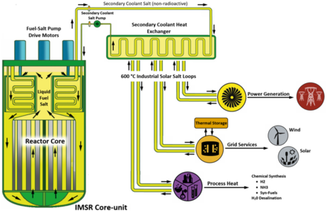
Terrestrial Energy IMSR
Graphite-moderated thermal reactor
Fuel enrichment lower than 5%
Core and moderator replaced as a unit every 7 years
U235 fuel (UF₄) in a fluoride carrier salt
Secondary fluid is ZrF₄-KF
Completed the first of three phases in the Canadian Nuclear Safety Commission's pre-licensing vendor design review
Three size units 80 MWt, 300 MWt and 800 MWt
Aim is first operation by 2030

Slide 26
First Business Casualty
Transatomic Power announced it is shutting down operations 9/25/2018
Did not believe they can catch up to the leaders
Will provide all design information as open source

Slide 27
Summary
We are at the “gold rush” stage
Early stage development
Effort is more software and concepts
Less expensive stage of evolution
Overly optimistic aura in the excitement of great new things
There will be an inevitable “shake-out” of ideas, providers and demonstrations
Now is the time for clear thinking and serious process development
Big issues looming
Regulatory process
Design process
Operations process
Thorium potential
Breeding and non-proliferation resolution
Expect development money and support will be a big factor

Slide 28
Hang on: this next generation will be very interesting

