Slide 1
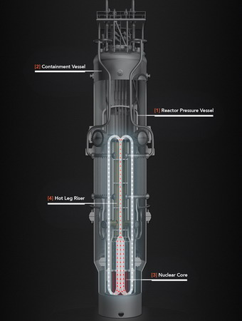
NuScale SMR
An Innovative Design by a Nuclear Newcomer
Rowland Linford
Dylan Robideaux

Slide 2
Background
Small Modular Reactor (SMR) interest
Lower manufacturing costs
Safety upgrading
Easier licensing process
Flexible generation capabilities – off grid possibilities
Less risk for operation
What is the development scene
World Nuclear Association (March 2018 update)
Some 86 designs listed
32 were LWR – mostly PWR based designs
2 PHWR
16 gas cooled - mostly helium
6 sodium cooled
9 molten core
Various other designs (traveling/standing wave, lead, bismuth cooled, etc)
International interest very high
Several non-traditional players

Slide 3
DOE Participation
Provided partial DOE funding for two systems
B&W mPower
Integral PWR design
500 MWt, 180 Mwe
Struggling with funding support to finish initial implementation
NuScale
Integral PWR design
160 MWt, 50 Mwe
Use of PWR technology simplifies both design and licensing

Slide 4
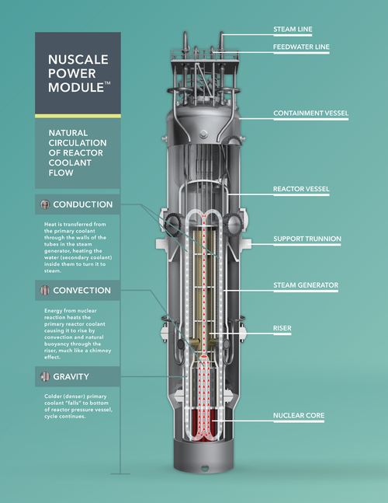
NuScale Reactor
What is the NuScale Reactor?
NSSS is Factory Manufactured
NSSS factory prefabricated
Shipped by rail, truck or barge
Natural Circulation Cooling:
Inherently safe – eliminates major accident scenarios
Improves economics – eliminates pumps, pipes and valves
Large Natural Heat Sink simplifies and enhances safety
Proven Technology
Below Ground Siting
Enhances security and safety

Slide 5
NuScale Reactor
NuScale Power ModuleTM details:
Thermal capacity – 160 MWt
Electrical capacity – 50 MWe (gross)
Capacity factor – >95 percent
Dimensions – 76' x 15' cylindrical containment vessel module containing reactor and steam generator
Weight – ~ 700 tons as shipped from fabrication shop
Transportation – Barge, truck or train
Cost – Numerous advantages due to simplicity, off-the-shelf standard items, modular design, shorter construction times, <$5,100/KW
Fuel – Standard LWR fuel in 17 x 17 configuration, each assembly 2 meters (~ 6 ft.) in length; 24-month refueling cycle with fuel enriched less than 4.95 percent
Natural Circulation

Slide 6
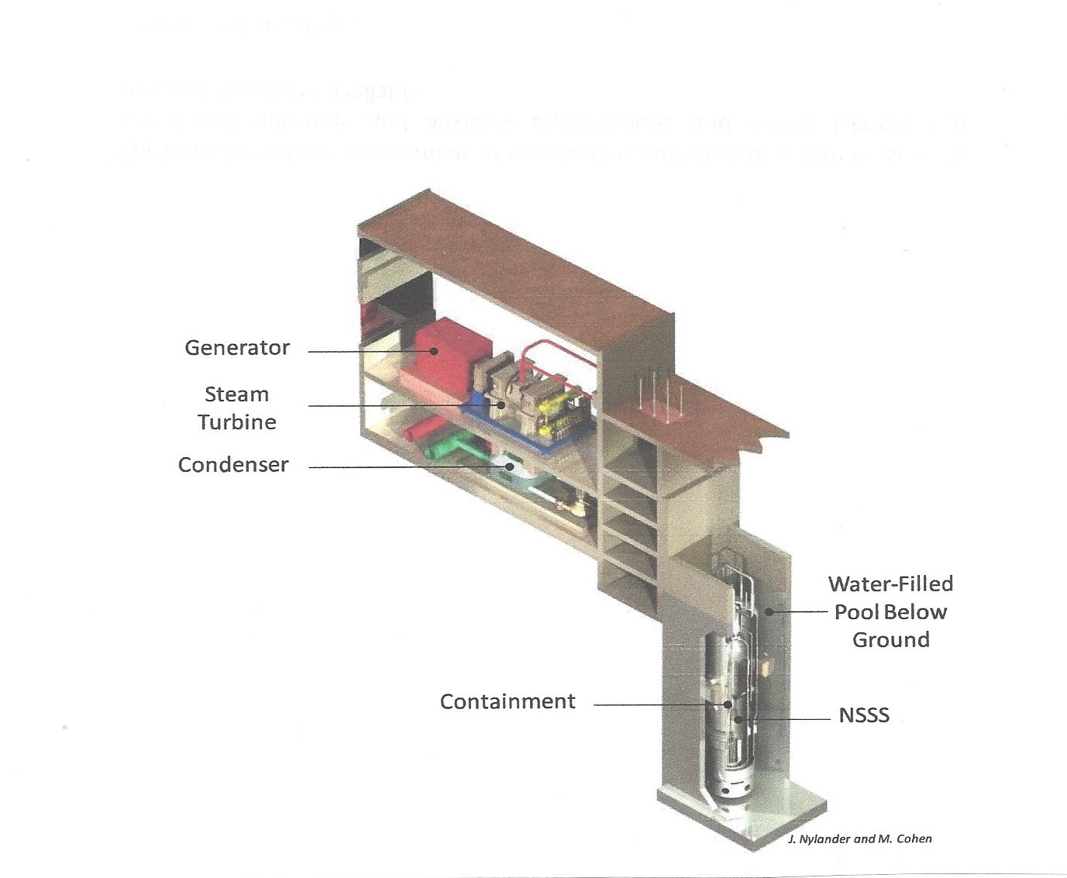
Single Power Module Reactor and TG Units Coupled

Slide 7
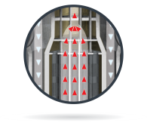
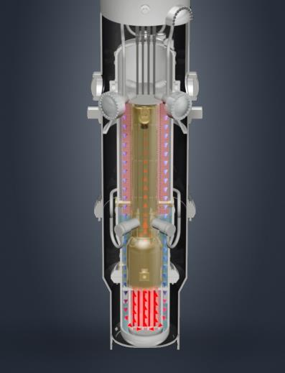
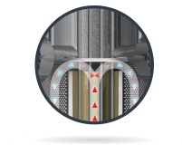
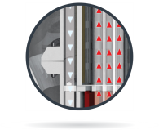
Convection – energy from the nuclear reaction heats the primary reactor coolant causing it to rise by convection and natural buoyancy through the riser, much like a chimney effect
Conduction – heat is transferred through the walls of the tubes in the steam generator, heating the water (secondary coolant) inside them to turn it to steam. Primary water cools.
Gravity-colder (denser) primary coolant “falls” to bottom of reactor vessel, cycle continues

Slide 8
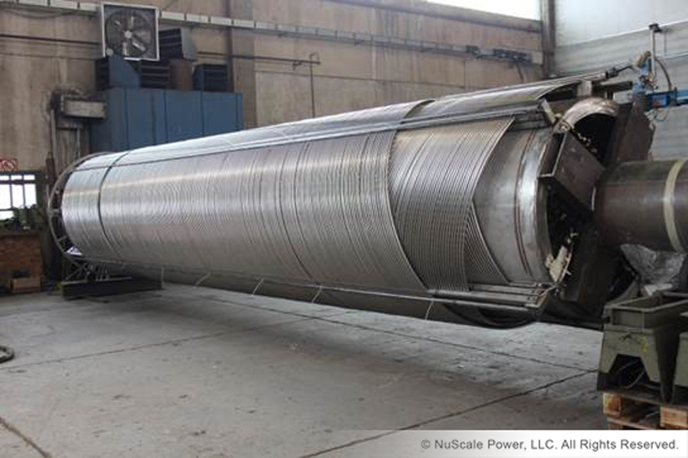
Helical Steam Generator

Slide 9
Natural Circulation Inside RPV
Steam Generator is fully integrated within the reactor pressure vessel (RPV)
Contained in annulus between the upper riser and the RPV shell
Feed flow enters the feed plenums, flows upward through the inside of the tubes and is discharged via the steam headers
Reactor coolant flows upward through the upper riser, is turned by the pressurizer baffle plate, and flows down through the helical bundle

Slide 10
Off-the-Shelf Items
Reactor Vessel and Containment Materials - Used in Commercial Nuclear Plant Operations
Magnetic Jack Control Rod Drive Mechanisms
Control Rods and Fuel Assemblies
Skid Mounted Steam Turbine
Air-cooled Generators
Condenser
Feedwater system
Emergency Core Cooling System Valves
Fuel Handling Cranes and Fuel Mast

Slide 11
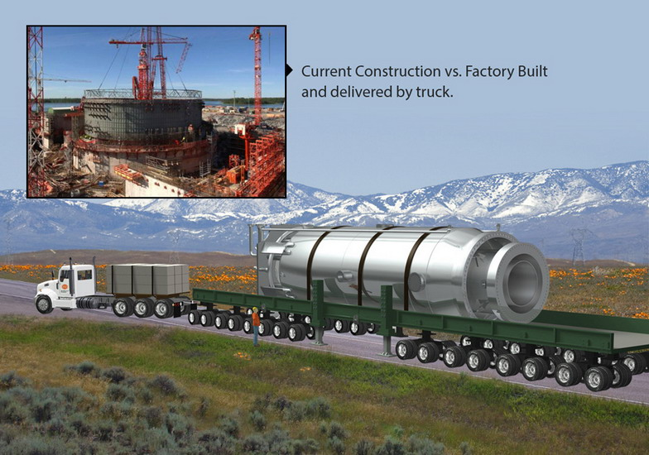
Ease for transportation from factory

Slide 12
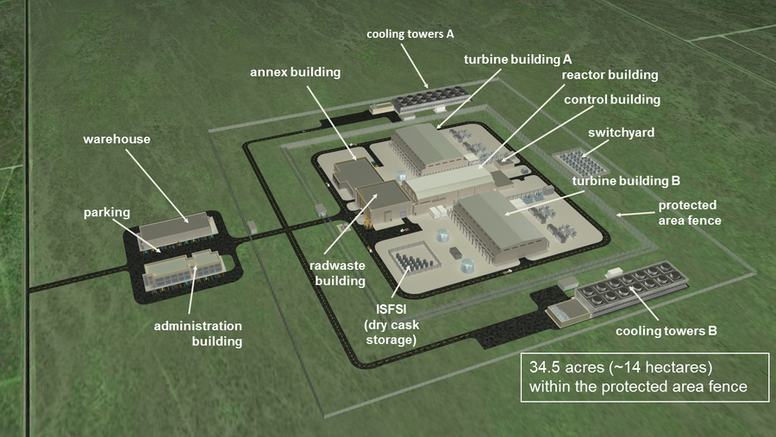

Slide 13
Overall Plant Performance

Slide 14
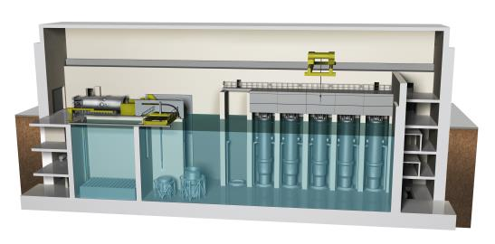
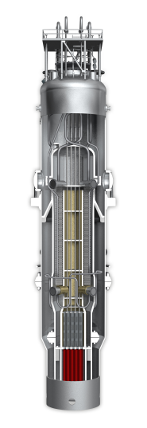
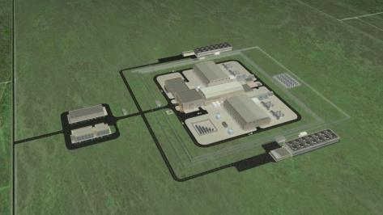

Slide 15
refueling machine
biological shield
reactor building crane
spent fuel pool
weir
reactor vessel
flange tool
containment vessel flange tool
reactor pool
NuScale Power Module
Reactor Building Side View

Slide 16
NuScale Safety Advantages
Natural Convection for Cooling
Inherently safe, gravity-driven natural circulation of water over the fuel
No pumps, no need for emergency generators
Seismically Robust
Containment is submerged in a pool of water below ground in an robust building
Reactor pool attenuates ground motion and dissipates energy
Simple and Small
Reactor is 1/20th the size of large reactors
Integrated reactor design, no large-break loss-of-coolant accidents
Defense-in-Depth
Multiple additional barriers to protect against the release of radiation to the environment
High-strength stainless steel containment 10 times pressure capability than typical PWR
Water volume to thermal power ratio is 4 times larger resulting in better cooling
Reactor core has only 5% of the fuel of a large reactor
50 MWe Reactor Module

Slide 17
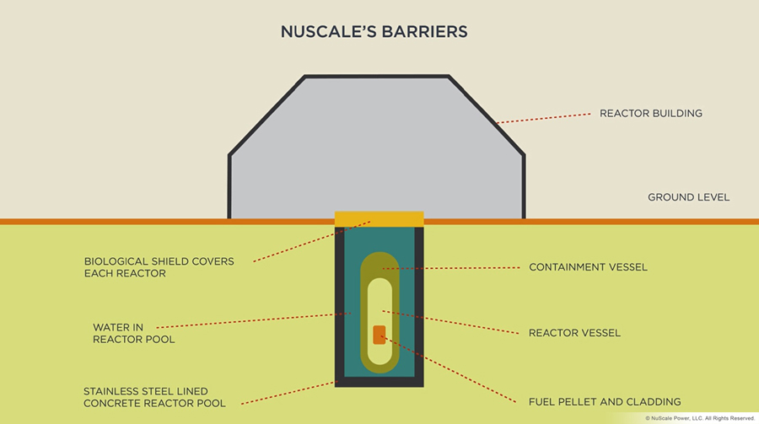
NuScale Nuclear Safety Considerations
Safety starts with underground installation of the NSSS

Slide 18
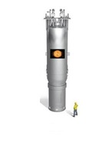
NuScale Power Module
Combined Containment Vessel and Integral Reactor System
Typical Pressurized-Water Reactor
Containment & Reactor System

Slide 19
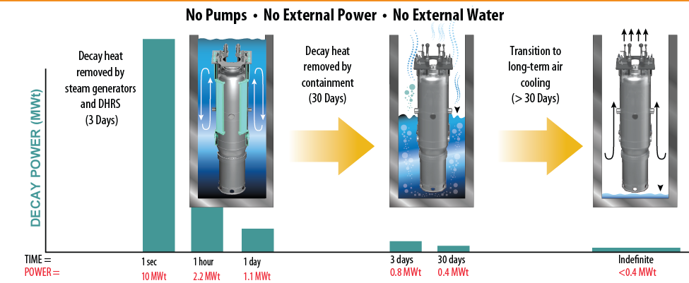
NuScale Safety Time Scale
AIR COOLING
WATER COOLING
BOILING
Triple Crown of Safety

Slide 20
Decay Heat Removal 0 to 3 Days Post Accident

Slide 21
ECCS Mode 3 to 30 Days Post-Accident

Slide 22
Core Damage Probability

Slide 24
NRC agrees NuScale SMR needs no back-up power
The US nuclear regulator is satisfied that NuScale Power's small modular reactor (SMR) design can operate safely without the need for safety-related electrical systems. The reactor uses passive safety features, such as relying on convection, not pumps, to circulate water in the primary circuit.

Slide 26
Twelve-reactor simulated control room commissioned in May 2012 for Human Factors Engineering development

Slide 27
A Brief History of NuScale SMR
From 2000 to 2003 NuScale participated in a DOE funded program for development of passive safety systems
After 2003 Oregon State University Built a one-third scale natural circulation heated version of their plant
OSU granted exclusive rights to NuScale for nuclear plant design and use of the test facility
2008 NuScale notified the NRC it would pursue Design Certification for it’s technology
2011 Fluor Corporation became the primary investor and to facilitate commercialization
2013 NuScale announced WIN, a western state collaboration to implement NuScale SMRs
Rolls Royce joined Fluor to add design and manufacturing capabilities
DOE added $217M matching funds to support the further development of the design and to secure a Design Certification from the U.S. Nuclear Regulatory Commission
2014 NuScale Power LLC and Enercon Services Inc. (ENERCON) announced a new strategic partnership

Slide 28
A Brief History of NuScale SMR
2015 Successfully installed a full-length helical coil steam generator (HCSG) at the SIET S.p.A.(Italy)
Fabrication and assembly of a full-scale, upper module mockup of the NuScale Power
Module was completed
NuScale Power and Ultra Electronics announced a new strategic partnership
Contracted for AREVA to manufacture first core and reload fuel assemblies for NuScale’s small modular reactor
2016 Completion of a study commissioned from the UK National Nuclear Laboratory
Asked NRC to approve NuScale DCA
2017 Submitted completed DCA to NRC

Slide 29
NuScale Reactor
Design Certification Application (DCA) (NuScale)
Tendered December 2016
Completed January 2017
NRC Staff now reviewing the DCA (NRC)
NuScale believes the review is somewhat ahead of schedule
Preliminary Safety Evaluation Report (SER) and requests for additional information – 4/16/18 (NRC schedule)
Final SER no open items – 9/8/20 (NRC schedule)
First COL application expected 2019 (UAMPS or other applicant)
Expected operation 2026 (NuScale schedule)
Note: Schedule disconnect between NuScale and NRC

Slide 30
Major Participants
SMR Builder- NuScale
Customer - Utah Associated Municipal Power Systems (UAMPS)
Regulatory review - NRC
Site provider and partial funding - DOE
Location - Idaho Nuclear Engineering Laboratory (INEL)
Oregon State University (Corvallis)
Expect no need to develop a prototype due to PWR type technology
Fluor Corporation – funding and fabrication
Rolls Royce - Commercialization support and UK connection

Slide 31
NuScale Innovations and Advantages
Underground NSSS Installation
Natural Circulation PWR Cooling System
Passive Safety System based on Natural Circulation
Modular Plant Concept
Factory Fabrication of NSSS
Helical Internal Steam Generator inside RPV
Based on existing PWR technologies

Slide 32
Backup Slides

