Slide 1

American Nuclear Society (ANS) Northeastern Section Meeting
January 19, 2021
Virtual
Call for Action
SNF Storage & Disposal in the US
Katrina McMurrian
Executive Director
Nuclear Waste Strategy Coalition

Slide 2
Outline
About the NWSC
The Facts – History & Highlights
The Impacts – Hosts, Electric Customers & US Taxpayers
Call for Action
Outlook & Closing Thoughts

Slide 3
About the NWSC
Section I

Slide 4
NWSC Overview
Formation & Membership (Outside the Beltway)
Member-driven and member-led
Activities:
  Develop cohesive messages on behalf of diverse and credible coalition
  Coordinate with other key stakeholder organizations
  Communicate to Congress, federal agencies, stakeholders, the media
  Inform members about relevant issues and events and provide opportunity for quick and effective input
Non-partisan; Not pro- or anti-nuclear

Slide 5
NWSC Mission & Goals
Mission:
  Ensure timely, safe, and cost-effective removal, transport, storage, and disposal of waste stranded at numerous commercial reactor sites; and
  Ensure sustainable access to NWF (electric customer pmts. + interest) for intended purpose under NWPA.
Goals:
  Release ratepayers’ money for intended purpose & protect all taxpayers from future liability
  Establish a permanent disposal facility
  Begin waste removal now
    Pilot CIS with Priority for SNF from Shutdown Reactors
    Transportation

Slide 6
The Facts – History & Highlights
Section II

Slide 7
Agreement Between Fed Gov’t and Utilities & Their Customers
Nuclear Waste Policy Act (NWPA) of 1982
  Authorized DOE to contract with utilities for DOE removal of spent nuclear fuel (SNF) starting in 1998 in return for fees
Contracts for Disposal between DOE & Utilities
  Established legal requirements & operational responsibilities of utilities (payment of fees, etc.) and DOE (accept title and dispose of SNF, etc.)
1987 NWPA Amendments
  Named Yucca Mountain (YM) as sole repository site
  If YM found unsuitable, studies to be stopped, site restored, and DOE to report to Congress in 6 mos. on course of action

Slide 8
Action by Utilities & Their Customers:
Nuclear Waste Fund Snapshot
NWF Payment Info as of Sept. 30, 2016 (Million Dollars)
 | Total NWF Contributions | 1-Time Fee Outstanding | Allocation of Interest on NWF | Total Liabilities
US Total | 21,191.0 | 3,084.1 | 22,427.8 | 46,703.0
Payments based on nuclear plant generation
Note: DOE suspended collection of 1 mill/kWh fee in May 2014 as result of Nov. 2013 USCA-DC ruling in NARUC fee suspension case.
Source of Information: DOE
Compiled by: NEI

Slide 9
Action by Fed Gov’t: Snapshot
2002: Sec. of Energy recommended Yucca Mountain (YM) for the only repository & President approved; Nevada exercised state veto in April; Veto overridden by Congress by mid-July
2008: DOE submitted license app for YM repository to NRC
2010: Administration zeroed out YM funding, closed DOE’s OCRWM, created Blue Ribbon Commission (BRC) to “recommend a new strategy”
2011: NRC discontinued technical review of YM license app
2012: BRC on America’s Nuclear Future Report to DOE issued
2013: NRC restarts review of YM license app as directed by USCA-DC writ of mandamus (as long as appropriated funds last)
2015-2016: NRC completion of Safety Evaluation Report (SER) and Supplemental EIS Statement (re groundwater impacts)

Slide 10
Action by Fed Gov’t: Snapshot (cont.)
2017-2019: Admin sought $ for DOE & NRC to restart YM app process & initiate “robust” interim storage in FY18, FY19 & FY20
2020 Admin: President & DOE changed course in FY21, requesting no $ for YM licensing, proposing $ for alternative technology R&D, and promising RFI/RFP on design of interim storage facility
2020 Congress: 116th Congress passed FY21 omnibus, including:
  $18 M for Integrated Waste Management (FY20 = $25 M);
  $62.5 M for Used Nuclear Fuel Disposal R&D (same as FY20);
  $27.5 M for Nuclear Waste Disposal to “carry out purposes” of NWPA
    outside DOE-NE (merge w/ IWM? set up new office? other?)
    $20 M for interim storage activities; and
    $7.5 M from NWF for NWF oversight (support DOE Standard Contract work? maintain facilities & security at YM site in present state?).

Slide 11
Key Questions
Has DOE removed commercial SNF from utility plant sites in accordance with its obligation under both the NWPA and contracts with utilities?
Are electric customers getting what was promised in exchange for substantial payments into the NWF?

Slide 12
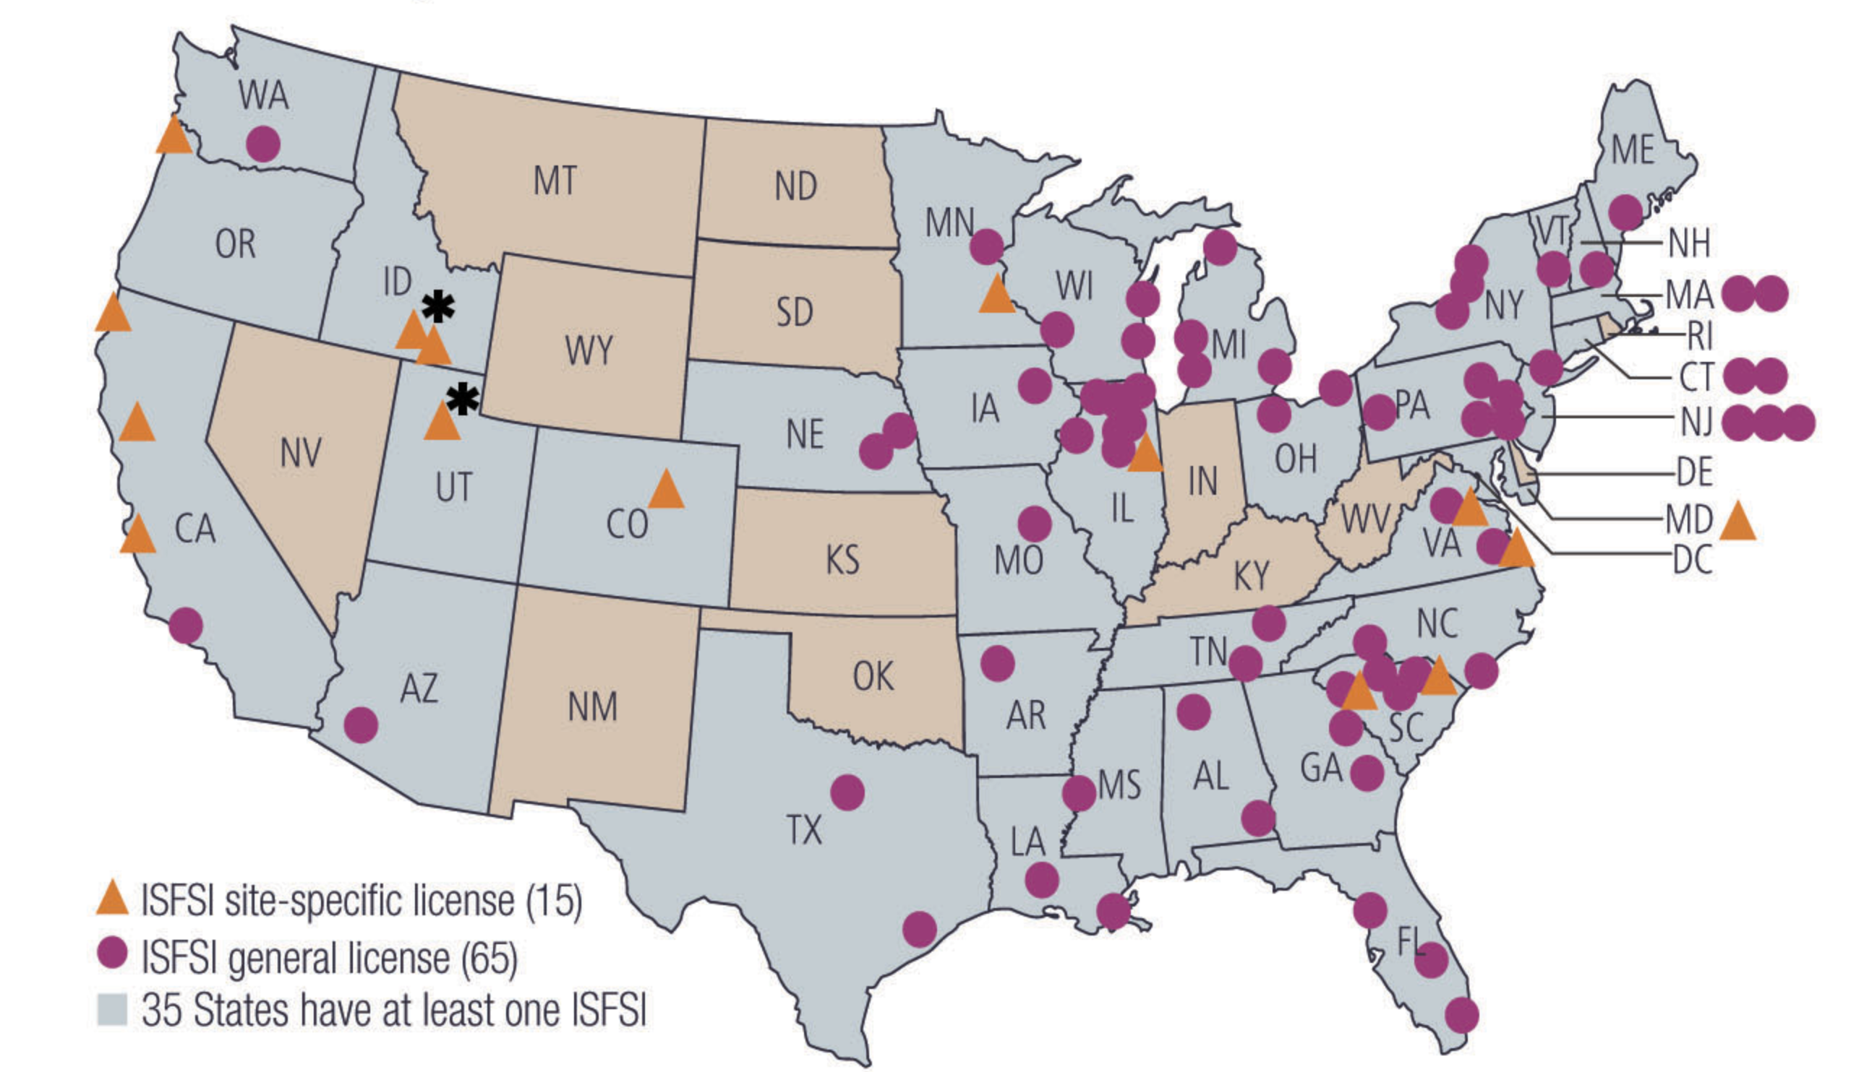
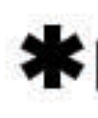
Spent Nuclear Fuel in Storage
As of August 2019
Credit: Nuclear Regulatory Commission
Facility licensed only, never built or operated.

Slide 13
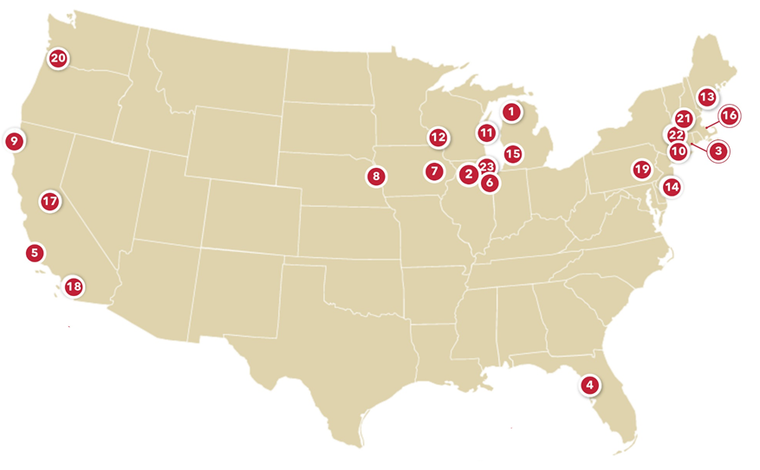
Permanently/Announced Shutdown Sites
1) Big Rock
Charlevoix, MI
2) Byron Station
Byron, IL
Announced Shutdown, 2021
3) Connecticut Yankee
Haddam Neck, CT
4) Crystal River
Crystal River, FL
5) Diablo Canyon
Avila Beach, CA
Announced Shutdown, 2025
6) Dresden Station
Morris, IL
Announced Shutdown, 2021
7) Duane Arnold
Palo, IA
8) Fort Calhoun
Blair, NE
9) Humboldt Bay
Eureka, CA
10) Indian Point
Buchanan, NY
Announced Shutdown, 2021
11) Kewaunee
Kewaunee, WI
12) La Crosse
Genoa, WI
13) Maine Yankee
Wiscasset, ME
14) Oyster Creek
Lacey Township, NJ
15) Palisades
Covert, MI
Announced Shutdown, 2022
16) Pilgrim
Plymouth, MA
17) Rancho Seco
Herald, CA
18) San Onofre
Pendleton, CA
19) Three Mile Island
Middletown, PA
20) Trojan
Ranier, OR
21) Vermont Yankee
Vernon, VT
22) Yankee Rowe
Rowe, MA
23) Zion
Zion, IL
Credit: Decommissioning Plant Coalition

Slide 14
The Impacts – Hosts, Electric Customers & US Taxpayers
Section III

Slide 15
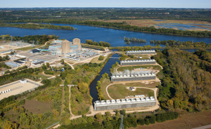
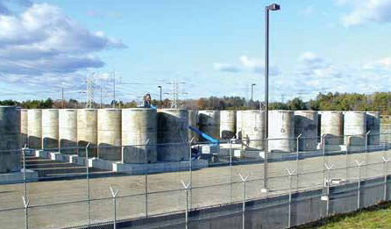
Impacts: Host Communities
Host community concerns:
  SNF won’t be removed
  Never consented to indefinite storage at sites
  Casks not licensed for indefinite storage
Shutdown site host community additional concerns:
  Storage preventing other economic uses of property
  Shrinking tax base

Slide 16

Impacts: Electric Customers
Customers in over 40 states paid $.001/kWh of nuclear-generated electricity into NWF (approx. $750 M/year) through May 2014, when collections stopped per court order.
Fee collections (≈ $21.8 B) + accumulated interest (≈ $28.5 B and growing at ≈ $1.7 B/year) + defense receipts (≈ $3.7 B) = Approx. $54 B in NWF receipts as of 9/30/20.
Spent on disposal program = Approx. $11.4 B.
NWF balance = Approx. $42.6 B as of 9/30/20.
Additional costs for utility dry cask storage, security, etc.

Slide 17

Impacts: All US Taxpayers
Damages for unmet obligation (breach of contract) paid, or to be paid in future, from US Treasury’s Judgment Fund
  $8.6 B paid as of 9/30/20
    About $0.6 B paid over past year
  $30.6 B estimated remaining future liability as of 9/30/20
    Assumes “activities on a DOE Facility” by FY 2023
    Assumes acceptance timeframes in NWPA and YM License Application
  Costing U.S. taxpayers and increasing federal deficit ≈ $2 million per day.
$$$$$$$$$$$$$$$$$$$$$$$

Slide 18
Call for Action
Section IV

Slide 19
Enlist Help from Stakeholders
Nuclear Industry & Associations – Operating & Shutdown Plants, Vendors/Suppliers
Nuclear/Clean Energy Supporters
Yucca Mtn. Supporters
CIS Supporters
State Officials & Associations – Governors, AGs, PUCs, Consumer Advocates, Legislators, State Regional Groups
Tribal Officials
Local Officials
Impacted Communities

Slide 20
Unite Around Key Messages
Identify messages that resonate (avoid more divisive issues) with stakeholders outside the beltway to develop call for action.
Seek opportunities to engage with key stakeholders (especially impacted communities, states, tribes) and enlist their support for call to action.
Reach out to Congress and the Administration on behalf of broader coalition and seek action.
Use multiple channels and opportunities for sharing key messages.

Slide 21
Call on Fed Gov’t
Administration
  President
  Office of Management & Budget (OMB)
  Department of Energy (DOE)
  Nuclear Regulatory Commission (NRC)
Congress: House & Senate
  Leadership
  Authorizers
  Appropriators
  Budget Leaders
  Congressional Budget Office (CBO)
Courts

Slide 22
6 Orgs to DOE re FY 21 (Dec. 2019)
Seek DOE Leadership to Request FY 2021 Funding for:
Completion of YM license app review per NWPA;
Implementation of pilot CIS with priority for SNF from shutdown reactors; and
Prep for necessary transportation of SNF & HLW regardless of destination (including infrastructure and assistance to states & tribes for transportation safety and related emergency preparedness activities).

Slide 23
NWSC to Congress re FY 21
Fund resumption of YM license app review per NWPA;
Authorize and fund pilot CIS with priority for SNF from shutdown reactors;
Fund SNF & HLW transportation regardless of destination, incl. infrastructure and assistance to states & tribes for transport safety and related emergency preparedness activities; and
Avoid concerning Senate EWD bill provisions that would diminish NWPA requirements; require consent-based siting; afford broad access to NWF for CIS without addressing underlying funding problems.

Slide 24
Call for Action
NWSC and fellow stakeholders should unite to call for federal government action to simultaneously:
Reestablish a national integrated NW management program (addressing timely, safe, and cost-effective removal, transport, storage & permanent disposal of waste stranded at commercial and defense sites); and
Provide sustainable access to the Nuclear Waste Fund (electric customer pmts. + accumulating interest) for intended purpose under NWPA.

Slide 25
NWSC Key Positions
Permanent Disposal – Yucca Mountain License App
Consolidated Interim Storage (CIS) – Pilot CIS with Priority for Shutdown Plants
Transportation – Infrastructure + Assistance for Preparations by States & Tribes
Funding Reform – Sustainable Access to Nuclear Waste Fund
Governance Reform – Re-establish OCRWM; Independent Organization

Slide 26
Outlook & Closing Thoughts
Section V

Slide 27
Outlook: Biden/Harris Administration
Views re Nuclear, Yucca Mountain/Disposal, CIS
Key Nominees
  Attorney General: USCA-DC Chief Judge Merrick Garland
  National Climate Advisor: NRDC President & Former EPA Administrator Gina McCarthy
  DOE Secretary: Former MI Governor Jennifer Granholm
  OMB Director: Center for American Progress Pres Neera Tanden
Budget Request & Other Policy Direction
  YM license app funding not expected
  Continuation of funded DOE initiatives (CIS, transportation)?

Slide 28
Outlook: 117th Congress
Leadership & Key Committee Changes
  House D leadership similar
  Senate leadership flip to D
  Committee partisan split narrows
Authorizations & Appropriations
  Same challenges to advancement and funding of integrated NW management solutions (particularly for CIS and disposal) in FY 2022
  New opportunities to address constructively with new leadership?

Slide 29
Closing Thoughts
Federal government has avoided responsibility and action, resulting in de facto national policy of inaction that negatively impacts host states & communities, electric customers, and all US taxpayers.
Resolution is long overdue, is in the public interest, is achievable, and helps to preserve nuclear option as tool in addressing climate change.
Congressional leadership needed to:
  Reestablish a national integrated NW management program; and
  Provide sustainable access to the NWF.

Slide 30

Closing Thoughts (cont.)
Often, crisis or consensus
needed to spur . . . ACTION.
Please join NWSC in pursuing consensus!

Slide 31

For More Info
Web: www.theNWSC.org
Twitter: @NWSCoalition
Email: katrina@theNWSC.org
Phone: 615.905.1375

