Slide 1
Miguel Alessandro Lopez
M.S./ B.S. Candidate Mechanical Engineering / Nuclear Engineering Minor
11 / 10 / 2022
American Nuclear Society NE Section
Student Panel
University of Rhode Island
Notes:
Ben Rosenberg - Control Systems & Mechatronic Engineer
Catherine Carver - Fluid & Mechatronic Engineer
Dan White - Mathematical Modeling & Experimental Engineer
Miguel Alessandro Lopez - Nuclear Mechanical Engineer
Caroline Dowling - Materials & Solid Mechanics Engineer

Slide 2
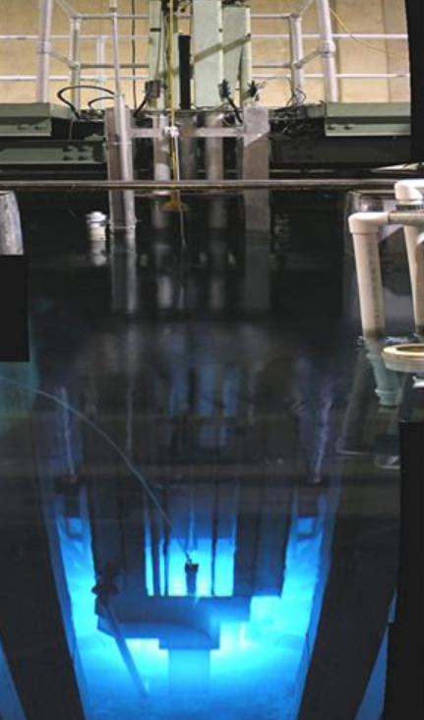
URI NUE Program
Minor in NUE
RINSC on Bay Campus 2MW Open Pool LW Reactor
Main Uses in Research, Education and Industry Services.
Some Nuclear Engineering Courses:
Nuclear Reactor Engineering
Nuclear Fuel Life Cycle and Performance
Materials in Nuclear Applications
Reactor Operations I & II
Space Nuclear Propulsion and Power
General Research Areas:
Nuclear Materials, Navy Nuclear Research, Nuclear Thermal Propulsion

Slide 3
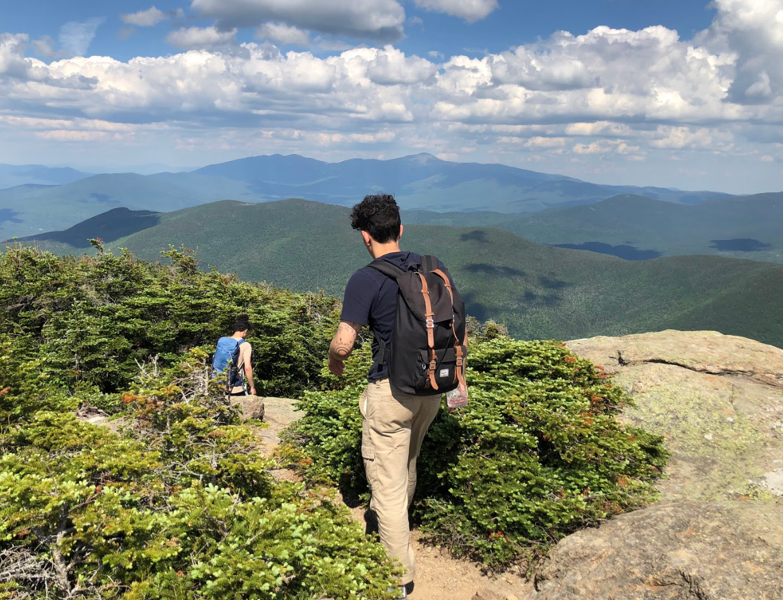
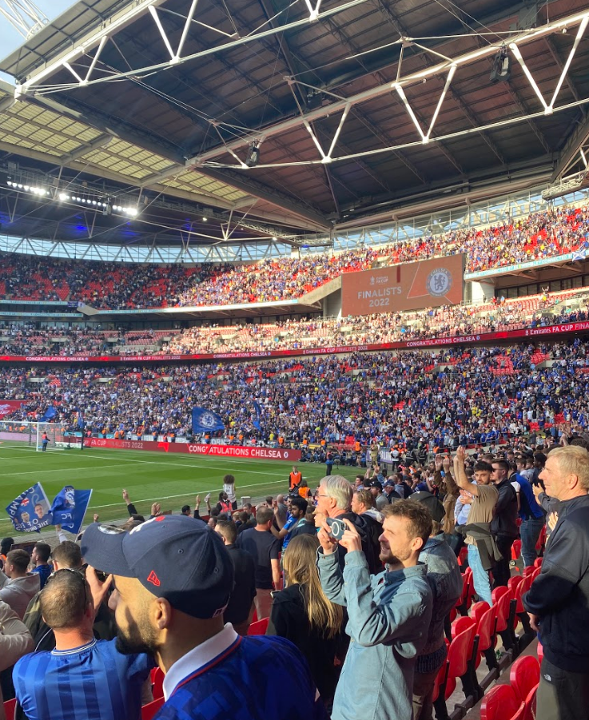
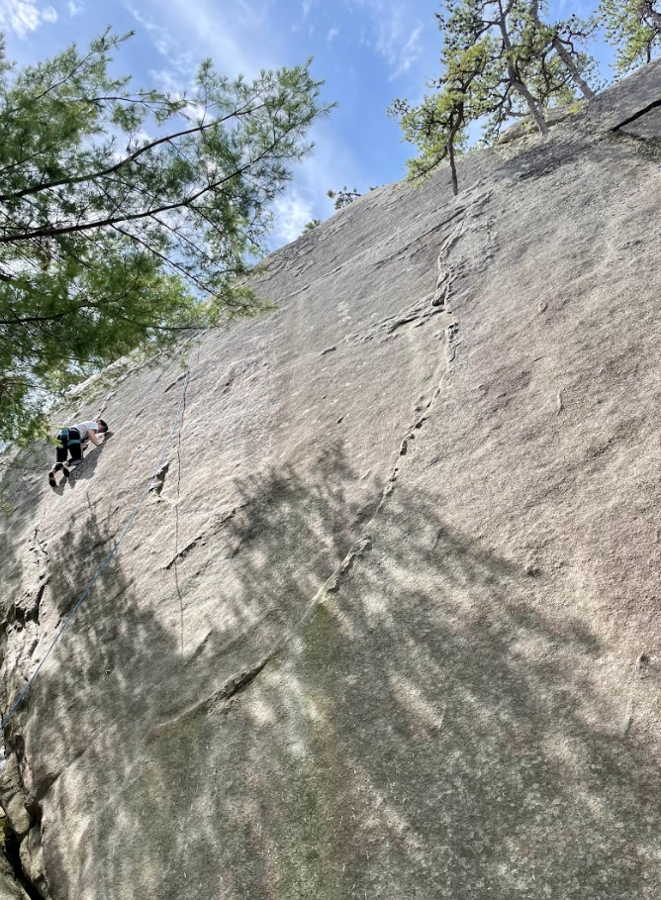
Who Am I?
University of Rhode Island : M.S./ B.S. Candidate Mechanical Engineering / Nuclear Engineering Minor
Out of School Interests: Cooking, Hiking, Rock Climbing, Learning Languages, European Football

Slide 4
Who Am I?
Engineering Experience: Research Fellow at RINSC
Operated Nuclear Reactor, under SRO
Interned at GDEB as a Fluids Systems Engineer
Interned at RIDOT as Field / Materials Engineer
Areas of Interest: Power Reactor Designs, Nuclear Thermal Propulsion and Space Power Systems
Areas of Research: High Performance Nuclear Thermal Propulsion
Design Projects: CNTR Design and Proof of Concept for Liquid Metal Rotating Fuel Tubes & HP-NTP Propellant and Nozzle Optimization, Project Sponsor NASA

Slide 5
How Did I Get Here?
Started off as Civil Engineering with the Nuclear Minor.
Landed my First Internship and instilled drive for me in the Nuclear Field.
Switched to Mechanical Engineering for versatility.
Attended a lot of random seminars that interested me.
Reaching out to NASA Engineers.
Brought NASA projects to my University.
Continually kept searching for information and knowledge.
TL;DR : Simple Emails and Attendance go a long way.

Slide 6
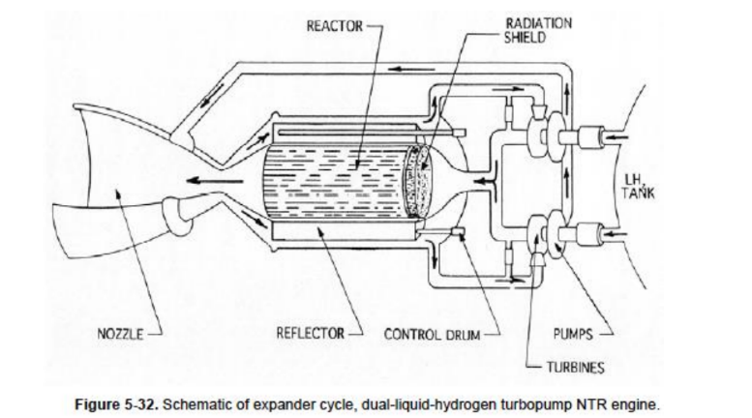
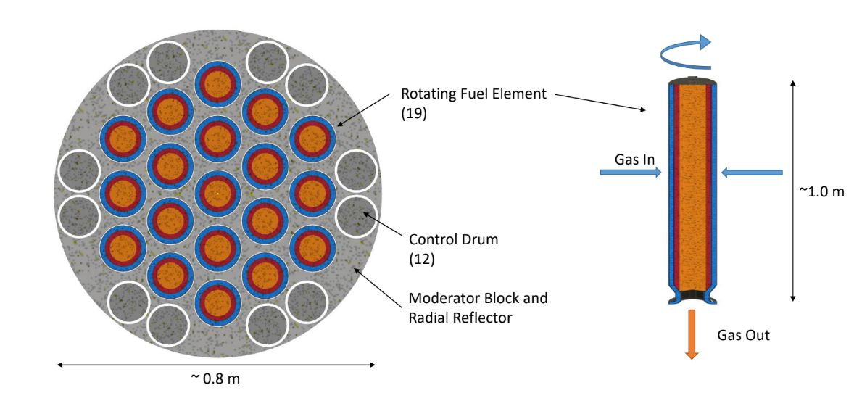
High Performance Nuclear Thermal Propulsion
Performance Goals for HP-NTP
• Specific impulse 1300-1800 seconds.
Enable < 15 month “round trip” human Mars missions with > 60 days in Mars vicinity
• Flexibility in choice of propellant.

Slide 7
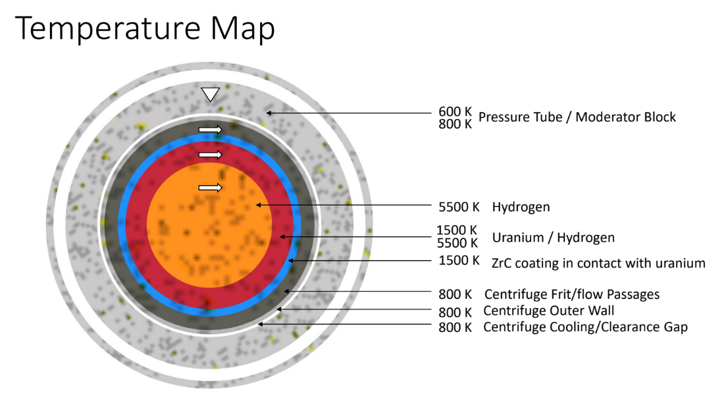
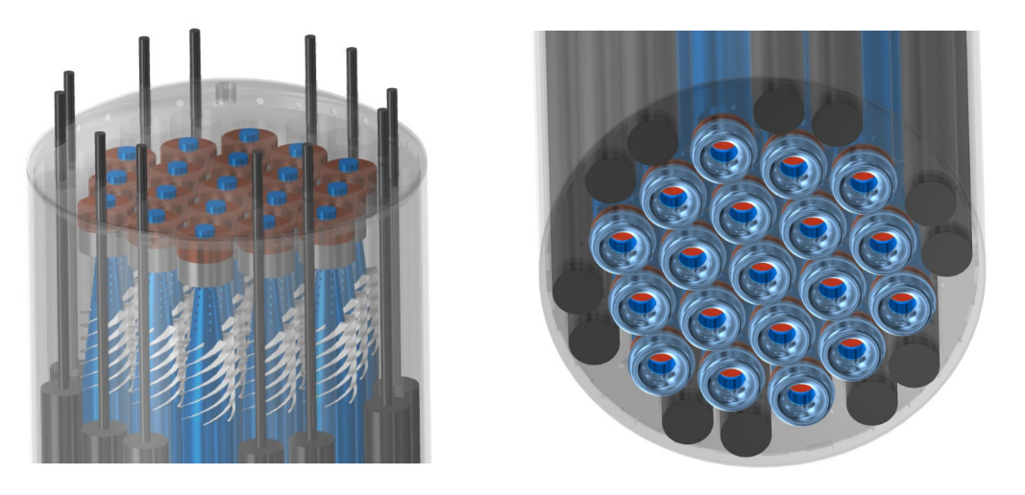
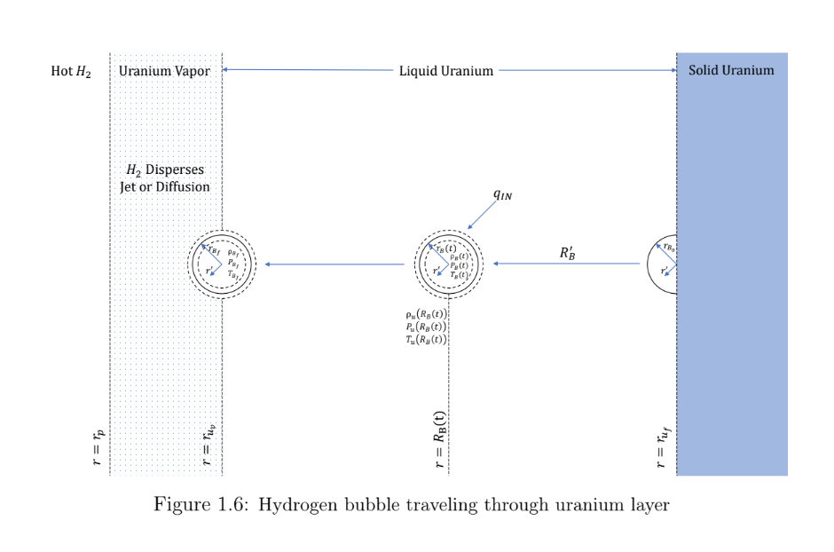
High Performance Nuclear Thermal Propulsion
CNTR involves 19 - 27 fuel rods rotating with liquid H2 being forced through Uranium Vapor.
Each individually rotating a fissioning and ejecting H2 gas propelling the rocket forward.

Slide 8
History of CNTR
Centrifugal Nuclear Thermal Rocket
Uses liquid fuel contained in rotating cylinders
Propellent heated through nuclear fission
Creates a specific impulse of 1800 s, reducing a mission to Mars to <420 days
Liquid fuel rocket engines proposed in 1954
Designs similar to CNTR established in 1960s
Rover/NERVA Project - 1955 - 1973
Investigations conducted in 1960s and 1970s
Recently – Galinstan study
Challenges (to name a few)
Adequate heat transfer from fuel to propellent
Reliable methods for rotating at several thousand RPM
Wall material compatible with 1500K
Minimize loss of uranium through outlet
Some Current University Work
MIT – Non-Dimensional Quantities of Interest for Bubbles
UAH – Bubbly Thermodynamics for Liquid/Gas Heat Transfer / BLENDER II Mission and Capabilities
Drexel – Turbine Characteristic Dimensionless Parameters for the CNTR
Penn State – Neutronics Design Considerations and Optimizations
URI – CNTR Design and Proof of Concept for Liquid Metal Rotating Fuel Tubes

Slide 9
Design 3
Apparatus Design:
Servo Drive Controlling motor connected to gearbox
Legs inside plates to improve alignment with legs
Two Bearings and plates
Top plate containing drive and power
Thermal Camera to assist tracking temperature gradient and fluid flow
Heating Application: Resistor Internally Through radius to provide heat internally to match Nuclear Heating Curve
Fixed Nozzle at bottom of Tube
Pros
2 Bearings assists apparatus capability to withstand and reach 5 - 7.5 k RPM.
Heating Gradient is similar to steady state.
Cons
Alignment Issues through plates.
Heating Element could break
Fixed Nozzle at bottom likely to cause increased strains at bottom of tube

Slide 10
Problems and Issues
Cap Design Compatibility and Torsion Capability
Evaluating Stresses and Strain on Test Apparatus
System-level PID Control
Unknown Properties of Liquid U₂₃₅ at 2100K - 5000K & .1 MPa
Servo Drive Acquisition
Vibration Minimization
Designing Heating Application Circuit

Slide 11
Summary
URI and NE has more going on than at first glance!
Open Pool LWR Nuclear Materials Research
NASA Projects Nuclear Careers & Opportunities

Slide 12
Thank you!
Questions or Comments?

