Slide 1
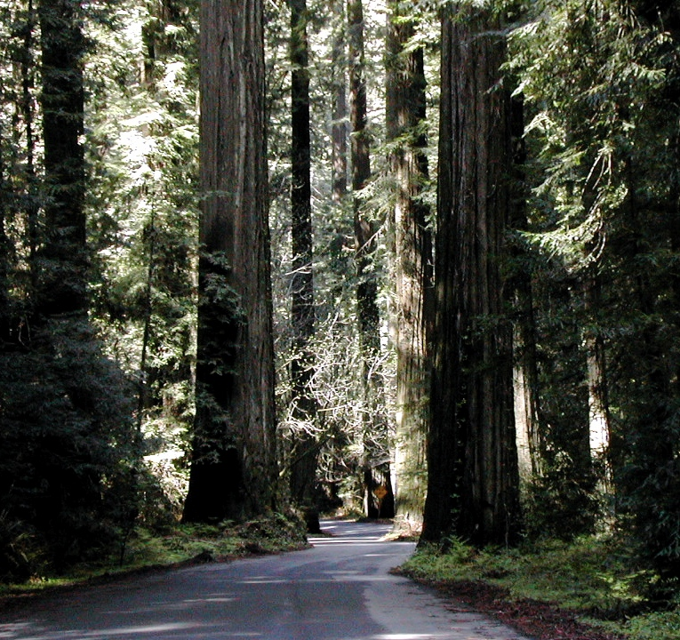
What’s Happened to Our
Nuclear Waste Disposal Program?
Dr. James Conca American Nuclear Society
Parker Foundation/UFA Ventures, Inc./Los Alamos/WSUTC
Richland, WA http://www.forbes.com/sites/jamesconca/ July 2022

Slide 2
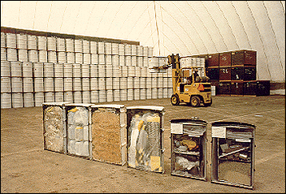
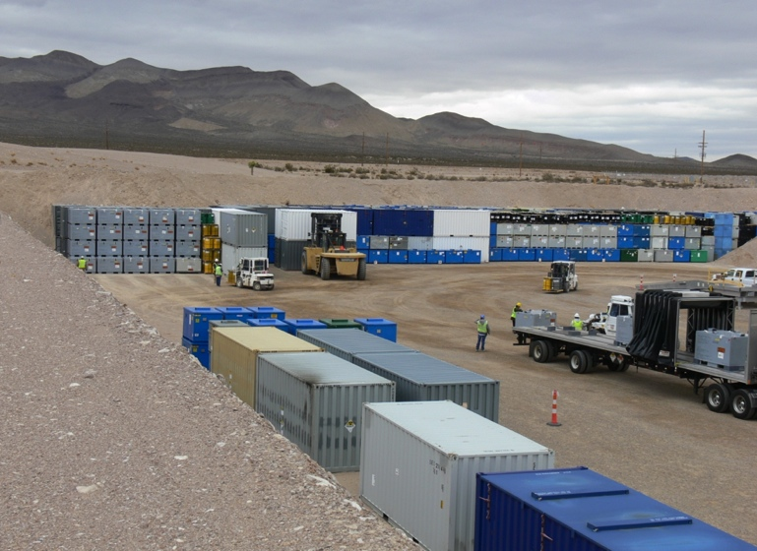
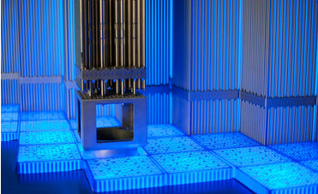
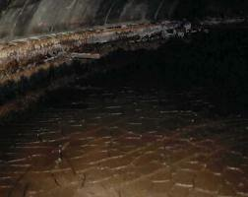
Categories of Nuclear Waste In the U.S.
Spent Nuclear Fuel (SNF)
High Level Waste (HLW)
Transuranic Waste (TRU-CH&RH)
Low Level Waste (LLW)
Radioactivity
RH
CH
Dose Rate
Contact Handled (CH) < 200 mrem/hr < Remote Handled (RH)
WA State has all four types of nuclear waste, especially TRU and HLW
Deep Geologic Disposal is required for SNF, HLW and TRU

Slide 3
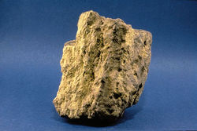
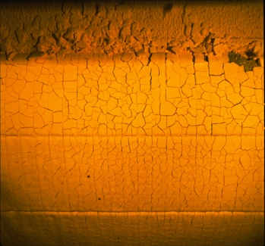
a short nuclear primer
²³⁵U - splits (fissions) easily
²³⁸U - does not fission easily
Uranium-ore
Yellowcake
U₃O₈
Natural uranium (ore) is 0.7% ²³⁵U and 99.3% ²³⁸U
Nuclear fuel is enriched to ~4% ²³⁵U, with ~96% ²³⁸U
Nuclear weapons must be enriched to >93.5% ²³⁵U
Notes:
So what about the waste?

Slide 4
Fission of ²³⁵U
Resultant formation of two unequal pieces (fission products), 3 neutrons and a small amount of mass turned into energy
proton
⁹⁰Sr
neutron
²³⁵U
²³⁵U
²³⁵U
92 protons
+ 143 neutrons
235 total
¹³⁷Cs
²³⁵U

Slide 5
Neutron Capture by ²³⁸U ⇒ ²³⁹Pu
⁹⁰Sr
proton
neutron
²³⁸
²³⁹
U
U
⁹²
⁹²
In fuel most of what these
released neutrons hit is ²³⁸U
β⁻
β⁻
²³⁹
Np
⁹³
²³⁹
Pu
several formation paths for the actinides
¹³⁷Cs
⁹⁴

Slide 6

FUEL
ASSEMBLIES
- 57 million gallons at Hanford
- most is now TRU or LLW
~ 600k gallons are HLW
HLW & TRU are both nuclear bomb waste
- SNF is not
CLADDING REMOVAL
(Coating Dissolution)
COATING REMOVAL WASTE
IRRADIATED FUEL
REPROCESSING
PLUTONIUM DECONTAMINATION
PLUTONIUM
CONCENTRATION
PLUTONIUM PRODUCT
URANIUM
DISSOLUTION
URANIUM
SEPARATION
1ST DECON
CYCLE
2ND DECON
CYCLE
IN 224 B & T
PROCESSING PLANTS
METAL WASTE
DECONTAMINATION CYCLE
WASTES
BUILDING 224 CONCENTRATION WASTES
Since 1970, most Cs/Sr has been removed, others mostly decayed, so now most tanks are TRU or LLW
HLW
TRU
Other SSTs
SSTs B-201 through B-204,
T-201 through T-204,
and T-104, T-110, & T-111

Slide 7
Three Ways Science Enters The Decision-Making Process
(1) Does not enter at all --➣ Ignored
(2) Enters before decision is made --➣ Science-Based Decision
(3) Enters after decision is made --➣ Science-Supported Decision
The Apollo program to land a human on the Moon was a (3)
Our nuclear waste program started out as (2) but then became (3)

Slide 8
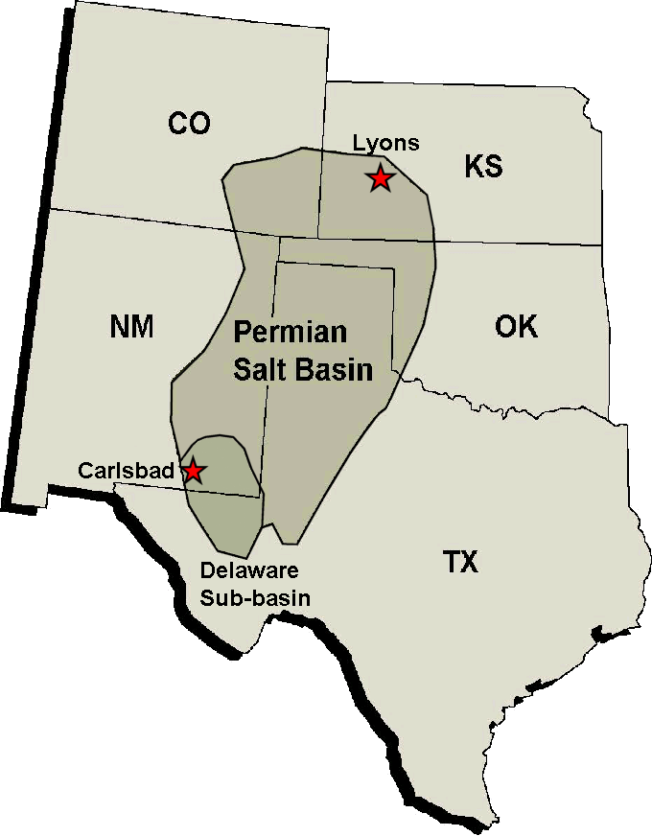
National Academy of Sciences (NAS) concludes in 1957 that the most promising disposal option for all radioactive waste is in massive salt deposits
1957
“Salt at great depth ‘flows.’ It will encapsulate any waste placed at depth and isolate it from the surface environment for eons.” - NAS
“The great advantage is that no water can pass through salt. Fractures are self healing..” – NAS
It takes a billion years for water to move an inch in this rock

Slide 9
1957 - deep geologic disposal adopted; salt chosen as best
1970 - AEC establishes new category for transuranic waste, distinct from low- and high-level radioactive waste but with significant overlap in radioactivity. EPA formed.
1976 – reprocessing of commercial spent fuel put on hold; retrievable disposal concept born for SNF/HLW; salt is out; separate HLW disposal site is sought. TRU still to go into salt.
1982 – Nuclear Waste Policy Act…
Disposal options for different waste streams begins to diverge in the 1970s
2018
1970
Spent Nuclear Fuel (SNF)
High Level Waste (HLW)
Transuranic Waste (TRU)
Low Level Waste (LLW)
TRU/LLW
HLW
RH
Radioactivity
Radioactivity
CH
RH
CH
Dose Rate
Volume
Contact Handled (CH) < 200 mrem/hr < Remote Handled (RH, up to 23 Ci/L)

Slide 10
….seventeen candidate sites for two high-level and commercial waste sites selected in 1982 after the NWPAct
⬅ Sites considered for the first repository
Sites considered for ➔ a second repository

Slide 11
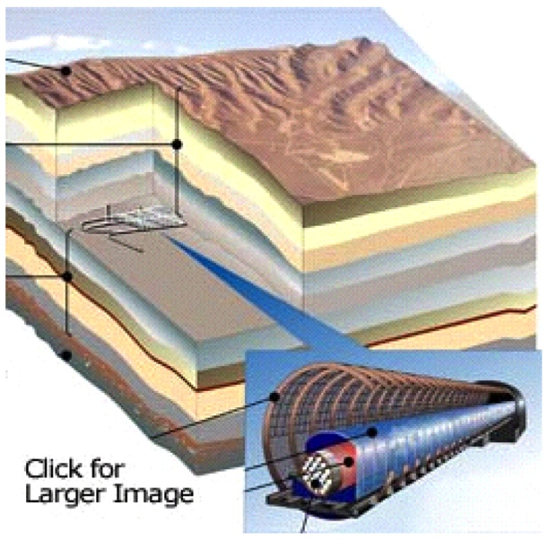
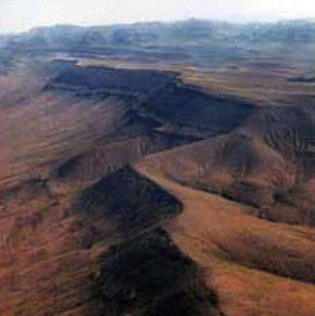
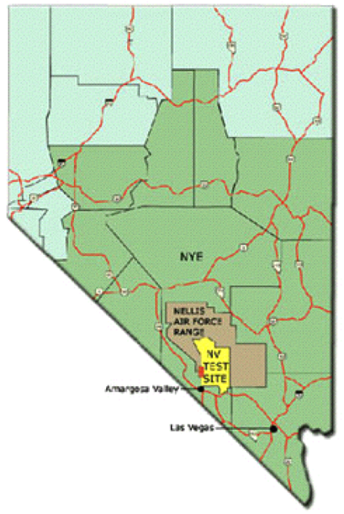
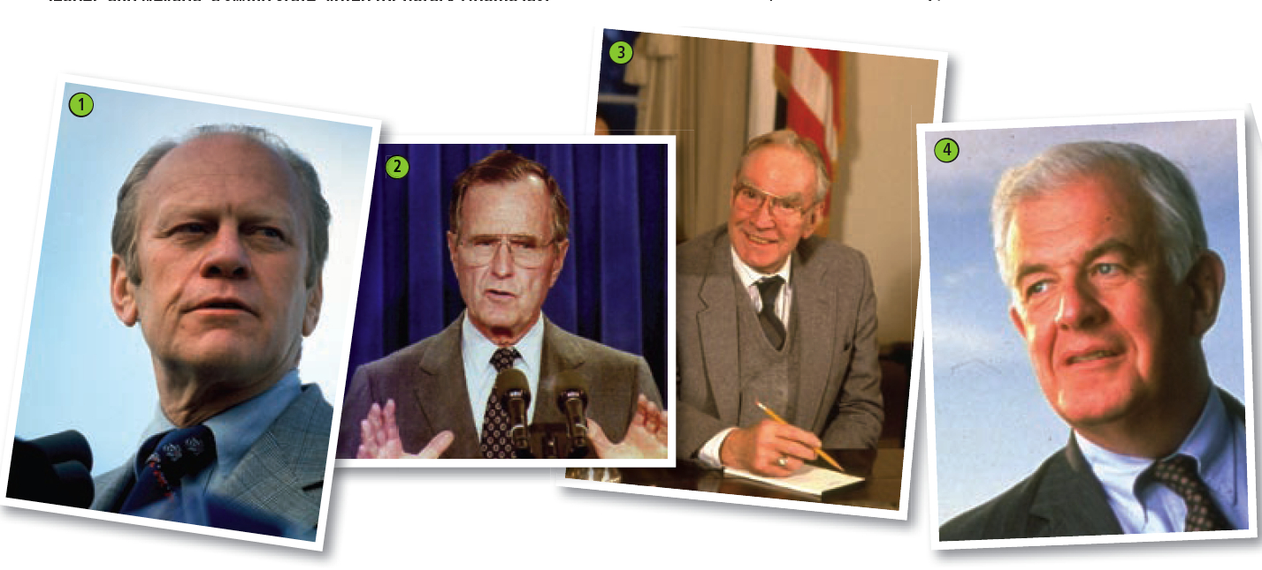

In 1987, Speaker of the House was Jim Wright from Texas, House majority lead was Tom Foley from Washington State. A junior, Harry Reid, was from Nevada. So Nevada was chosen. Harry Reid led the effort to shut down the Yucca Mountain project, and eventually became Senate Majority Leader. In 2008, the YM license application submitted. In 2009, YMP was halted and President Obama put a Blue Ribbon Commission together to develop a new strategy.
….powerful eastern politicians removed all eastern sites, removed the second site completely, and by 1987 the remaining western sites were narrowed to three
- Yucca Mt, Nevada
- Hanford, Washington State
- Deaf Smith, Texas
In 1987, Speaker of the House was Jim Wright from Texas, House majority lead was Tom Foley from Washington State. A junior, Harry Reid, was from Nevada. So Nevada was chosen.

Slide 12
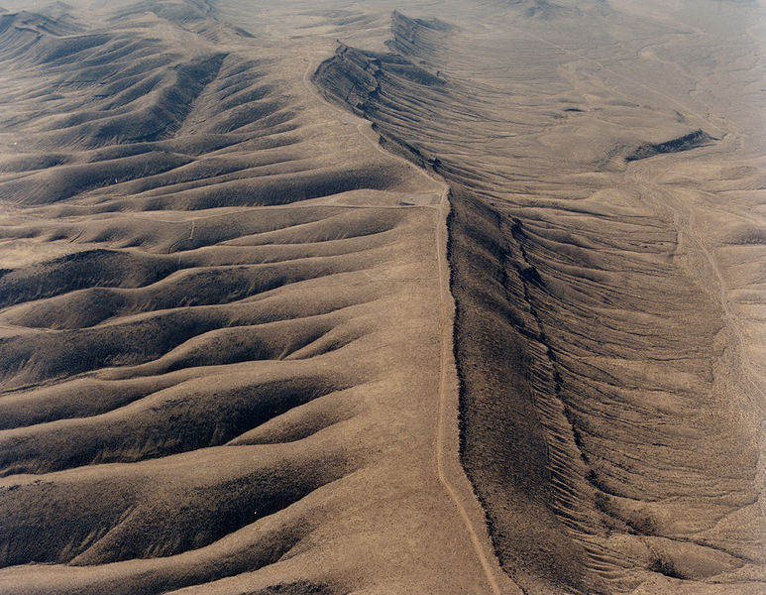
What Makes A Good Deep Geologic Nuclear Waste Repository?
There are seven criteria used to evaluate the suitability of a site for a deep geological repository
Yucca Mt.
a simple hydrogeology,
a simple geologic history,
a tectonically interpretable area,
isolation robustly assured for all
types of wastes (no vitrification
or reforming necessary),
minimal reliance on engineered
barriers to avoid long time
extrapolation of models for certain
types of performance,
performance that is independent of the canister, i.e., canister and container requirements are only for transportation, handling and the first several hundred years of peak temperature after emplacement in a repository, and
a geographic region that has an existing and sufficient sociopolitical and economic infrastructure that can carry out operations without proximity to a potentially rapidly growing metropolis (unlikely to ever have human habitation anywhere near the site).
a simple hydrogeology,
a simple geologic history,
a tectonically interpretable area,
isolation robustly assured for all
types of wastes (no vitrification
or reforming necessary),
minimal reliance on engineered
barriers to avoid long time
extrapolation of models for certain
types of performance,
performance that is independent of the canister, i.e., canister and container requirements are only for transportation, handling and the first several hundred years of peak temperature after emplacement in a repository, and
a geographic region that has an existing and sufficient sociopolitical and economic infrastructure that can carry out operations without proximity to a potentially rapidly growing metropolis (unlikely to ever have human habitation anywhere near the site).
a simple hydrogeology,
a simple geologic history,
a tectonically interpretable area,
isolation robustly assured for all
types of wastes (no vitrification
or reforming necessary),
minimal reliance on engineered
barriers to avoid long time
extrapolation of models for certain
types of performance,
performance that is independent of the canister, i.e., canister and container requirements are only for transportation, handling and the first several hundred years of peak temperature after emplacement in a repository, and
a geographic region that has an existing and sufficient sociopolitical and economic infrastructure that can carry out operations without proximity to a potentially rapidly growing metropolis (unlikely to ever have human habitation anywhere near the site).
a simple hydrogeology,
a simple geologic history,
a tectonically interpretable area,
isolation robustly assured for all
types of wastes (no vitrification
or reforming necessary),
minimal reliance on engineered
barriers to avoid long time
extrapolation of models for certain
types of performance,
performance that is independent of the canister, i.e., canister and container requirements are only for transportation, handling and the first several hundred years of peak temperature after emplacement in a repository, and
a geographic region that has an existing and sufficient sociopolitical and economic infrastructure that can carry out operations without proximity to a potentially rapidly growing metropolis (unlikely to ever have human habitation anywhere near the site).
a simple hydrogeology,
a simple geologic history,
a tectonically interpretable area,
isolation robustly assured for all
types of wastes (no vitrification
or reforming necessary),
minimal reliance on engineered
barriers to avoid long time
extrapolation of models for certain
types of performance,
performance that is independent of the canister, i.e., canister and container requirements are only for transportation, handling and the first several hundred years of peak temperature after emplacement in a repository, and
a geographic region that has an existing and sufficient sociopolitical and economic infrastructure that can carry out operations without proximity to a potentially rapidly growing metropolis (unlikely to ever have human habitation anywhere near the site).
a simple hydrogeology,
a simple geologic history,
a tectonically interpretable area,
isolation robustly assured for all
types of wastes (no vitrification
or reforming necessary),
minimal reliance on engineered
barriers to avoid long time
extrapolation of models for certain
types of performance,
performance that is independent of the canister, i.e., canister and container requirements are only for transportation, handling and the first several hundred years of peak temperature after emplacement in a repository, and
a geographic region that has an existing and sufficient sociopolitical and economic infrastructure that can carry out operations without proximity to a potentially rapidly growing metropolis (unlikely to ever have human habitation anywhere near the site).
a simple hydrogeology,
a simple geologic history,
a tectonically interpretable area,
isolation robustly assured for all
types of wastes (no vitrification
or reforming necessary),
minimal reliance on engineered
barriers to avoid long time
extrapolation of models for certain
types of performance,
performance that is independent of the canister, i.e., canister and container requirements are only for transportation, handling and the first several hundred years of peak temperature after emplacement in a repository, and
a geographic region that has an existing and sufficient sociopolitical and economic infrastructure that can carry out operations without proximity to a potentially rapidly growing metropolis (unlikely to ever have human habitation anywhere near the site).
a simple hydrogeology,
a simple geologic history,
a tectonically interpretable area,
isolation robustly assured for all
types of wastes (no vitrification
or reforming necessary),
minimal reliance on engineered
barriers to avoid long time
extrapolation of models for certain
types of performance,
performance that is independent of the canister, i.e., canister and container requirements are only for transportation, handling and the first several hundred years of peak temperature after emplacement in a repository, and
a geographic region that has an existing and sufficient sociopolitical and economic infrastructure that can carry out operations without proximity to a potentially rapidly growing metropolis (unlikely to ever have human habitation anywhere near the site).
As a result, to fully implement the Yucca Mt repository will cost well over $300 billion.
To put the repository in the correct rock would cost only about $30 billion
Yucca Mt. is a highly fractured, oxidizing, variably saturated, dual porosity, hydrologic system that sits on the edge of the Las Vegas Shear Zone

Slide 13
But there is a site that meets all seven criteria and that has already demonstrated it can handle all of our nuclear waste of any type, including high-level waste
Extreme re-engineering required to counteract the choice of the wrong rock
reducing inverts
shotcrete
ceramic coating
titanium drip shield
vitrified waste
package supports
gravel backfill

Slide 14
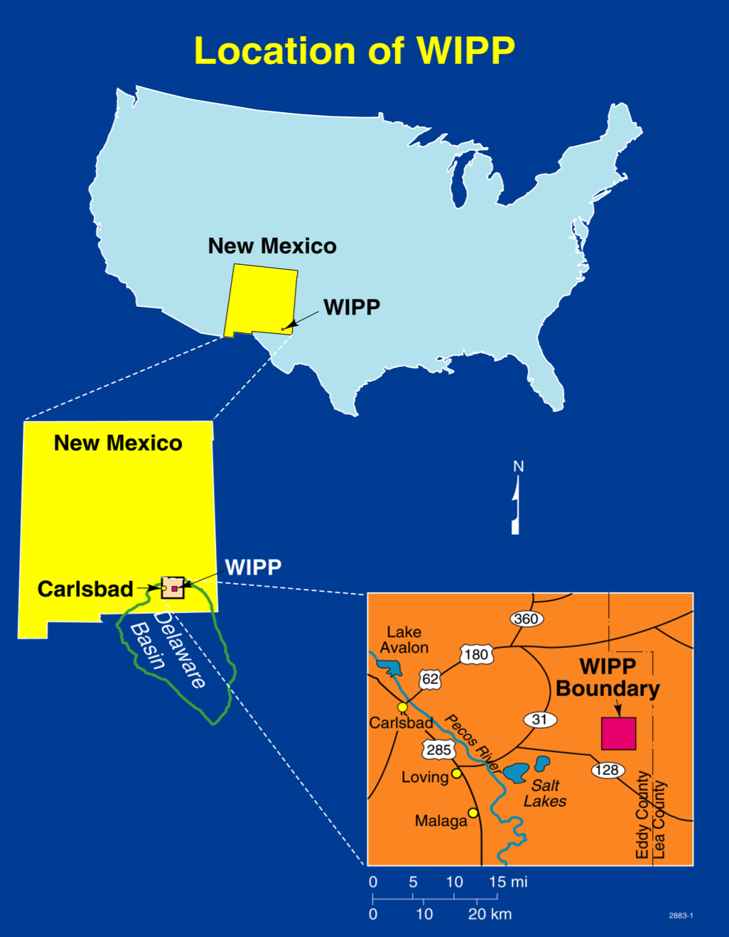
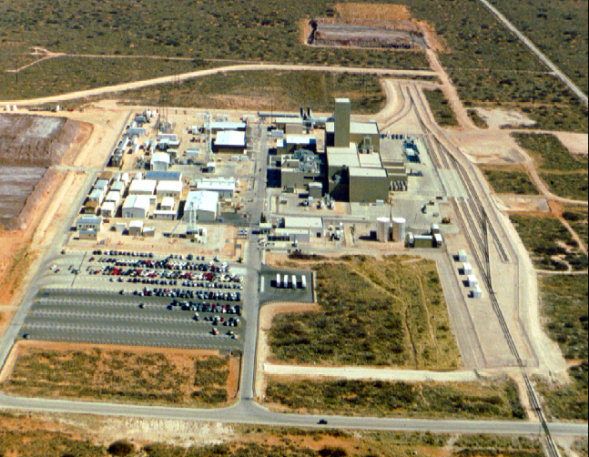
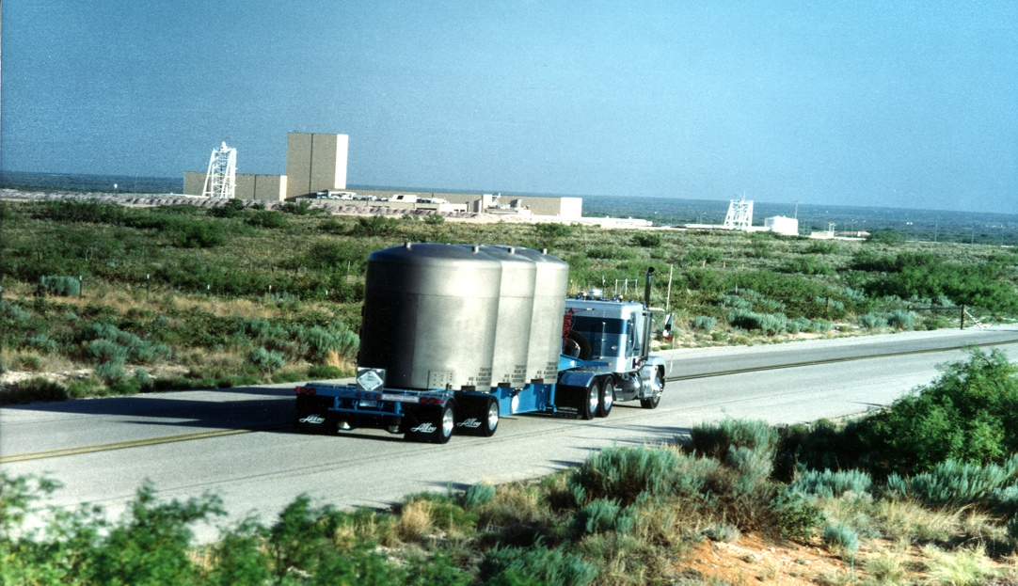
Unknown to most, transuranic waste (bomb waste) continued on into the salt as planned, leading to the Waste Isolation Pilot Plant.
WIPP has shown that geologic disposal of nuclear waste is safe and cost-effective
Unknown to most, transuranic waste (bomb waste) continued on into the salt as planned, leading to the Waste Isolation Pilot Plant.
WIPP is ahead of schedule and under-budget
Only defense-generated TRU waste
presently permitted: 100 nCi/g to 23 Ci/L
of alpha-emitting ²³⁹Pu equivalents
but WIPP was originally designed
to handle all nuclear waste
16 miles² set aside in the 1992 Land Withdrawal Act
- when WIPP is full, only 1/2 mile² will have been used
Notes:
Third there’s WIPP - the Waste Isolation Pilot Plant in southeastern New Mexico.

Slide 15
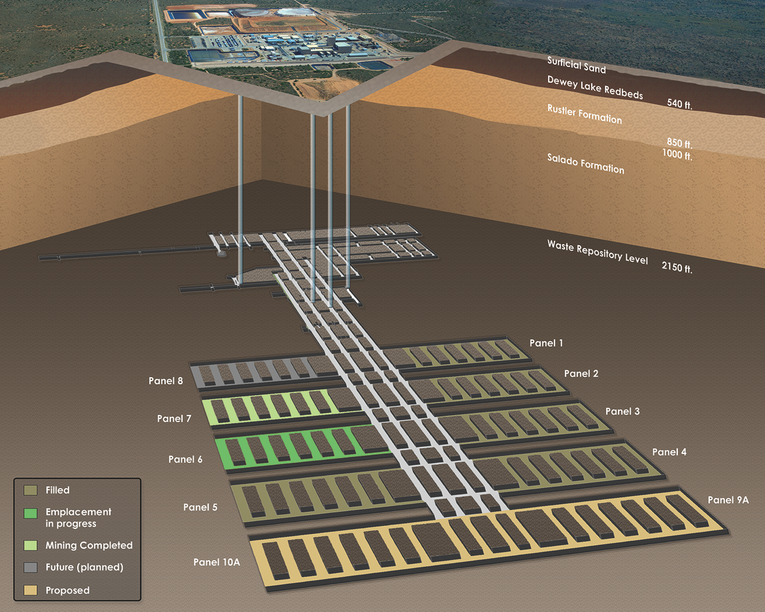
Waste Isolation Pilot Plant
U.S. Department of Energy
2,130 feet below the surface
Ventilation system:
425,000 ft³/minute
Constantly monitored
HEPA filtered

Slide 16
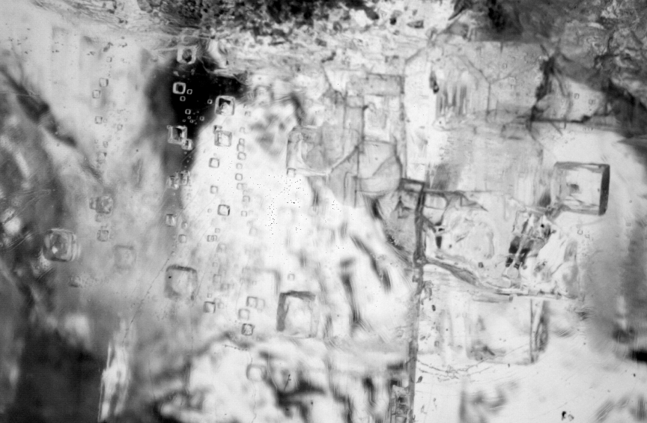
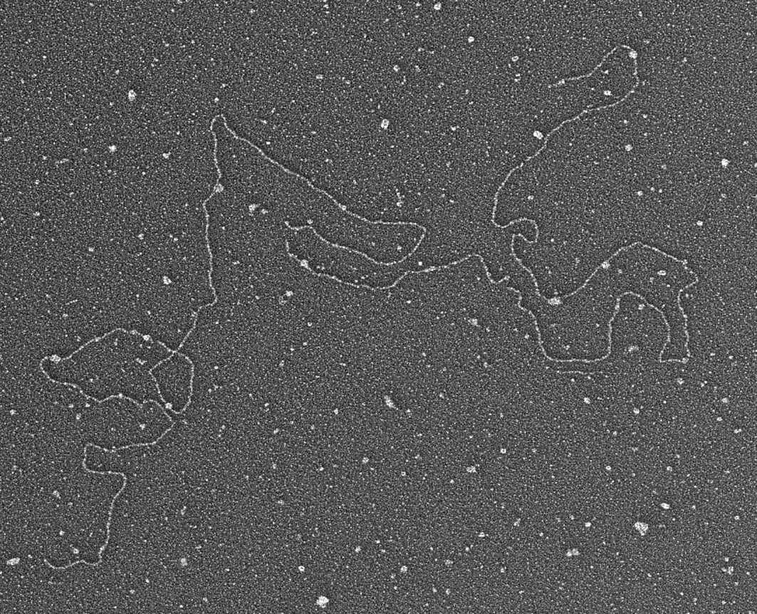
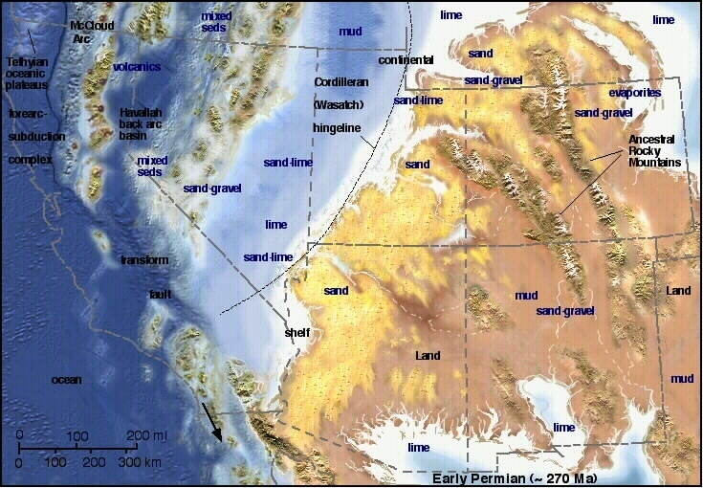
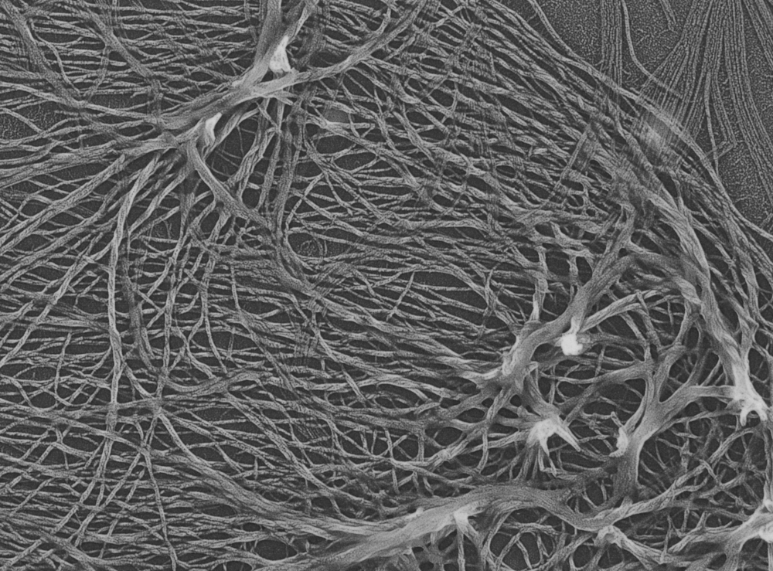
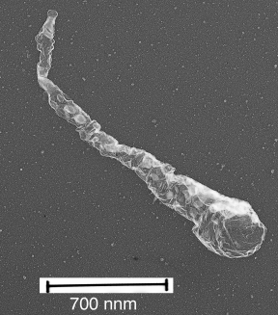
1 cm
Length: 4136 nm = ~12, 100 base pairs (similar to modern halophilic bacterial DNA)
WIPP Salado Formation salt was deposited by repeated evaporation of shallow marine incursions into the Permian Basin of New Mexico
200 nm

Slide 17
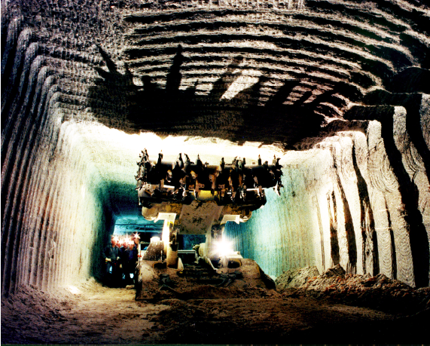
Mining the Salado is the easiest and safest mining operation in the world

Slide 18
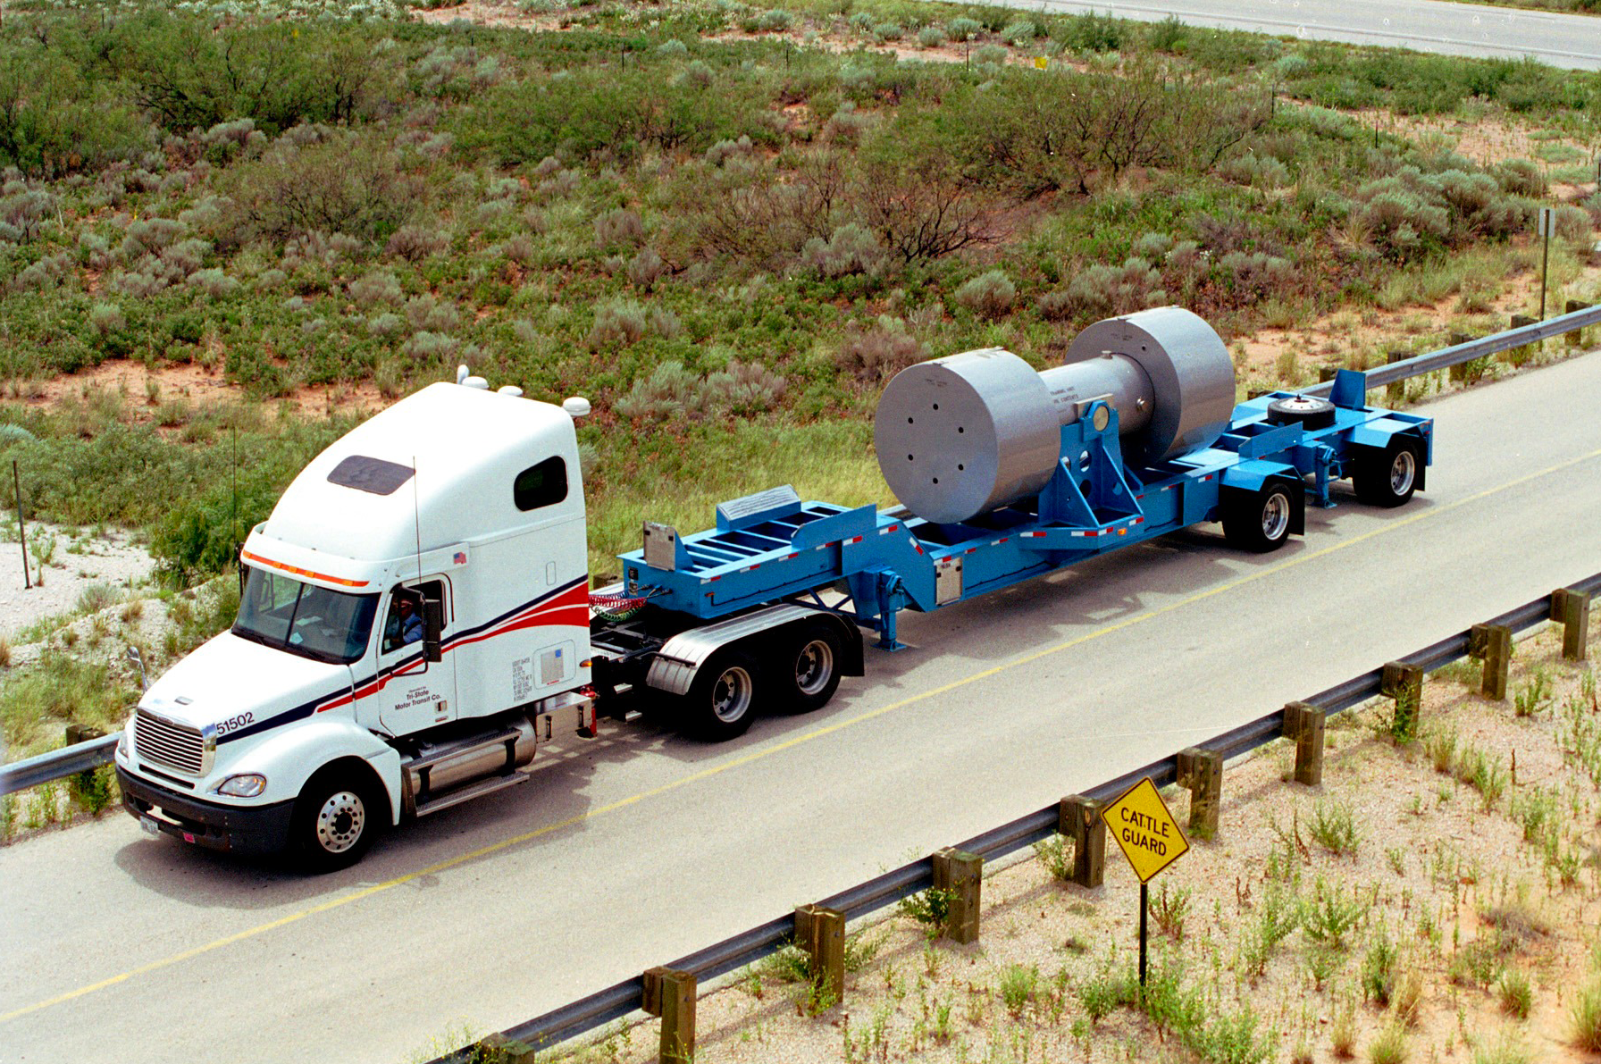
January 2007, high activity waste began shipping to WIPP;
up to 1000 R/hr surface and 23 Curies/liter (87 Curies/gallon)

Slide 19
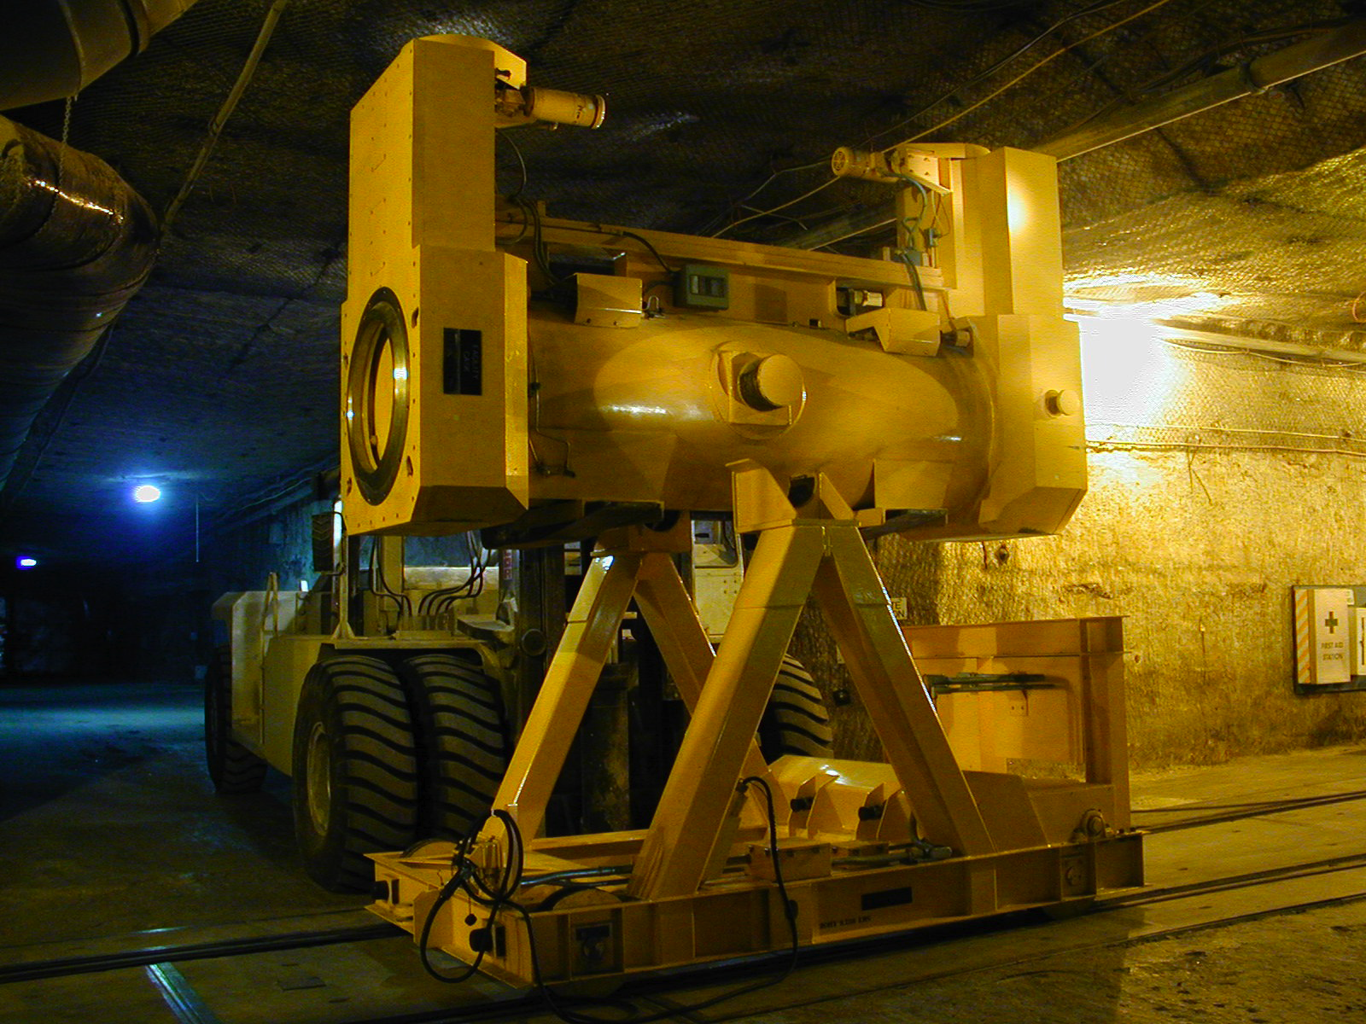
The higher activity waste is remotely handled in shielded transport casks

Slide 20
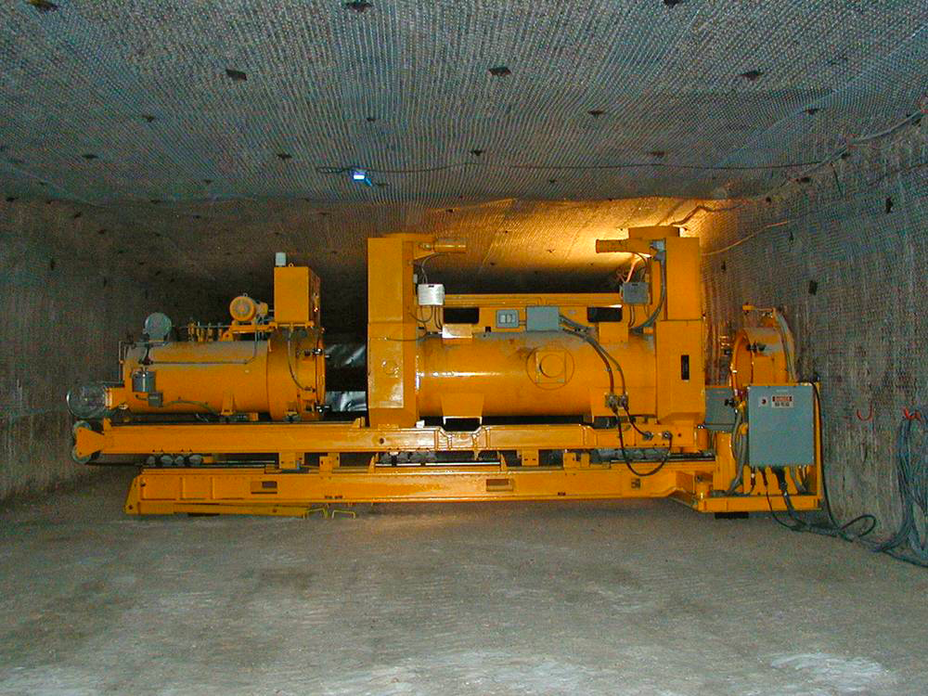
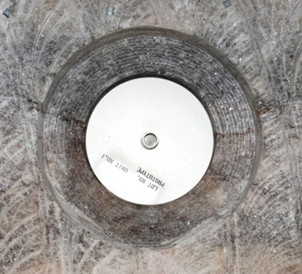
The higher activity waste is robotically plunged into boreholes in the room walls prior to filling with the lower activity waste

Slide 21
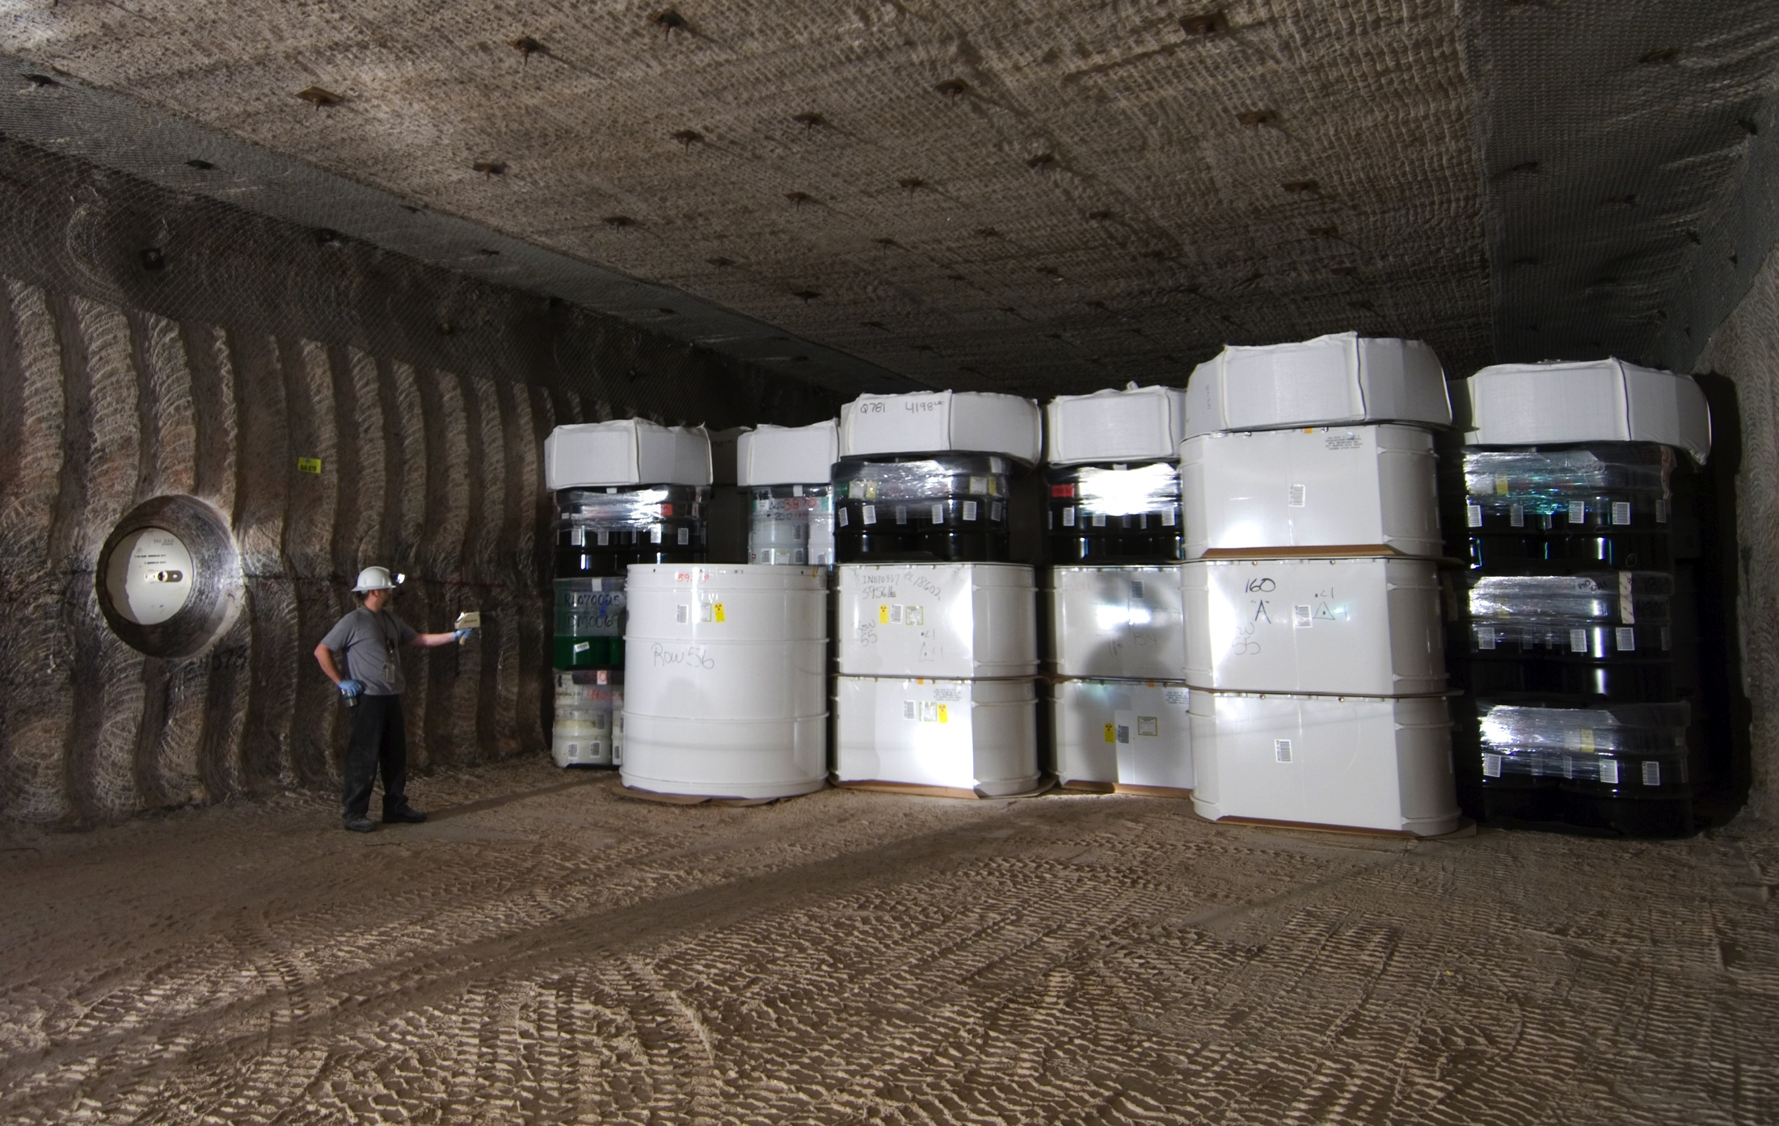
At the 2000 lbs/inch² pressure at this depth, the salt exhibits significant creep closure, i.e., the salt completely closes all fractures and openings, even micropores, making the salt extremely tight, such that water cannot move even an inch in a billion years
22 years of operation: >90,000 cubic meters of nuclear waste disposed
>500,000 fifty-five gallon drum equivalents
22 DOE sites cleaned of legacy waste
1 minor release to the environment
0 deaths 0 people contaminated

Slide 22
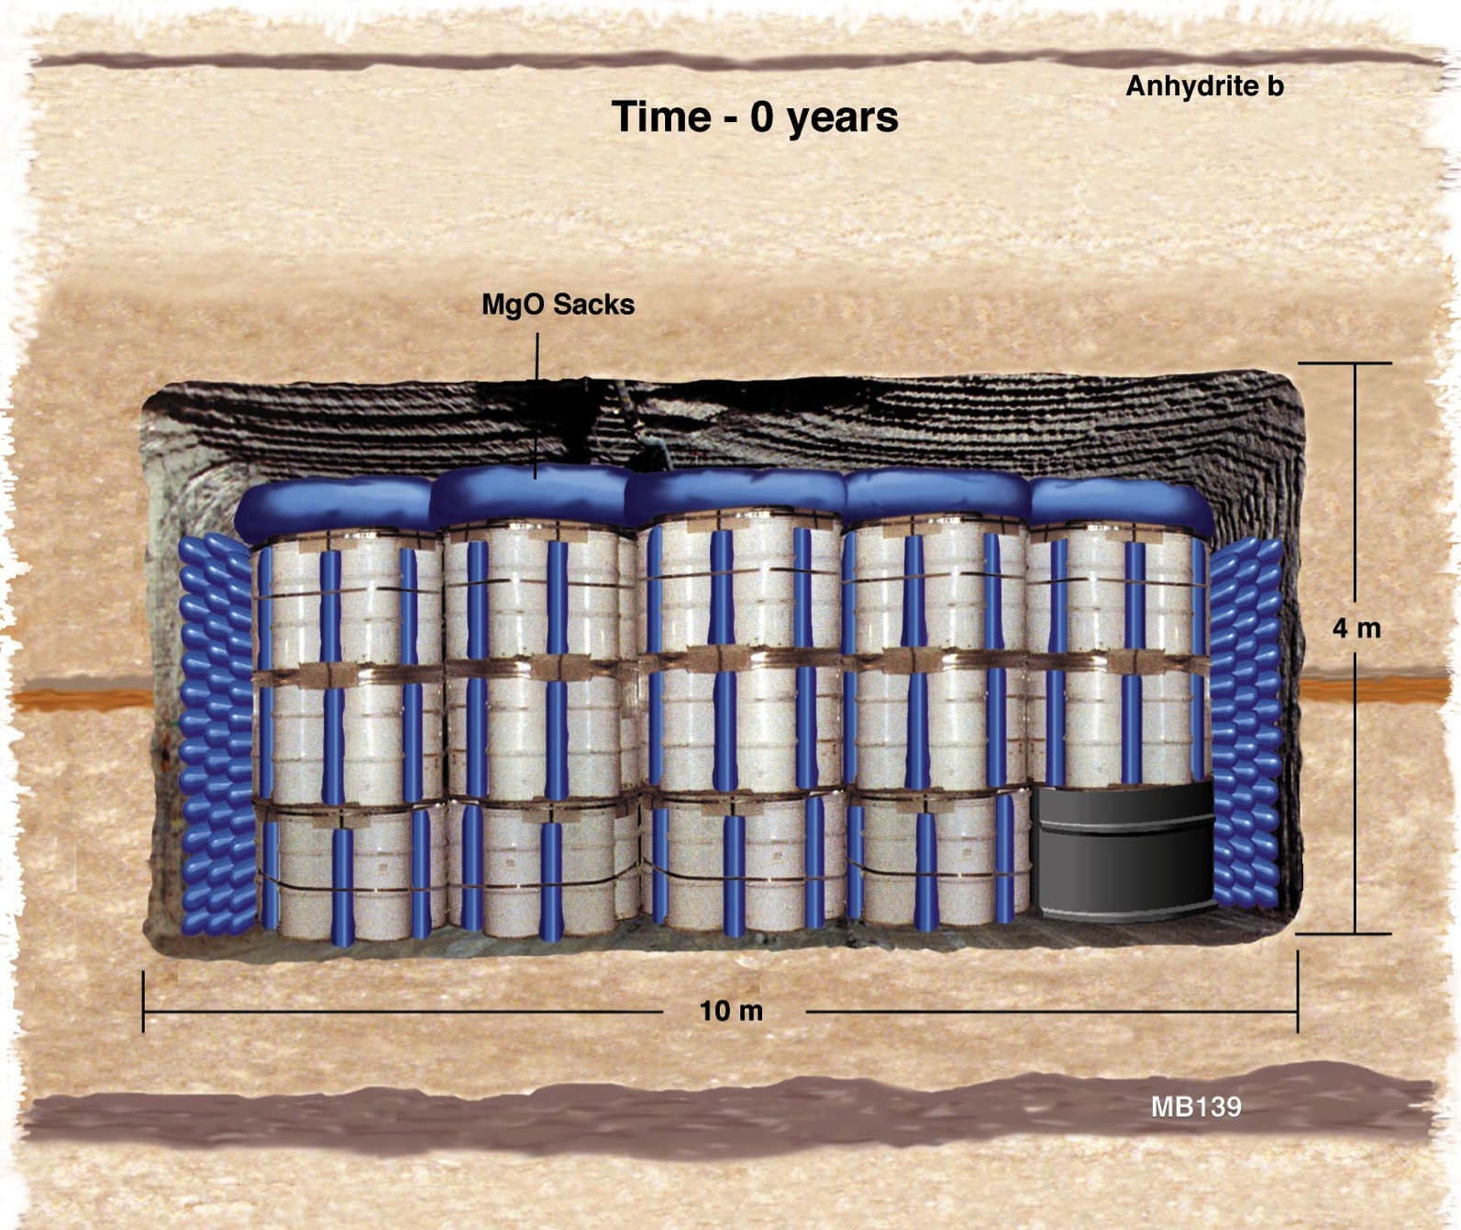
Evolution of the WIPP Disposal Rooms (t = 0 yrs)
Courtesy of Frank Hansen, SNL

Slide 23
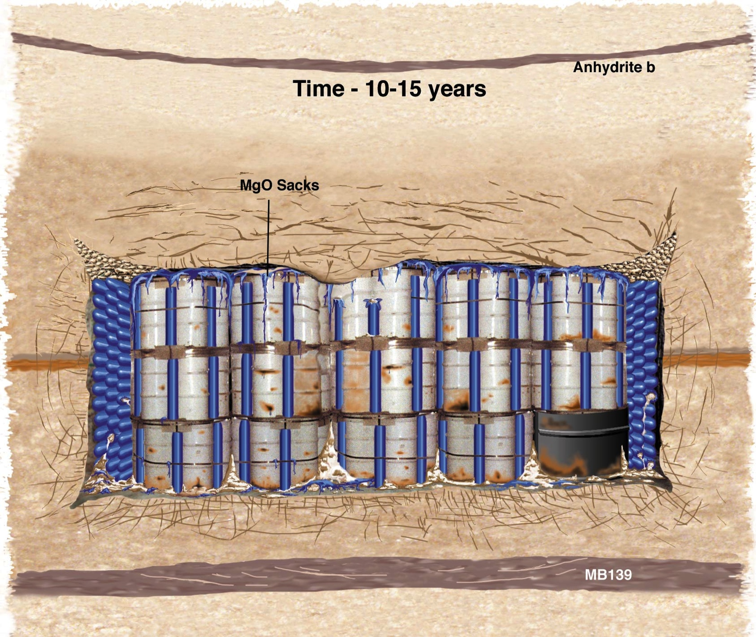
Evolution of the WIPP Disposal Rooms (10-15 yrs)
Courtesy of Frank Hansen, SNL

Slide 24
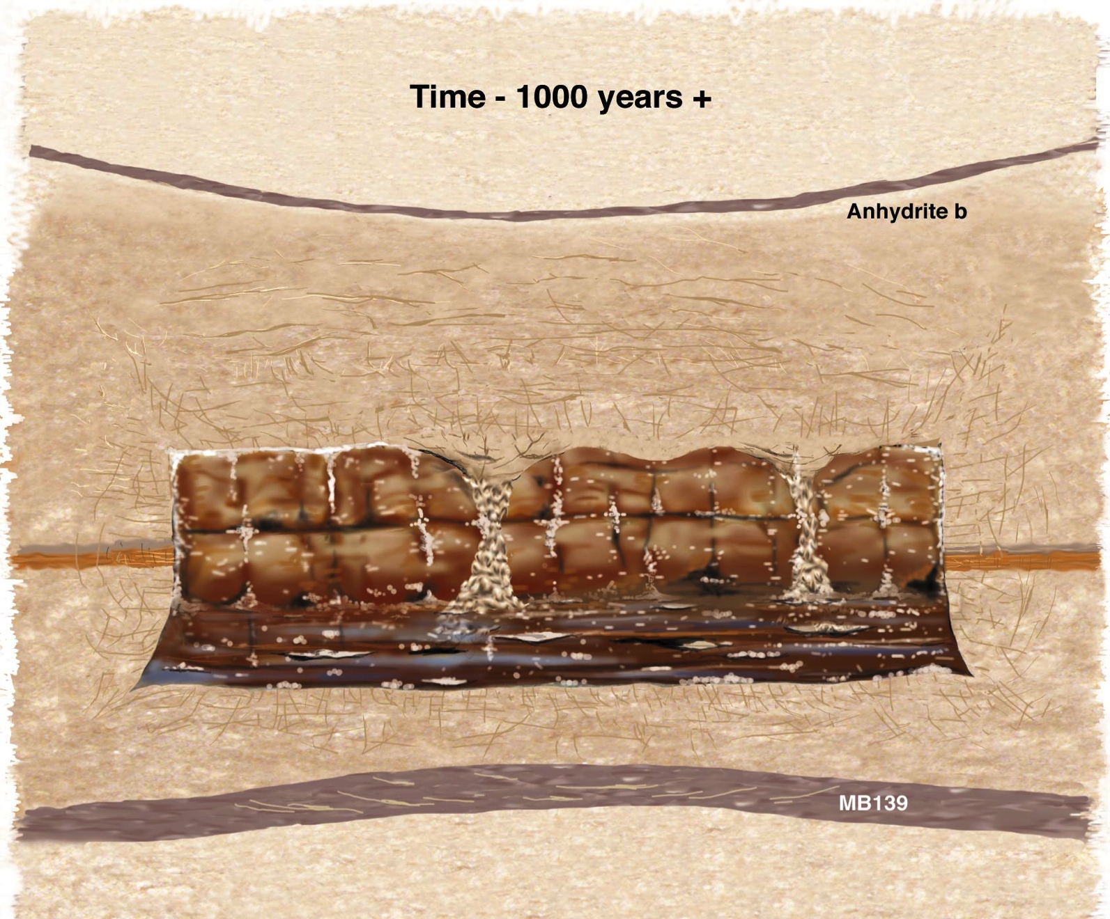
Evolution of the WIPP Disposal Rooms (1000 yrs)
K ≤ 10⁻¹⁴ m/s
D ~ 10⁻¹⁵ m²/s
(water and contaminants move less than an inch in a billion years)
1% - 1.5% porosity pH = 8.6 - 9.2 Eh < -500 mV
K_{τsalt} ~ 15 kcal/m/hr/deg @ 200°C = 5 x K_{τcrystalline}
annealing of disturbed salt ~ ƒ(T^{x}) where 6 < x < 9 ⇒ closes in < 3 years for HLW
performance period - 200,000,000 years, not 10,000 or 100,000 years
no engineered barriers needed, waste form irrelevant
no persistence of cladding or canister needed
no adverse temperature effects, fluid inclusion migration irrelevant

Slide 25
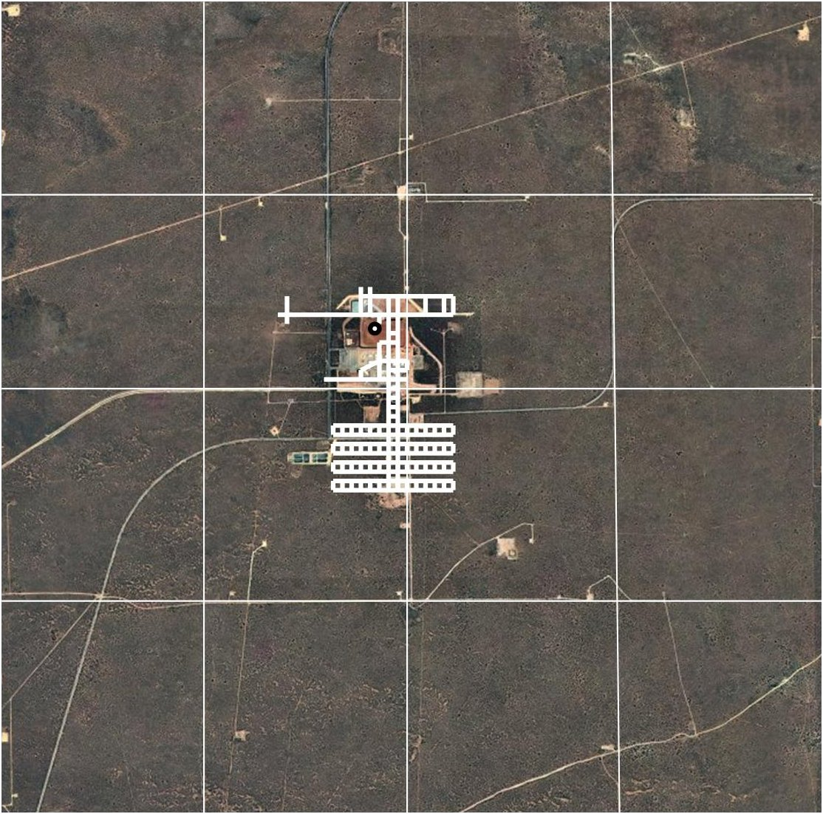
Waste Disposal Footprint in Salt
Final footprint of WIPP will be only 1 mile² out of 16 set aside for nuclear waste disposal by the the 1992 Land Withdrawal Act.
Small leak in 2014 that caused no external contamination, does not change anything, WIPP is still 10 yrs ahead of schedule and $1 billion under budget.

Slide 26
Waste Disposal Footprint in Salt
New footprint of an expanded WIPP to include HLW that has become TRU, with interim storage for SNF, would be less than 3 mile² out of the 16 set aside for nuclear waste disposal by the the 1992 Land Withdrawal Act

Slide 27
WCS
Andrews
TX
•
- least tectonically deformed, thickest, most optimal depths

Slide 28
Interim Storage for Commercial Spent Fuel
-ideal for hundreds of years, enough time for SNF to no longer be high-level

Slide 29
Deep Borehole Injection of Nuclear Waste

Slide 30

Probable Outcomes for U.S. Nuclear Waste (also supported by BRC)
WIPP
Defense Waste (TRU and
HLW)
HLW redefined as TRU
stays right where it is
(EISs show no problem)
2nd salt repository - cheap
HLW redefined as LLW to TX
Commercial nuclear fuel
•
Second salt repository
Interim storage
Burn in fast reactors later this century
Deep borehole

Slide 31
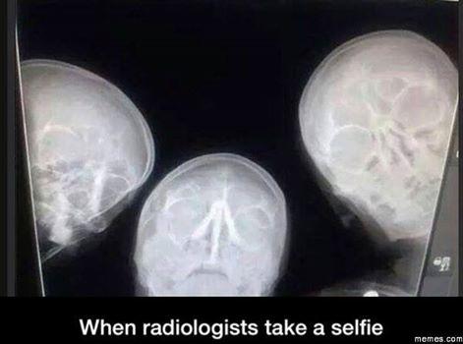

Slide 32
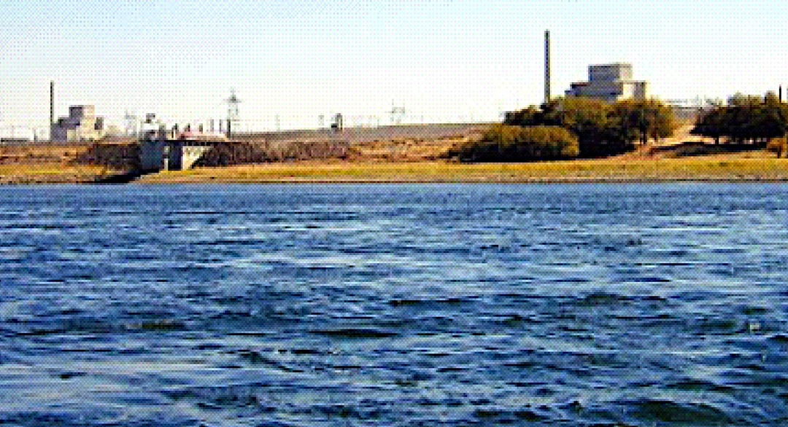
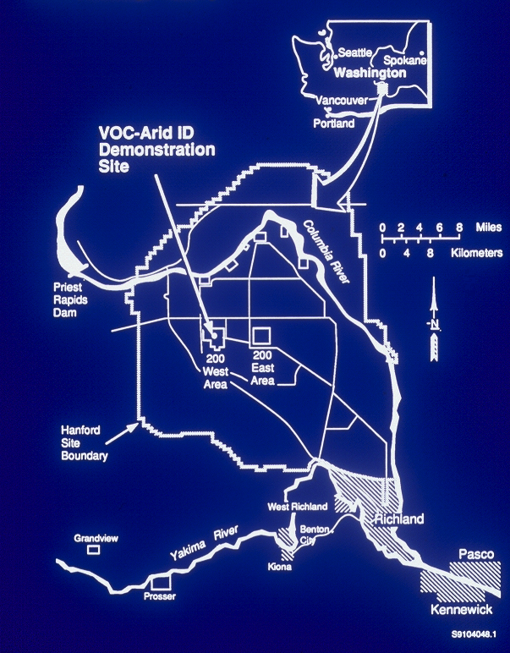
Waste Tanks
What is in the tanks at the Hanford Nuclear Reservation Washington State?

Slide 33

Hanford tank waste poses no measureable risk to human health and the environment -- offsite
Hanford tank waste only poses a small risk to human workers – onsite – and is greater if vitrified

Slide 34
TIMEFRAME
EPA 40 CFR 191
1,000-year requirement
  4 mrem/yr whole body (water)
  25 mrem/yr whole body (all pathways)
  75 mrem/yr critical organ
10,000-year requirement
  Curie release limits
    1-in-10 chance of exceeding the limit
    1-in-1000 chance of exceeding 10x the limit

Slide 35
Hanford has a complex subsurface stratigraphy, but all vadose zone flow ends up at the Columbia River’s edge

Slide 36
Regulatory limit at river’s edge
4 mrem/yr

Slide 37
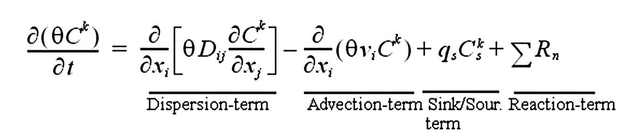
Advection-Diffusion-Dispersion Equations for Radionuclide Subsurface Transport
Notes:
This slide demonstrates that we all receive a total of about 370 mrem (0.37 mSv) of radiation exposure each year from background sources. The range of exposures from background is very high in different environments. Background radiation increases as a function of elevation, as a function of radon in homes and from natural radioactive materials in the environments. There are some areas where the natural background radiation dose is increased by more than a factor of ten. Many of the man made exposure are being regulated at levels much below background. For example there are some very vigorous discussions on whether the level for exposure from man-made sources should be 15 or 25 mrem per year. Since both of these levels are far below the background level, and the range of background level is so high, it is difficult to justify the needed expense required to comply with the lower standard.

Slide 38
Tank Closure Alternatives For The DOE Environmental Impact Statement

Slide 39
EIS results for Hanford tank waste – No Action (1) or vitrification with various closure scenarios. Note column showing peak dose at river’s edge ( ) at peak year (e.g., 4978)
Table S-10. tank Closure Alternatives - Summary of Radiation Dose and Hazard Index at
Year of Peak Dose/Hazard Index for the Drinking-Water Well User
Note: Calendar year of peak impact shown in parentheses
Tank Closure Alternative | Core Zone Boundary |  | Columbia River Nearshore
 | Radiation Dose (millirem per year) | Hazard Index | Radiation Dose (millirem per year) | Hazard Index
1 (No Action) | 58.88 (4313) | 9.20 (2500) | 4.37 (4978) | 1.01 (4498)
2A | 8.64 (2069) | 5.26 (2068) | 0.941 (2317) | 1.01 (2079)
4\2B, 3A, 3B, 3C, 6C | 7.58 (2056) | 4.81 (2050) | 0.885 (2242) | 0.971 (2076)
4 | 7.41 (2056) | 4.80 (2050) | 0.882 (2242) | 0.971 (2076)
5 | 7.57 (2056) | 4.81 (2050) | 0.894 (4809) | 0.971 (2076)
6A, Base Case | 7.37 (2056) | 4.80 (2050) | 0.876 (2251) | 0.971 (2076)
6A, Option Case | 7.64 (2066) | 5.22 (2051) | 0.899 (2251) | 0.912 (2076)
6B, Base Case | 7.35 (2056) | 4.80 (2050) | 0.822 (2218) | 0.972 (2076)
6B, Option Case | 7.92 (2065) | 5.23 (2083) | 0.807 (2218) | 0.830 (2074)

Slide 40









  Comparison of 4 mrem/yr Worst-Case Peak Dose from Hanford tanks with Normal Background Radiation
Normal annual exposure from natural radiation
About 300 mrem/yr
Radon gas 200 mrem
Human body 40 mrem
Rocks, soil 28 mrem
Cosmic rays 27 mrem
Normal annual exposure from man-made radiation
About 70 mrem/yr
Medical procedures 53 mrem
Consumer products 10 mrem
One rnd-trip coast to coast airplane flight 4 mrem
Watching color TV 1 mrem
Sleeping with another person 1 mrem
Weapons test fallout less that 1 mrem
Nuclear industry less than 1 mrem
Move to Spokane
50 mrem/yr
Notes:
This slide demonstrates that we all receive a total of about 370 mrem (0.37 mSv) of radiation exposure each year from background sources. The range of exposures from background is very high in different environments. Background radiation increases as a function of elevation, as a function of radon in homes and from natural radioactive materials in the environments. There are some areas where the natural background radiation dose is increased by more than a factor of ten. Many of the man made exposure are being regulated at levels much below background. For example there are some very vigorous discussions on whether the level for exposure from man-made sources should be 15 or 25 mrem per year. Since both of these levels are far below the background level, and the range of background level is so high, it is difficult to justify the needed expense required to comply with the lower standard.

Slide 41
Even though TRU and HLW have different disposal pathways, reclassifying this HLW as TRU or LLW and disposing elsewhere (2R), e.g., WIPP, is identical to vitrification (2A, 3, 4, 5, 6)
Table S-10. tank ClosureAlternatives- Summary of Radiation Dose and Hazard Index at
Year of Peak Dose/Hazard Index for the Drinking-Water Well User
Note: Calendar year of peak impact shown in parentheses
Tank Closure Alternative | Core Zone Boundary |  | Columbia River Nearshore
 | Radiation Dose (millirem per year) | Hazard Index | Radiation Dose (millirem per year) | Hazard Index
1 (No Action) | 58.88 (4313) | 9.20 (2500) | 4.37 (4978) | 1.01 (4498)
2R (non-DOE estimate) | 8.10 (2400) | 5.10 (2300) | 0.910 (2700) | 0.990 (2080)
2A | 8.64 (2069) | 5.26 (2068) | 0.941 (2317) | 1.01 (2079)
4\2B, 3A, 3B, 3C, 6C | 7.58 (2056) | 4.81 (2050) | 0.885 (2242) | 0.971 (2076)
4 | 7.41 (2056) | 4.80 (2050) | 0.882 (2242) | 0.971 (2076)
5 | 7.57 (2056) | 4.81 (2050) | 0.894 (4809) | 0.971 (2076)
6A, Base Case | 7.37 (2056) | 4.80 (2050) | 0.876 (2251) | 0.971 (2076)
6A, Option Case | 7.64 (2066) | 5.22 (2051) | 0.899 (2251) | 0.912 (2076)
6B, Base Case | 7.35 (2056) | 4.80 (2050) | 0.822 (2218) | 0.972 (2076)
6B, Option Case | 7.92 (2065) | 5.23 (2083) | 0.807 (2218) | 0.830 (2074)

Slide 42
What Would We Do To Reclassify This Waste to What It Really Is?
What is defense high-level nuclear waste?
33 USCS § 1402 (j) and 10 CFR 60.2 (1) define high-level radioactive waste as liquid wastes resulting from the operation of the first cycle solvent extraction system, and the concentrated wastes from subsequent extraction cycles, in a facility for reprocessing irradiated reactor fuel, and any solids into which such liquid wastes have been converted.

Slide 43
FUEL
ASSEMBLIES
- 57 million gallons at Hanford
- most is now TRU or LLW
~ 600k gallons are HLW
HLW & TRU are both nuclear bomb waste
- SNF is not
CLADDING REMOVAL
(Coating Dissolution)
COATING REMOVAL WASTE
IRRADIATED FUEL
REPROCESSING
PLUTONIUM DECONTAMINATION
PLUTONIUM
CONCENTRATION
PLUTONIUM PRODUCT
URANIUM
DISSOLUTION
URANIUM
SEPARATION
1ST DECON
CYCLE
2ND DECON
CYCLE
IN 224 B & T
PROCESSING PLANTS
METAL WASTE
DECONTAMINATION CYCLE
WASTES
BUILDING 224 CONCENTRATION WASTES
Since 1970, most Cs/Sr has been removed, others mostly decayed, so now most tanks are TRU or LLW
HLW
TRU
Other SSTs
SSTs B-201 through B-204,
T-201 through T-204,
and T-104, T-110, & T-111

Slide 44
the nature of defense high-level nuclear waste
HLW must be:
highly radioactive,
result from reprocessing spent nuclear fuel for weapons, and
if a solid waste that was derived from liquid waste produced directly in reprocessing, it must contain fission products in sufficient concentrations to require permanent isolation.
⁹⁰Sr
1
0
1
0
.
1
neutron
% yield
0
.
0
1
0
.
0
0
1
0
.
0
0
0
1
5
0
7
0
9
0
1
1
0
1
3
0
1
5
0
1
7
0
¹³⁷Cs
⁹⁰Sr
mass number
¹³⁷Cs

Slide 45
the nature of defense high-level nuclear waste
HLW must be:
highly radioactive,
result from reprocessing spent nuclear fuel for weapons, and
if a solid waste that was derived from liquid waste produced directly in reprocessing, it must contain fission products in sufficient concentrations to require permanent isolation.
The House Armed Services Committee provided a rationale for changing the HLW definition from the prior source-based definition to a source plus hazard-based definition - it should matter what’s in the waste.
Congress provided better language to DOE when it defined high-level radioactive waste (HLW) in the Nuclear Waste Policy Act of 1982 (NWPA) directing government agencies to consider both the source and the hazard of wastes before classifying the waste as HLW or otherwise.
Unfortunately, at the time NRC refused to define the word sufficient, believing that “the principles of waste classification were well known”

Slide 46
the nature of defense high-level nuclear waste
Under current policy, wastes emanating from the reprocessing of irradiated and/or spent nuclear fuel are presumed to be HLW unless formally demonstrated to not be HLW using either:
Section 3116 of the Ronald W. Reagan National Defense Authorization Act for Fiscal Year 2005 (NDAA), or
One of the DOE Order 435.1 Waste Incidental to Reprocessing (WIR) processes (evaluation or citation)
Both Section 3116 and the WIR Evaluation Process require expensive treatment and extensive analyses to demonstrate that radionuclides have been removed from the subject waste stream to the maximum extent practical along with extensive performance assessments and consultation with NRC.
Each waste determination made using Section 3116 or the WIR Evaluation Process can take three to five years to complete and can cost several million dollars.

Slide 47
the nature of defense high-level nuclear waste
To find a conservative interpretation of sufficient, the best and only reasonable place is:
10 CFR 61.55 defines these sufficient limits as 7 Ci/liter for ⁹⁰Sr and 4.6 Ci/liter for ¹³⁷Cs, below which radioactive waste can go into a shallow landfill.
99% of Hanford HLW tanks have less than 1 Ci/liter of either ⁹⁰Sr or ¹³⁷Cs
  most Cs/Sr removed for use in research and to control heat in the tanks, and the rest has gone through 1 or 2 decay lives
  some of the waste has alpha-emitting radionuclides exceeding 100 nanoCi/g of ²³⁹Pu equivalent (lower limit for TRU in WIPP) and all have radioactivity less than 23 Ci/liter (upper limit for TRU in WIPP)
Therefore, 56 million out of 57 million gallons of Hanford HLW tank waste is no longer HLW except in name, but does meet the material definition of TRU (about six million gallons) or LLW (about 50 million gallons)
Is it possible to incorporate this observation into our long-term disposal program?
Do we care what’s real?

Slide 48
What would an alternative plan look like for Hanford Tank waste?
Scenarios – 1) vitrify all 2) vitrify a little (600k gallons direct vit)
Waste Sludge (11 million gallons)
  1.4 million gallons is contact-handled transuranic waste (CH) that could be retrieved, dried, packaged, and disposed of at WIPP following a Class 3 Permit Modification approved by the State of New Mexico -- much of this is in the leaking tanks
  9.6 million, presently intended for pretreatment in the WTP, could be dried and packaged for about a fourth of the cost of the WTP, resulting in about 3.5 million gallons of packaged waste acceptable to WIPP in < 20 years.
  Rail transport using dedicated containers and trains - rail spurs already in place at Hanford and WIPP
  < $10 billion total
Saltcake and Supernatant Waste (45 million gallons)
  supernatant, mixed with water, used to dissolve tank saltcake wastes
  could be immobilized as LAW for disposal at Hanford or Texas using a combination of drying and cast-stoning for about $12 billion
Or liquid could be dried down to about 35 million gallons of solid, and disposed in WIPP, taking an additional 15 years for WIPP, totaling < $8 billion

Slide 49
What would an alternative plan look like for Hanford HLW?
Baseline (as HLW) > $400 billion > 60 years
Alternative (as TRU/LLW + HLW) < $50 billion < 30 years
This alternative is likely the only path to satisfy the anticipated cost and schedule deadlines of the Tri-Party Agreement
Recently, the estimated cost of the present vitrification program, including building and operating the final repository, has risen to $400 billion and > 60 years

Slide 50
Required Changes to the WIPP Land Withdrawal Act (LWA P.L. 102-579)
LWA provides EPA regulatory authority through 40 CFR Part 191
LWA limits the total capacity of TRU waste to 6.2 million ft³ (175,570 m³)
LWA limits the total radioactivity of RH waste to 5.1 million curies
Consultation and Cooperative Agreement with the State of New Mexico (1981)
  total Remote Handled (RH) TRU capacity of 250,000 ft³ (7,080 m³)
  total Contact Handled (CH) TRU capacity of 5.95 million ft³ (168,490 m³)
Regulatory changes needed for NM (NM is an Agreement State)
Repeal 2004 Category 3 Permit Mod prohibiting tank waste of any sort
Increase above limits to handle increased defense waste volumes
Modify LWA to acceptance of non-TRU waste or re-categorize defense HLW waste as TRU
Modify RCRA permit with the New Mexico Environment Department
Modify Compliance Certification with the EPA
Changes to the Low-Level Radioactive Waste Policy Amendment Act (LLRWPAA) to authorize EPA to regulate other waste at WIPP
  DOE Order 435.1, NWPA 1982, Tri-Party Agreement, NEPA, etc.
WDoE would rather change LWA; NM would rather designate HLW as TRU

