Slide 1
Consent-Based Siting: Strides of Progress on Spent Nuclear Fuel
Sam Brinton
Deputy Assistant Secretary for Spent Nuclear Fuel and Waste Disposition
U.S. Department of Energy

Slide 2
Office of Spent Fuel and Waste Disposition

Slide 3
Integrated Waste Management
As we continue to deploy nuclear energy as a solution for decarbonization, increasing access to energy, and tackling climate change, we need to make progress on the back end of the fuel cycle
The U.S. Department of Energy is responsible for managing the nation’s spent nuclear fuel and high-level radioactive waste, including finding sites to store and dispose of the spent nuclear fuel
While spent nuclear fuel is stored safely all over the country, the communities that have the spent nuclear fuel never agreed to host the material long term

Slide 4
Waste Management R&D​
Conduct R&D for eventual geologic disposal, extended storage, and transport of spent nuclear fuel and high-level radioactive waste
Investigating different geologies and developing generic disposal concepts
Quantify effects of storage and transportation on spent fuel integrity
Leverage international collaboration

Slide 5
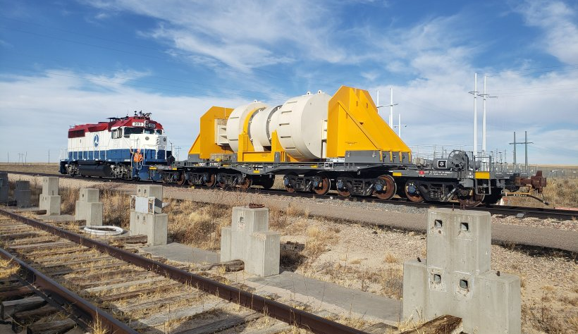
Integrated Waste Management, Interim Storage & Transportation
Consent-based siting
Plan for transportation of spent nuclear fuel​
Perform system analysis and integration​
Generic design of facilities

Slide 6
Allow for removal of spent nuclear fuel from reactor sites
Provide useful research opportunities
Reduce taxpayer liability
Build trust and confidence with stakeholders
Interim Storage

Slide 7
Consent-Based Siting
Consent-based siting is an approach to siting facilities that focuses on the needs and concerns of people and communities.
By prioritizing communities and people, we believe we can find a solution to the decades-long stalemate on managing the nation’s spent nuclear.
A consent-based approach, driven by community well-being and community needs, is both the right thing to do and our best chance for success.

Slide 8
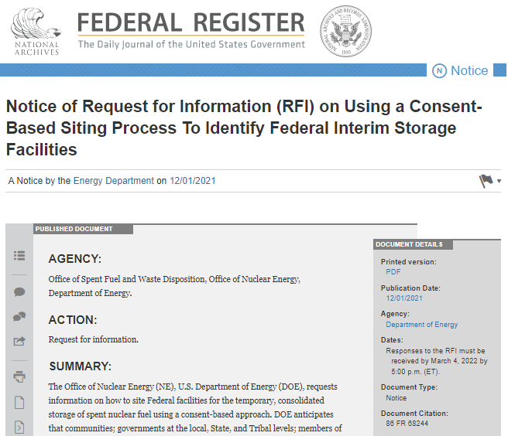
Request for Information
Questions on:
the consent-based siting process itself
removing barriers to meaningful participation—especially for groups and communities who have not historically been well-represented in these conversations
interim storage as a component of the nation’s waste management system
Special focus on ensuring issues of equity and environmental justice are built into the consent-based siting process, as well as the waste management system as a whole

Slide 9
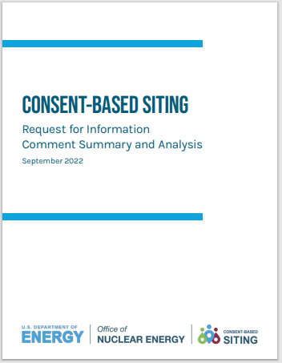
Summary of Feedback
~225 comments as follows:
Tribes: 3 from Tribal groups, 3 from Tribes
States: 12 State government organizations, 3 State and Regional Groups, and 3 groups representing State governments or their interests
Local governments: 7
NGOs: ~35
Environmental Justice organizations: 2
Industry: ~12
Members of Academia: ~7
Labor Union: 1
Private Citizens: ~132 (including 45 “form” letters)
energy.gov/consent-based-siting

Slide 10
FUNDING OPPORTUNITY INFORMED BY PUBLIC FEEDBACK
“Funding to Participate: Funding and technical assistance should be provided to Tribes to participate in all stages of the CBS process. Tribes often do not have the same resources, staff capacity, or time as states, so DOE must take proactive steps to ensure that Tribes can participate in the process.”
– Tribal Representatives
“Extensive outreach activities and financial support for interested communities to learn for themselves. Funding should be provided as soon as possible.”
– Private Citizen
Quoted text from Responses to the Request for Information (86 FR 68244)
Available at energy.gov/consentbasedsiting

Slide 11
FUNDING OPPORTUNITY ANNOUNCEMENT
KEY FACTS
$16 million in funds to be awarded; 6-8 awards; period of performance is 18-24 months
Eligible awardees include:
Higher-education institutions (colleges, universities, and other institutions of higher learning)
Tribal, State, and local governments (municipalities, towns, cities, and counties)
Community foundations
Non-governmental organizations (trade associations, 501(c)(3) organizations, and other public groups)
Geographically and institutionally diverse awardees
Across the continental United States
BUILDS CAPACITY FOR FUTURE ENGAGEMENT
Establishes a community of practice
Strengthens involvement and mutual learning aimed at building trust
Special focus on environmental justice

Slide 12
AWARD RECIPIENTS
WILL REPRESENT CONSENT-BASED SITING CONSORTIA
Award recipient is a hub for community engagement and resources
Reduce barriers for participation
Increase outreach (multiplication factor)
Allow for greater community engagement
Allow for cohort development/capacity

Slide 13
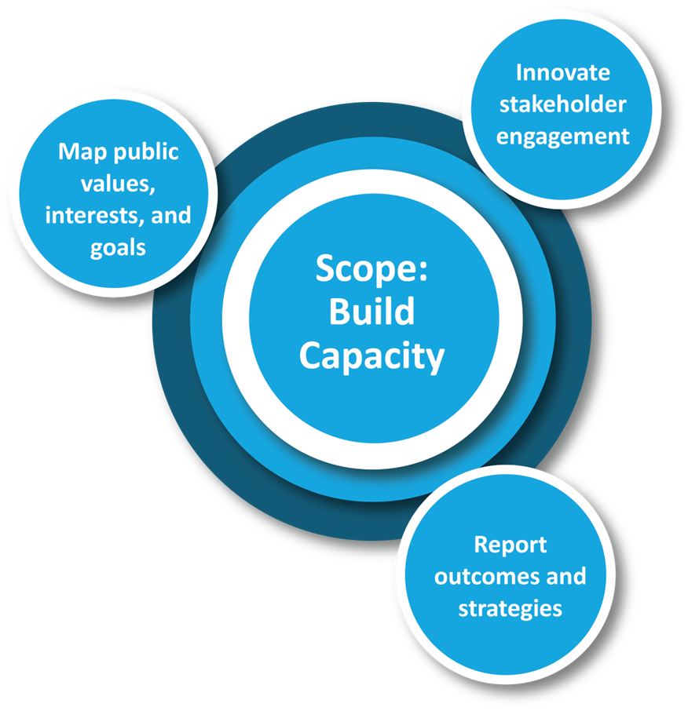
FUNDING OPPORTUNITY TASKS
Three main tasks are centered around consent-based siting and the role a federal consolidated interim storage facility may have in a community

Slide 14
Public Feedback is Informing Next Steps in Consent-Based Siting
Further developing consent-based siting process
1
Clarifying our broader strategy for an integrated waste management system
3
Awarding cooperative agreements for interested groups and communities to learn more
2

Slide 15
Consent-based siting, addressing societal challenges, and intergenerational equity
Need for a disposal pathway
Extended storage research
Foreseeing waste management from advanced reactors deployment
Knowledge management
Looking Ahead

