Slide 1
X-energy and the Xe-100
American Nuclear Society
San Diego Chapter
Harlan Bowers, President
July 25, 2017

Slide 2
About X-energy

Slide 3

Xe-100: Providing a Secure Future
X-energy is developing an innovative nuclear power plant design solution,
the Xe-100 and U.S.-made, proliferation-resistant fuel, which provides
security sustainability for the
global energy and process heat markets
“I am convinced that advanced reactors will become the backbone of our energy mix as we move through this century and develop clean carbon-free energy. President Kennedy once said that we are in a space race and my work with NASA reflects the progress he had hoped for.
Today, I believe we are in an energy race.
Providing clean energy across the world is my vision for X-energy and I believe that clean, safe, reliable nuclear energy is necessary to making this possible.”
Dr. Kam Ghaffarian, Founder and Chief Executive Officer, X-energy

Slide 4

Reimagining Nuclear Energy
X-energy is reimagining nuclear’s role in solving
tomorrow’s energy challenges
Founded in 2009 out of Dr. Ghaffarian’s desire to address the world’s most serious energy challenges and make a lasting contribution to clean energy technology in the U.S. and around the world
Leverages expertise from SGT, Inc. (www.sgt-inc.com) – 2nd largest engineering services contractor to NASA, and another prominent company founded & managed by Dr. Ghaffarian. He is also leading several other high-technology companies (www.axiomspace.com and www.intuitivemachines.com)
Funding of ~$34M committed through 2017 to the company
Nucleonics team, led by Chief Nuclear Officer Dr. Eben Mulder, leverages experience from TRISO-based reactors around the world, including experience at AVR & THTR (Germany)
Dr. Kam Ghaffarian
Founder/CEO
“I began X-energy because the world needs energy solutions that are clean, safe, secure, and affordable. With so much at stake, we cannot continue down the same path.”
-Dr. Kam Ghaffarian, Founder & CEO

Slide 5
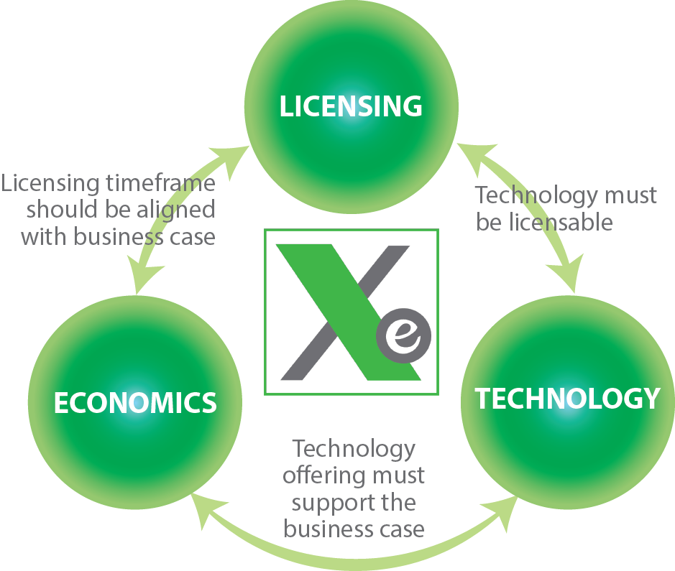
X-energy HTGR Innovation Model
  X-energy Products MUST balance the following characteristics:
  Economics
  Economically competitive with nuclear and coal
  Energy output scalable by adding reactor modules
  Licensing
  Licensable in North America
  Fuel produced in accordance with a U.S. NRC license
  Technology
  Produce electricity and/or process steam
  Intrinsically safe (meltdown proof)
  Capable of operating on and off the electric grid
  Use proven technologies
  Operational design life of 60 years
  Designed to use Low Enriched Uranium
  Capable of using advanced fuel cycles

Slide 6
X-energy Strategy
Be first to market
  Leverage U.S. government (i.e., DOE funding for advanced reactor development), Canadian government and strategic partners to bring Xe-100 to the market by 2030
Leverage existing knowledge
  License existing HTGR technology where possible (subsystems, components, fuel)
  Leverage past lessons learned (South Africa/Germany)
Simple Product design
  Technically simple to design and operate
  Lowest possible plant/operational cost
LCOE competitive with alternative fuel sources
  Natural gas combustion turbines
  Advanced nuclear
  Coal
Obtain NRC “Gold Standard” for safety
Source: U.S. Energy Information Administration, Levelized Cost and Levelized Avoided Cost of New Generation Resources in the Annual Energy Outlook 2016, August 2016. The X-energy plant LCOE is based on internal estimates.
General EIA assumptions: WACC 5.6%; 30-year cost recovery period.

Slide 7
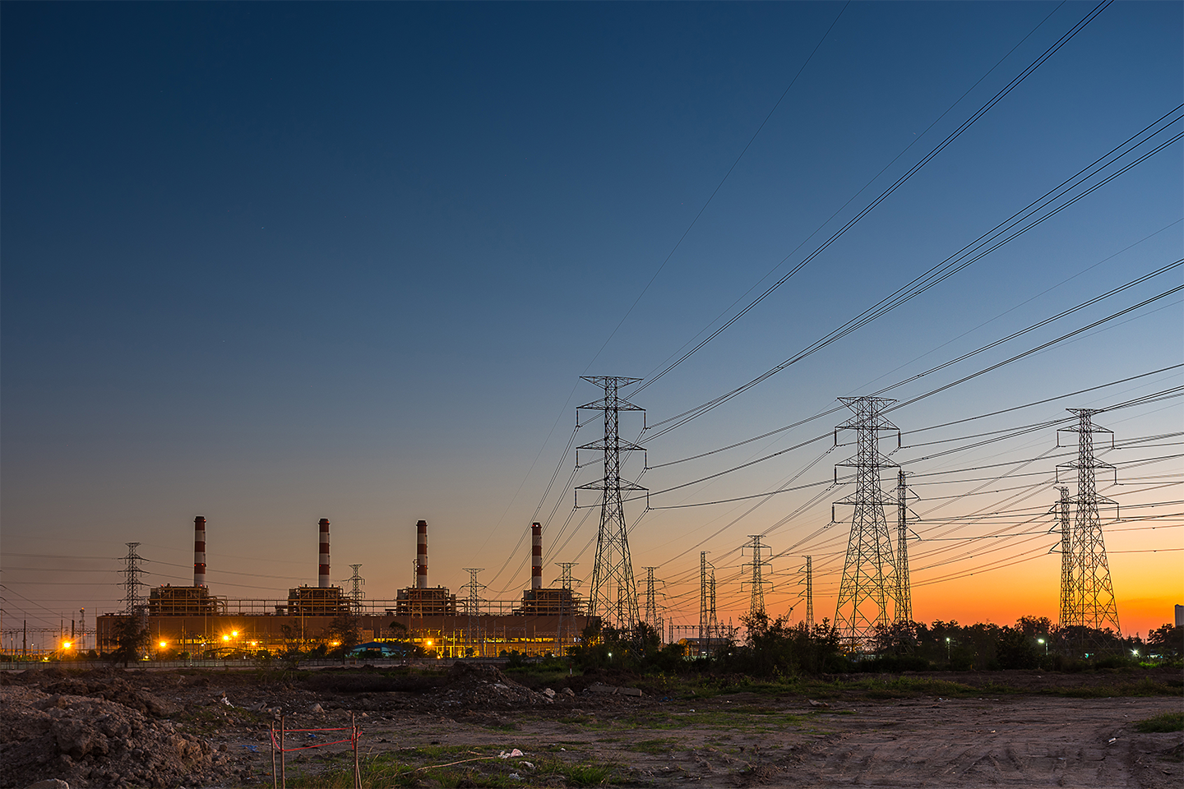
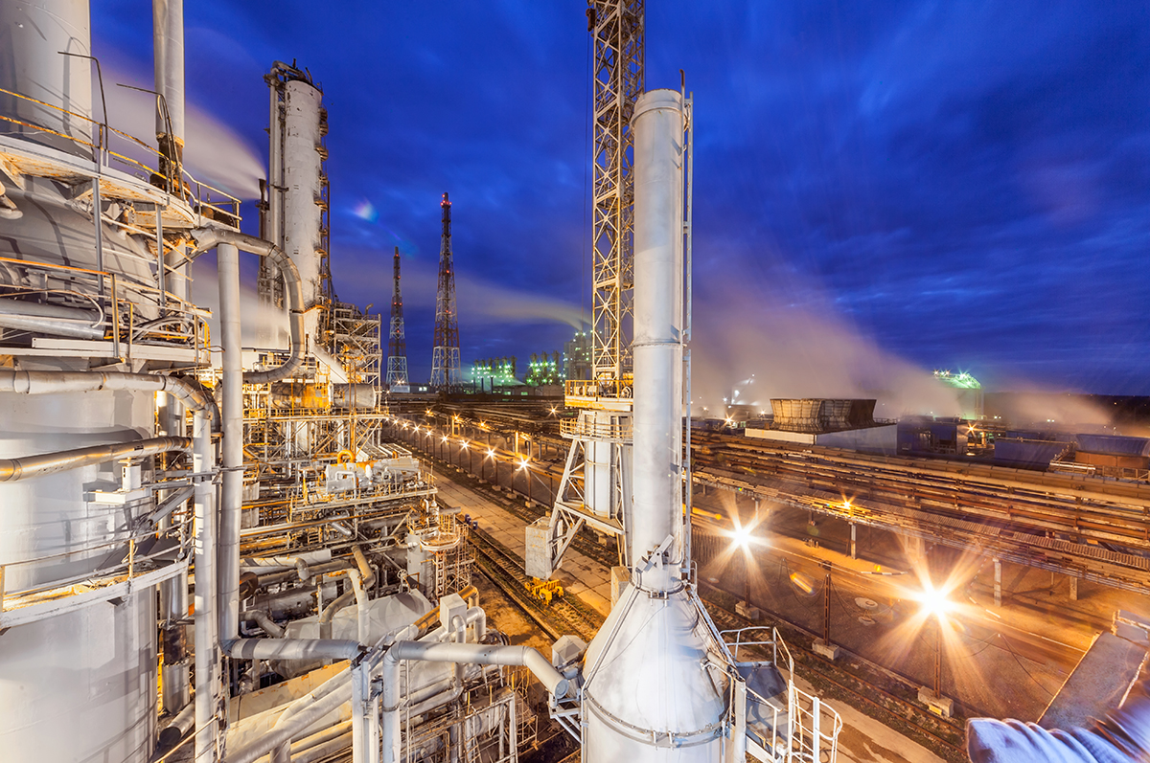

Potential Customers
X-energy has identified three market segments with requirements that are aligned with the Xe-100’s unique benefits:
Utilities
Industrial/Commercial
Government
Compact, ultra-safe generation capacity that will replace retiring coal-fired power plants in line with federal mandates
Nuclear power that can support high-temperature industrial and commercial applications for the first time
On-base, grid-dependent power source that achieves resilience and energy security while supporting federal emissions reduction goals

Slide 8
Projected Electricity Market
Target Plant Capacity:
150-600 MWe
150MWe-600MWe is a likely market for utilities replacing aging power plants from 2025-2040

Slide 9
U.S. Target Market 2025-2040
Target Plant Capacity:
150-450 MWe
15 Renewables
46 Natural Gas
49 Coal
49 Coal Plants
100MWe
-150MWe
150MWe
-200MWe
200MWe
-250MWe
250MWe
-300MWe
300MWe
-350MWe
350MWe
-400MWe
400MWe
-450MWe
450MWe
-500MWe

Slide 10
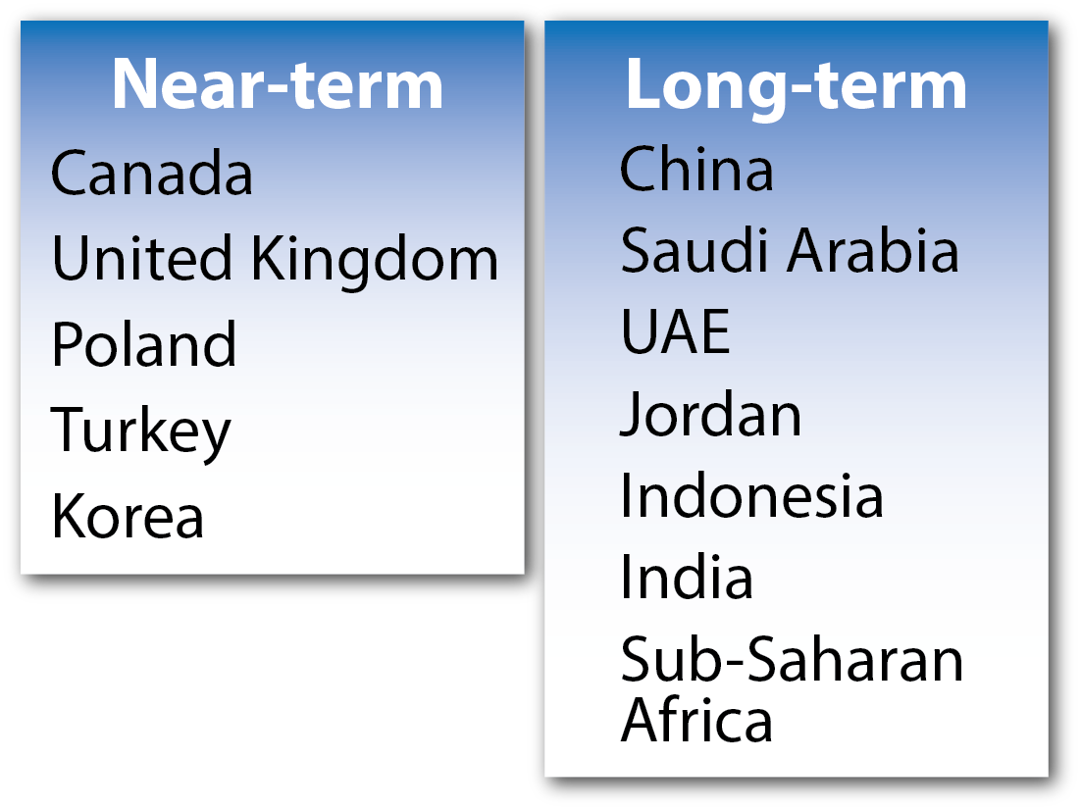
International Markets
Growth of global demand for electricity is expected to be more than double by 2040. X-energy is taking a two-step approach to pursue these opportunities:
  Near-Term: large, developed nations with existing U.S. 123 Agreements.
  Long-Term: countries with tremendous growth potential and proven interest in using nuclear energy.
10

Slide 11
Temperature Ranges for Process Heat
LWR: 0° C – 250° C
Energy Solutions
Combined Heat and Power (CHP): 0° C – 500° C
Xe-100: 0° C – 565° C
Waste Heat
High Temperature

Slide 12
Potential U.S. Industrial Steam Market
Facility Description | Total Nameplate Capacity (MWe) | Number of Boilers | Average MWe per Boiler
Dow Chemical Texas Operation | 678 | 7 | 97
Houston Chemical Complex Battleground | 296 | 3 | 99
ExxonMobil Baytown Refinery | 170 | 6 | 28
Motiva Enterprises Port Arthur Refinery | 110 | 5 | 22
ExxonMobil Beaumont Refinery | 110 | 5 | 22
Whiting Refinery | 84 | 5 | 17
CITGO Refinery Powerhouse | 75 | 3 | 25
Corpus Refinery | 47 | 1 | 47
ExxonMobil Oil Joliet Refinery | 40 | 3 | 13
Port Arthur Texas Refinery | 38 | 1 | 38
Goodyear Beaumont Chemical Plant | 15 | 1 | 15
Bunge Oil | 4 | 1 | 4
Grand Total | 1,666 | 41 | 41

Slide 13
International Electricity Markets
Near-Term: developed OECD nations with existing U.S. 123 Agreements – minimal work required to export nuclear technology, Ex-Im funding more likely
Long-Term: developing nations (may lack U.S. 123 Agreements) with potential dramatic growth, Ex-Im funding potentially challenging
Near-term
Canada
United Kingdom
Poland
Turkey
Long-term
Saudi Arabia
UAE
Jordan
Indonesia
India
X-ENERGY PROPRIETARY INFORMATION
13

Slide 14
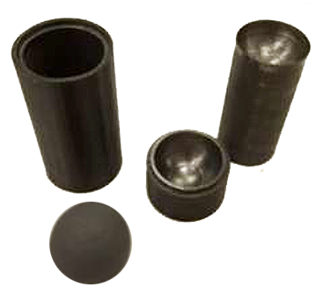
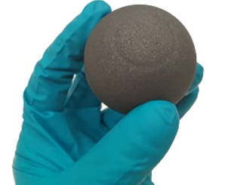
U.S. Department of Energy Endorsement
DOE Cooperative Agreement
X-energy began activities July 1, 2016 on a 5-year, $53M cooperative agreement with the U.S. Department of Energy focused on:
    Furthering the Xe-100 reactor design
    Establishing pebble fuel manufacturing capability
    NRC engagement
Milestones Completed to-date
  Mechanistic source term development roadmap
  Structural graphite selection criteria summary
  Pebble matrix graphite analysis summary
First fuel form pebbles
produced at ORNL,
Fall 2016
Prototype mold
and first pebble

Slide 15

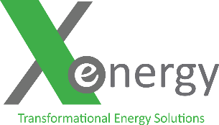

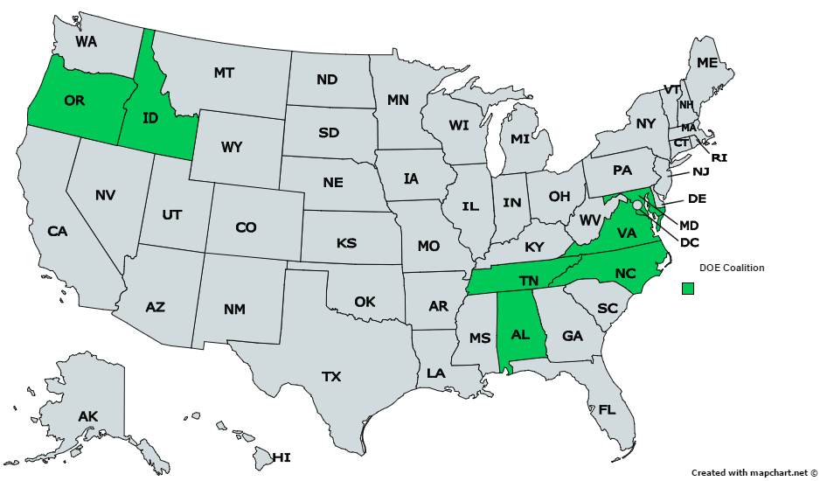




X-energy Leveraging a Proven Team
5-year, $53M cost-share Cooperative Agreement
National Labs receive 40%
Idaho Falls, ID
Greenbelt, MD
Corvallis, OR
Lynchburg, VA
Charlotte, NC
Oak Ridge, TN
Huntsville, AL
Notes:
Building this new reactor is a huge endeavor – you need a lot of partners and a lot of different endeavors

Slide 16







Partners Towards Deployment
DOE ARC Teammates
X-energy Advisory Committee
X-energy Industrial Partners

Slide 17
The Xe-100

Slide 18


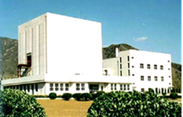
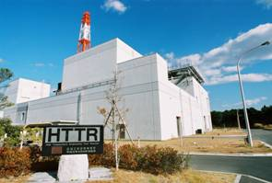
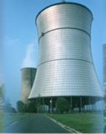
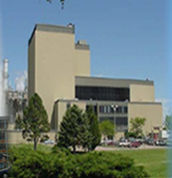
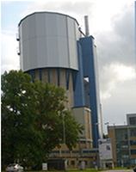

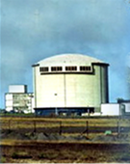
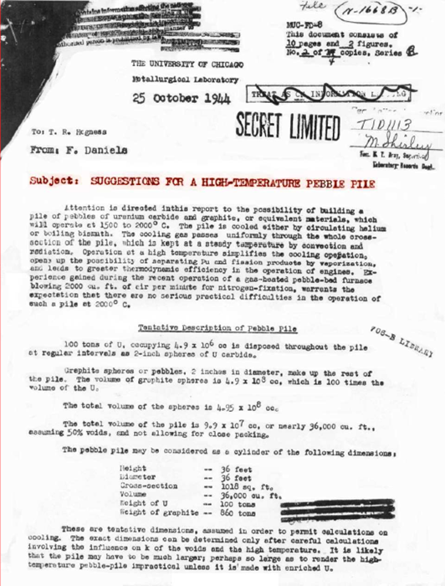
Innovating on a Proven Foundation
The Xe-100 is an evolutionary High Temperature Gas-Cooled Reactor design that builds on over 70 years of research, testing, and demonstration
USA
USA
China
Japan
Germany
USA
2005 – Present
2000-Present
HTR-10
Germany
1998-Present
HTTR
1986-1989
THTR
USA
1967-1988
Fort St. Vrain
UK
1967-1988
AVR
1966-1974
Peach Bottom
USA
1966-1975
Dragon
Extensive testing of reactor core and pebbles to extreme temperatures, pressures and failure modes have validated the safety performance of High Temperature Gas-Cooled Nuclear Reactors (HTGRs)
1944
ORNL
Notes:
Key Message: the system’s underlying principles are all proven & validated; we don’t focus on “research” as much as optimization & development.

Slide 19


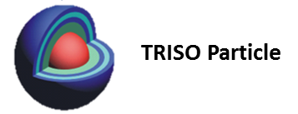
What Is a Pebble Bed Reactor?
A nuclear reactor that uses TRistructural ISOtropic coated particle LEU fuel, embedded in graphite spherical fuel elements (pebbles)
LEU is in the form of Uranium Oxycarbide (UCO), enabling higher temperatures, lower internal pressures, and therefore higher burnup (163,000 MWdays/ton) as compared to UO₂ (~80,000 MWdays/ton)
15.5% Low Enriched Uranium is the Xe-100 Baseline
~ 19,000 TRISO coated particles in each pebble
60mm diameter
~ 1mm
Fuel is the Key to Unsurpassed Safety

Slide 20
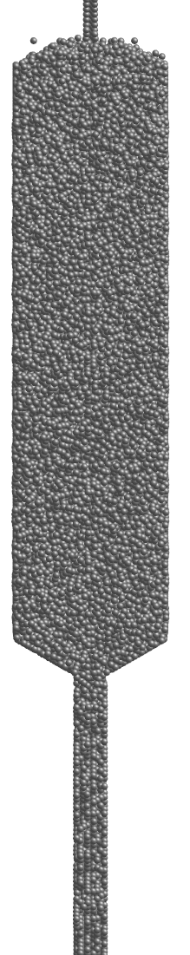
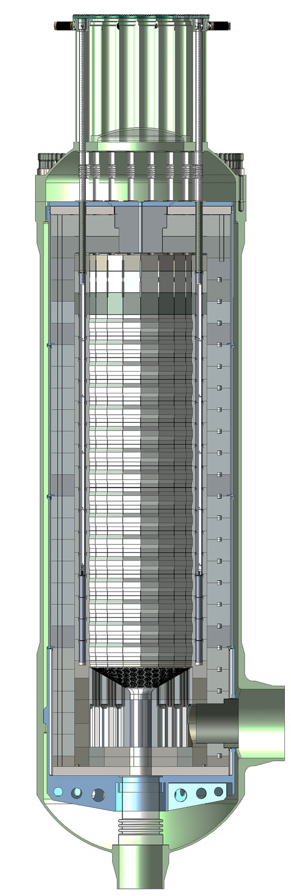
What Is a Pebble Bed Reactor?
Pebbles are placed in a cylindrical volume formed by graphite blocks to form the reactor core.
The heat generated in the
pebbles is transported to
the steam generator by
circulating helium through
the core to remove the heat.
Pebble bed reactors cannot meltdown due to the fact that the heat generation is controlled through the system’s negative temperature coefficient.
This is achievable due to the low power density of the core which is approximately 30 times lower than traditional nuclear reactors.
≈220 000 pebbles in the core

Slide 21
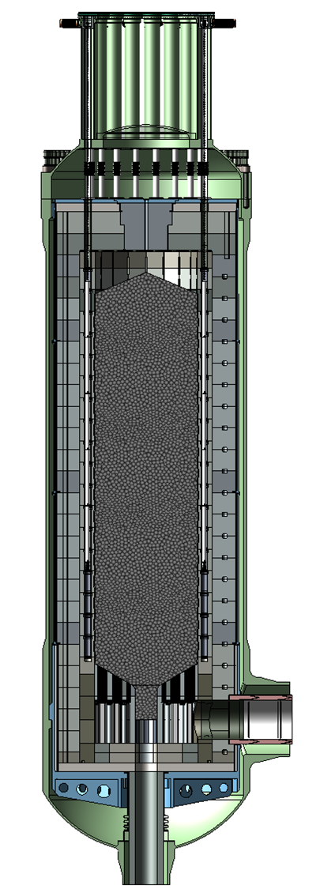
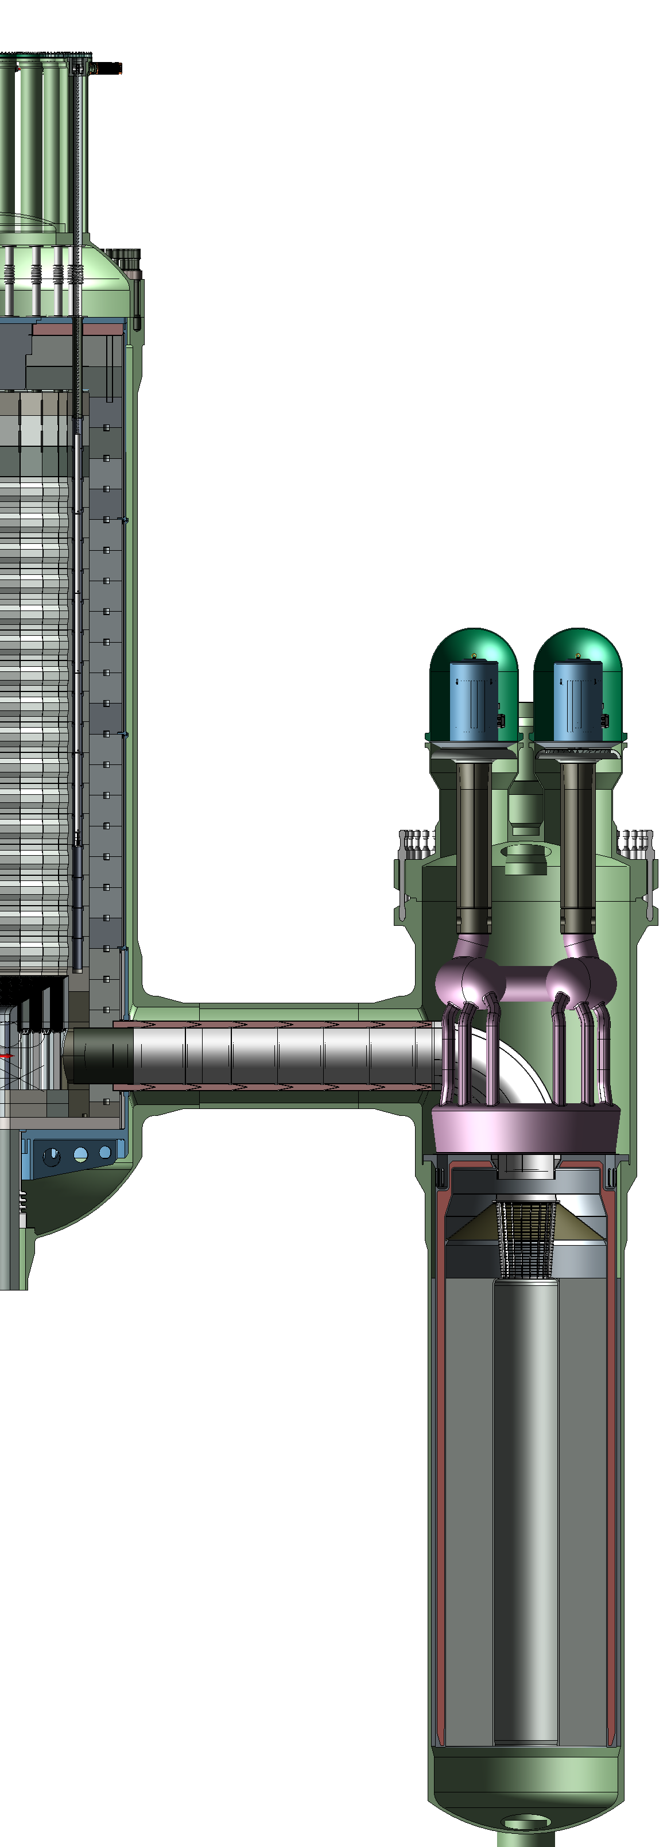
Xe-100 Baseline Reactor
Control rods
Pebble bed
Key Technical Specifications:
200MWt / 76MWe
Rankine Cycle
Helical steam generator
Multi pass fuel cycle using 15.5% LEU
Graphite top
reflector
Steam Generator
Graphite side
reflector
Circulators
Steam collection manifold
Graphite bottom
reflector
Core barrel
Pressure vessel
Reactor
Helical coil tubes (not shown)
Xe-100 Reactor Specifications
Thermal Output | Steam Temperature | Steam Pressure | Electric Output
200MW | 565ºC | 16.5MPa | ~76MW
Feed water inlet

Slide 22
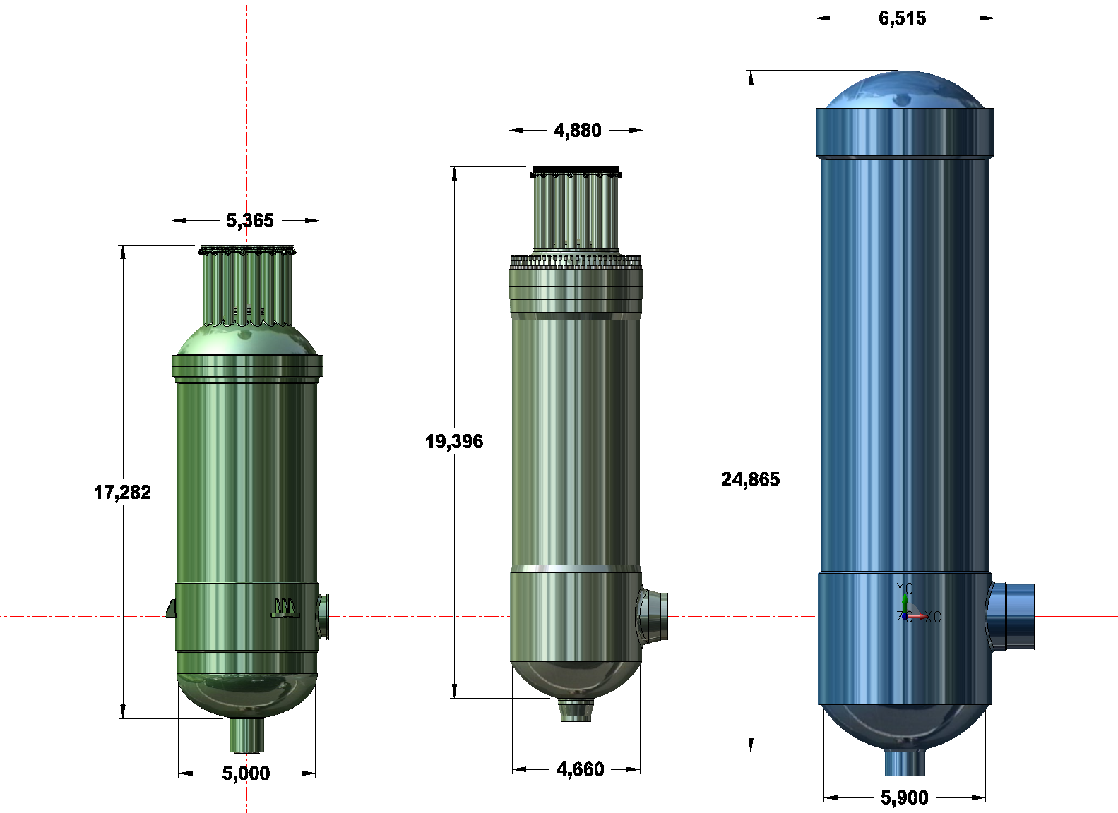
Comparison in Pressure Vessel Size
Product: Xe-100
Power: 200MWt
Type: Multi-pass UCO fuel @ 15.5% enrichment
Weight: 200 Tones
Product: HTR-PM
Power: 250MWt
Type: Multi-pass, UO₂ fuel @ ~10% enrichment
Weight: 700 Tones

Slide 23
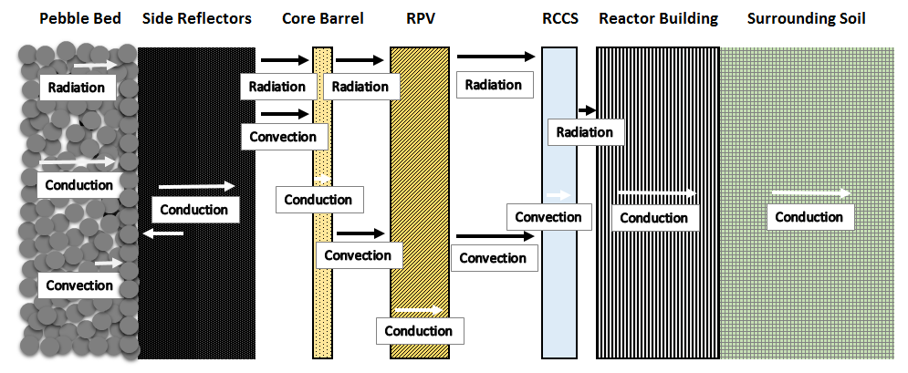
Feature: Passive Heat Removal
During a loss of forced cooling, with or without helium pressure, heat from the core is passively removed via:
  Conduction through the pebbles and side reflector
  Convection and thermal radiation to the core barrel and Reactor Pressure Vessel (RPV) to the reactor cavity cooling system (RCCS)
  Normal heat removal through RCCS by natural convection
  Conduction through the concrete to the environment if the RCCS is not available

Slide 24
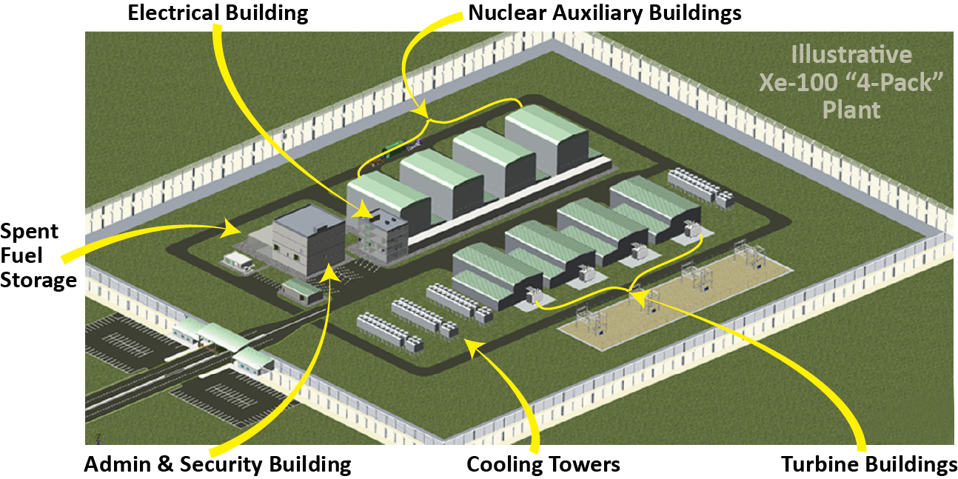
Features: Xe-100 Modular Plant Layout
Nuclear Auxiliary Buildings
(Above Grade)
Electrical Building
Spent Fuel Storage
Turbine Buildings
Cooling Towers
Admin & Security Building
Illustrative
Xe-100 “4-Pack” Plant
Layout is not to scale
Secure: underground reactor layout is possible
Scalable: allows for build-out based on power demand
Small: can be built on 10 acres of land and allows for grid independence
Safe: smaller EPZ allows for building close to existing infrastructure

Slide 25
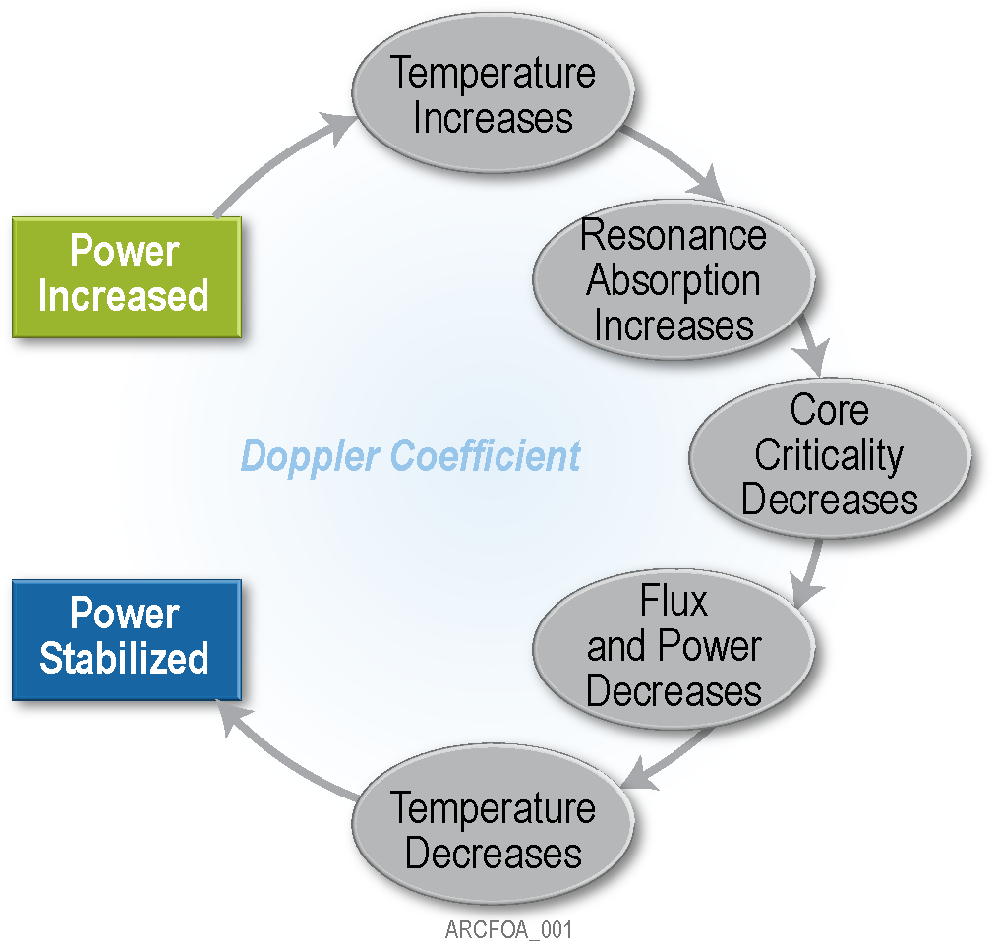
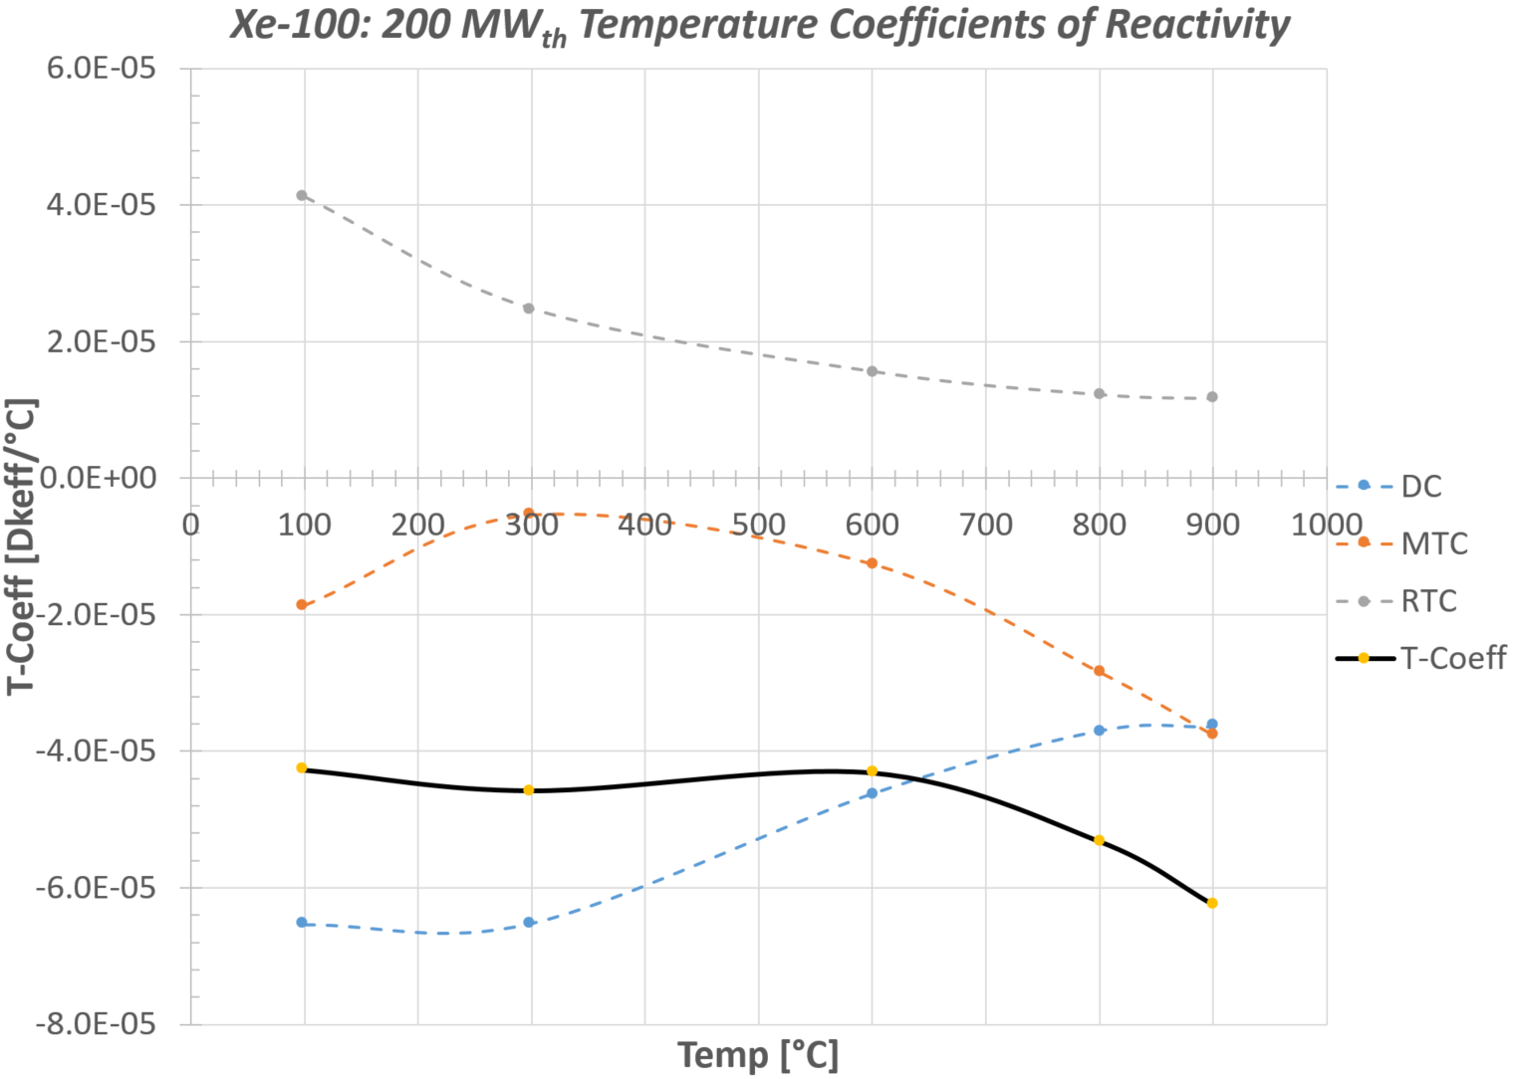
Feature: Negative Temp. Coefficient
If the temperature increases, the nuclear chain reaction dies down due to overall negative temperature coefficient

Slide 26
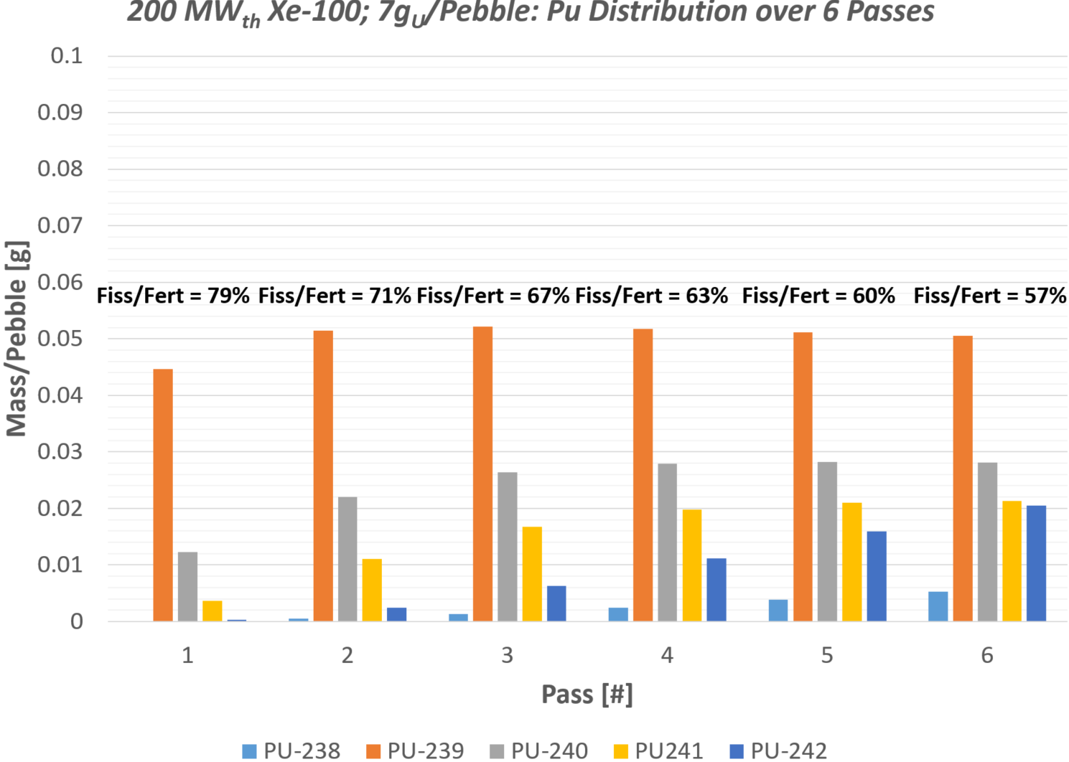
Feature: Proliferation Resistance
Odd isotopes are fissile and potentially weapons material
Even isotopes are fertile and add proliferation resistance when included in discharge
Xe-100 fuel cycle (Multi-pass) renders Pu isotopic mixture useless for nuclear proliferation
Notes:
26

Slide 27
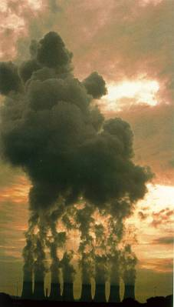


Feature: Emissions Reductions
1 pebble:
7g with 15.5 wt% enriched
Uranium,
27.4 MWh
about 0.8 metric tons of ash
8.0 metric tons of CO₂
2.66 metric tons of coal
Ref: EIA https://www.eia.gov/tools/faqs/faq.cfm?id=667&t=2
© 2017 X Energy, LLC, all rights reserved
Nuclear Energy. Reimagined.

Slide 28
Emissions Comparison
Typical 618 MW Coal-Fired Power Unit
CO₂ = 9,125,000 tons per year
SO₂ = 746,198 tons per year
NO₂: 37,148 tons per year
N₂O: 113 tons per year
Ash = 1,155,833 tons per year
9 x Xe-100
CO₂ – None
SO_{X} – None
NO_{X} – None
N₂0 – None
Ash – None
118 tons of radioactive pebbles per year (11 t high level waste)
Notes:
28

