Slide 1
Fusion Research and Development at Savannah River National Laboratory
Holly B. Flynn
Senior Scientist, Fusion Modeling Lead
Hydrogen Isotope Processing Science Group
02-24-2023

Slide 2
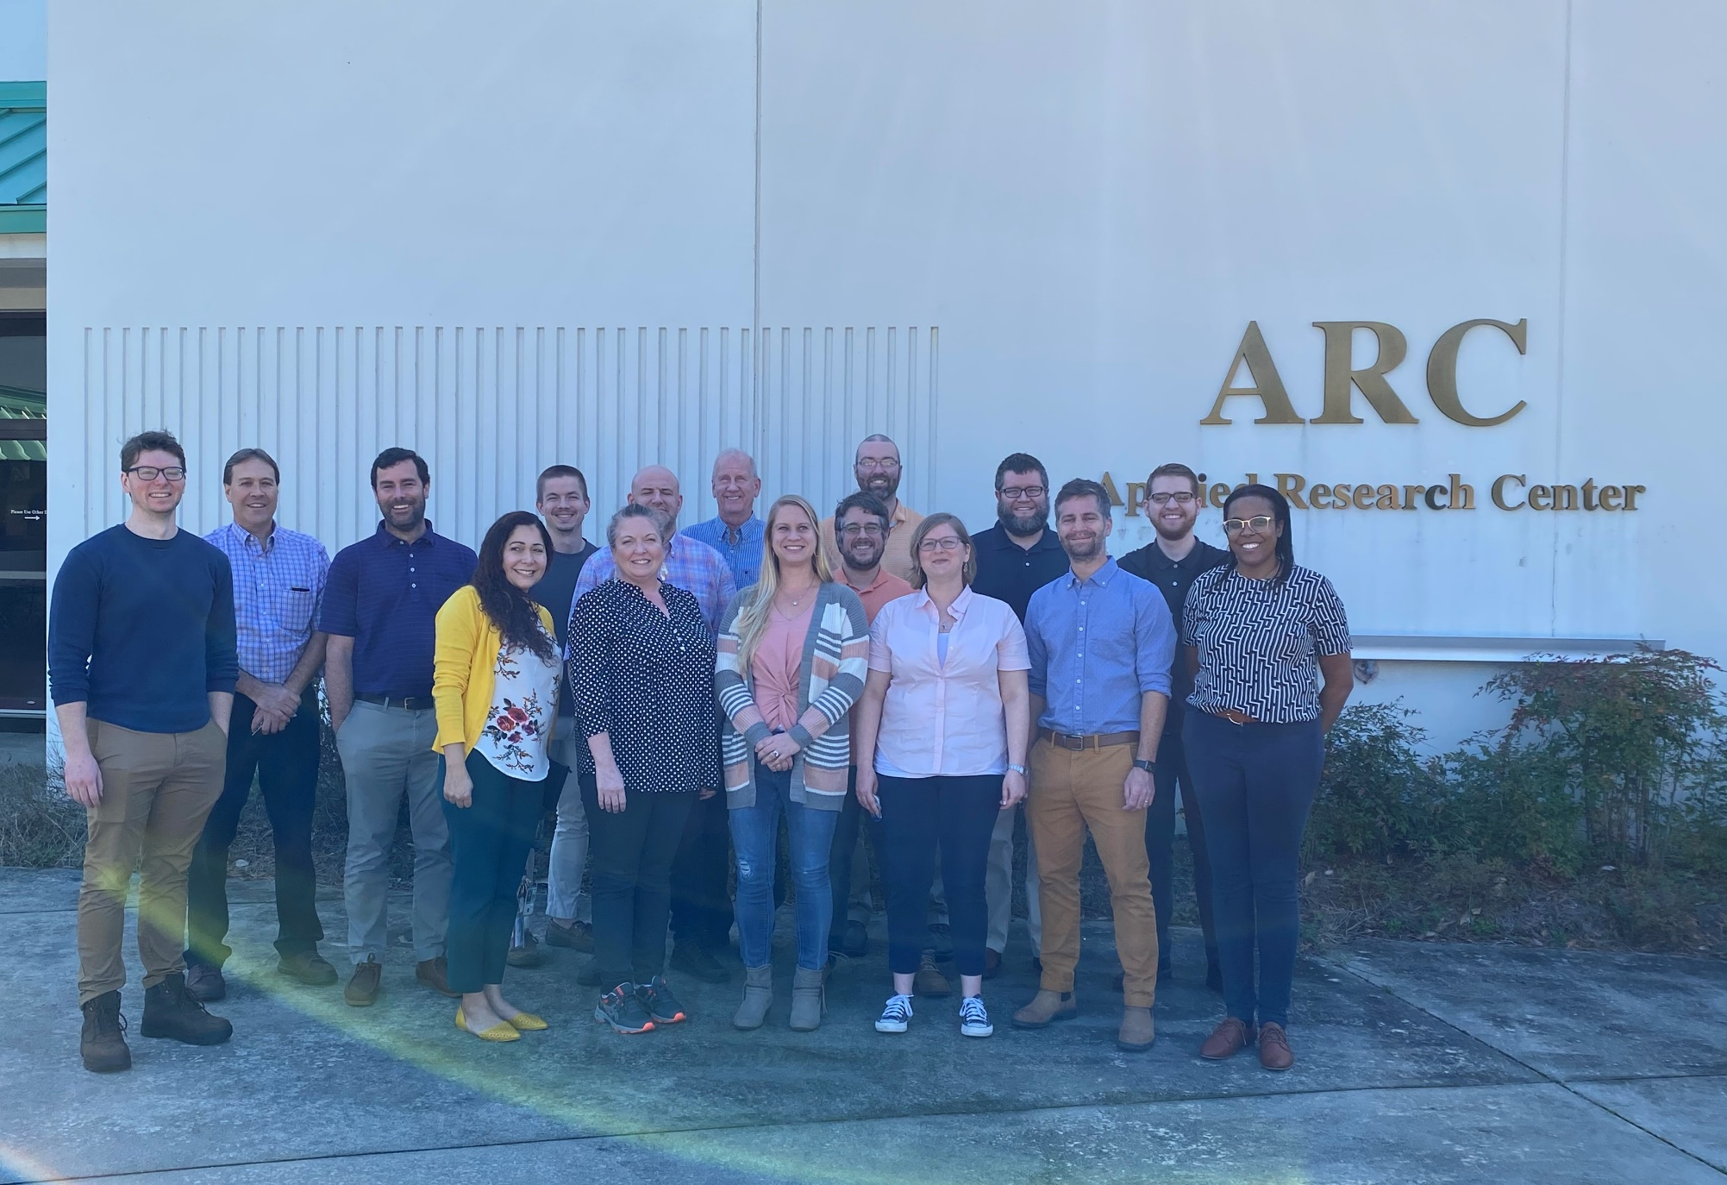

Slide 3
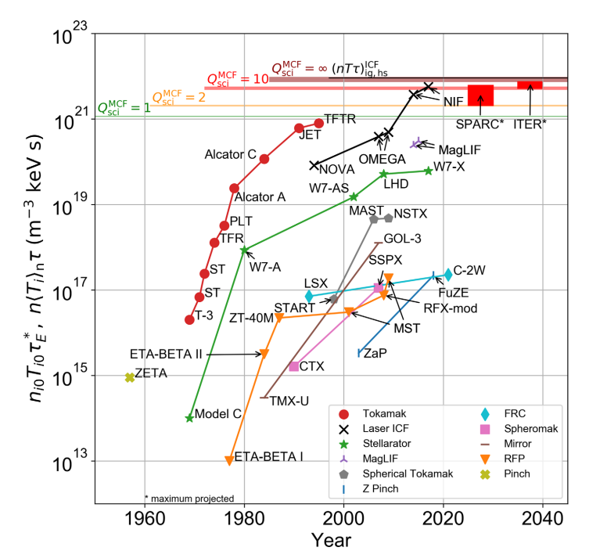
Background and Introduction to Fusion Research
Scientific breakeven, Q_{sci} = 1
  Power released from fusion reaction is equal to the required heating power
  NIF, Lasers provided 2.05 MJ and fusion yielded 3.15 MJ (2022)
A commercial device will need all power consumption to break even with fusion yield
  Components that make up the fuel cycle
  Critical heating components
  Redundancies
  Sensors or diagnostics
Wurzel, Samuel E., and Scott C. Hsu. "Progress toward fusion energy breakeven and gain as measured against the Lawson criterion." Physics of Plasmas 29.6 (2022): 062103.

Slide 4
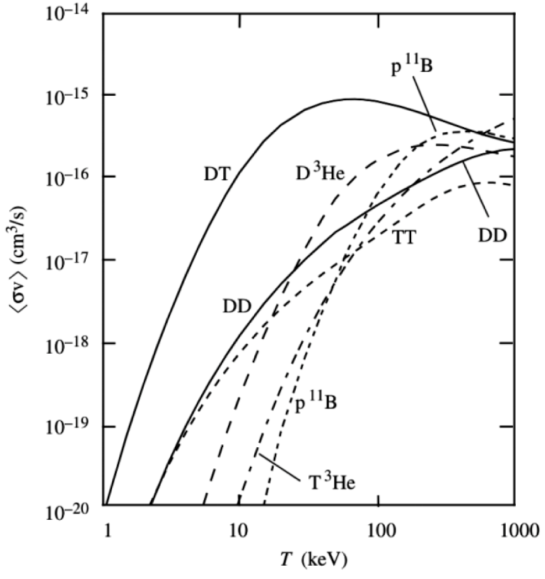
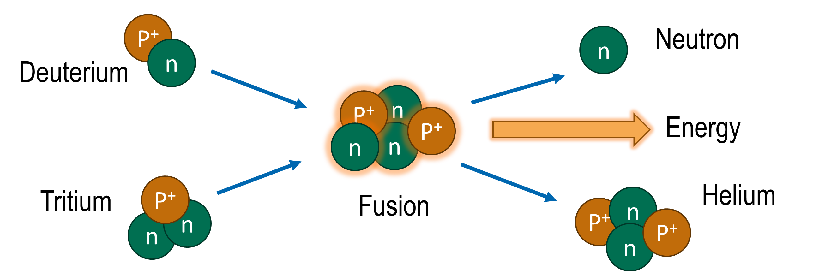
Background and Introduction to Fusion Research
The Deuterium-Tritium (DT) fusion reaction (thermonuclear)
  ~17.5 MeV of energy and a helium-4
  Highest energy gain at the lowest ‘temperatures’ (~2 keV, >100,000,000 C)
  Thermonuclear fusion needs a medium called a plasma
The plasma will need to be
  Self sustainable by breeding more tritium than is burned
  Continuously fueled to maintain burn rate for power production
Tritium is a radioactive material that has special needs in handling, processing, and storing

Slide 5
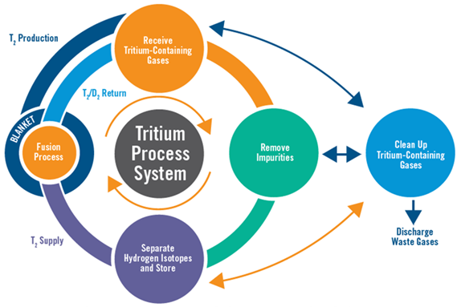
Five Tritium Research Topics to Enable Fusion
Process Modeling, Process Control, & Simulation – Define models to advance & optimize system design, monitor operation, control the process and simulate performance during normal and off-normal operation
Tritium Inventory Reduction & Improved Process Technologies – Improve tritium processing to reduce the inventory needed and lower the radioactive source term.
Isotope Supply, Tritium Breeding, and Tritium Extraction– Define tritium/isotope supply source and processing, ensure tritium breeding ratio can be achieved, and minimize captive inventory
Tritium Confinement to Reduce Emissions and Support Safety Basis – Develop advanced tritium wetted materials and confinement barriers, understand and mitigate tritium effects on plasma facing components, and improve tritium removal and recovery from secondary/tertiary confinements and effluent streams
Tritium Accountability and Tritium Analytical/Diagnostic Capabilities – Develop rapid, high-accuracy/precise accountability measurement instruments and techniques to measure tritium and account for it in different parts of the system

Slide 6

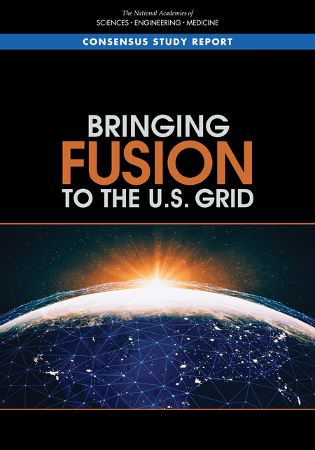
The Fusion Fuel Cycle and Fusion Commercialization
Dec 2020 FESAC Report – “Powering the Future Fusion & Plasmas”
Recommendation: Significantly expand blanket and tritium research and development programs
Recommendation: Expand existing and establish new public-private partnership programs to leverage capabilities, reduce cost, and accelerate the commercialization of fusion power and plasma technologies.
Mar 2021 NASEM Report – “Bringing Fusion to the US Grid”
Recommendation: The Department of Energy should establish and demonstrate efficient tritium processing technologies at relevant rates and processing conditions before operation of a pilot plant.
Recommendation: The Department of Energy should move forward now to foster the creation of national teams, including public-private partnerships, that will develop conceptual pilot plant designs and technology roadmaps and lead to an engineering design of a pilot plant that will bring fusion to commercial viability.

Slide 7
SRNL Fusion Program Efforts
Tritium Facilities at the Savannah River Site (SRS) are some of the few facilities in the world that handle large amounts of tritium
SRNL has decades of experience in tritium processing, handling, and R&D
Leveraging expertise gained from NNSA, ITER, and programs to help industry
Licensing of fusion-relevant technologies to industry and supporting commercialization
DOE FES INFUSE Program
DOE FES Technology Development
DOE FES Efforts to Define/Support an FPP
  Blanket & Fuel Cycle Working Group Mtg
  Fusion Energy System Studies
ARPA-e GAMOW Technology Development
  HyPOR Loop Development
  Direct LiT Electrolysis

Slide 8

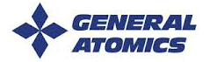
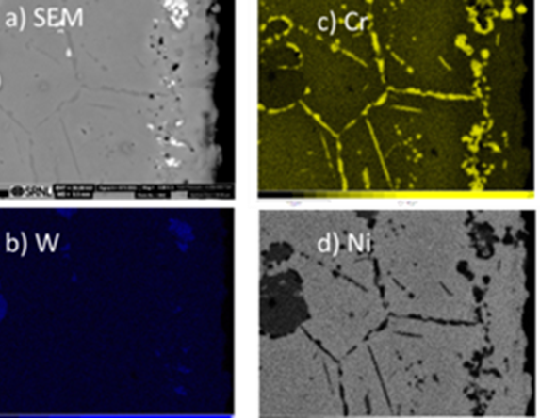
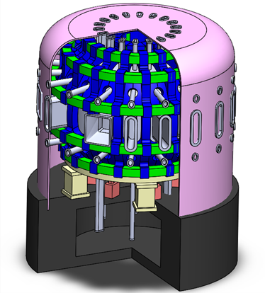


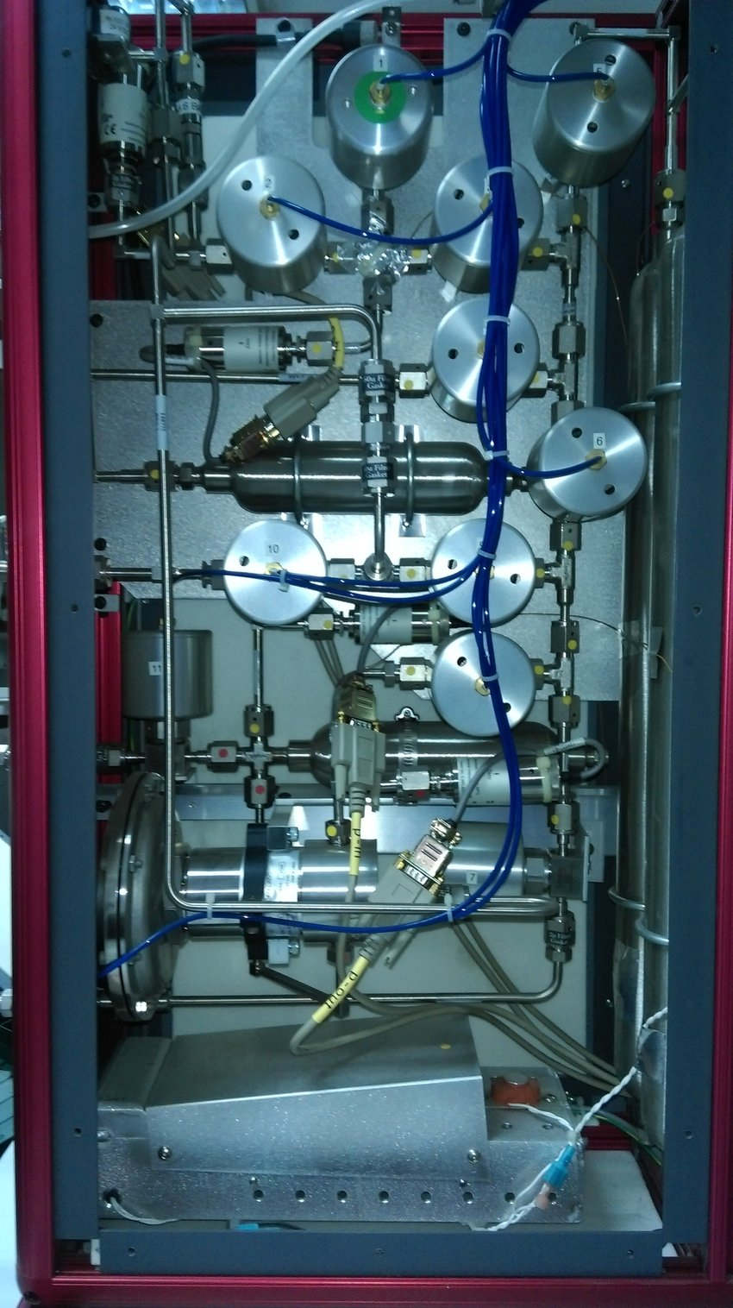
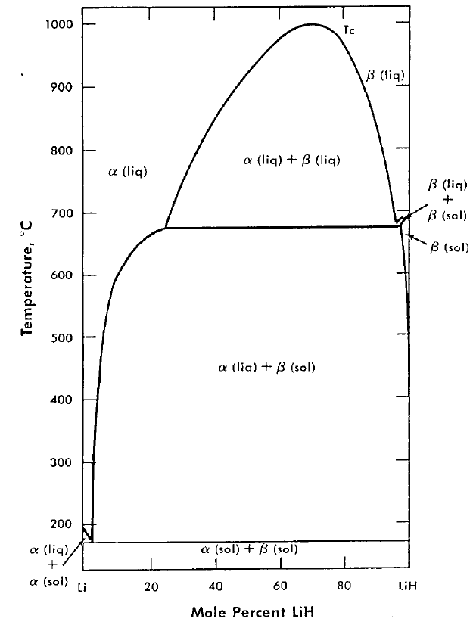
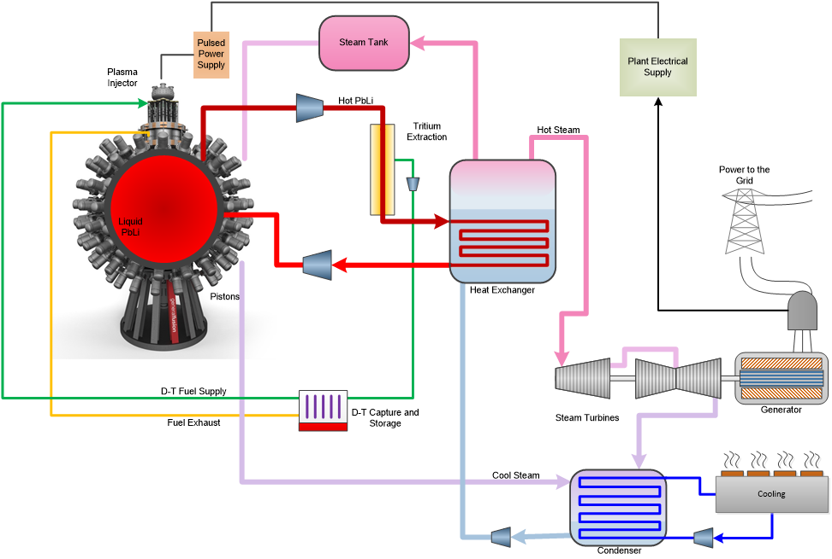
Partnering with Industry through INFUSE CRADA projects
Active Redox Control of Molten Salts For Fusion Blankets
Fuel Cycle and Tritium Plant Model for Fusion Pilot Plant
Demonstrate corrosion mitigation using redox control coupled with electrochemical potential measurements
Brandon Sorbum – CFS PI
Brenda Garcia-Diaz – SRNL Pi
Develop reduced and detailed models form a fusion pilot plant fuel cycle that can be utilized for integration into overall fusion pilot plant models
David Weisberg – General Atomics PI
Holly Flynn – SRNL Pi
Tritium Fuel Cycle Modelling and Optimization to Enable Fusion Pilot Plant Development
Phase Diagram of Li-LiH,D,(T) Mixtures and Implications for Tritium Retention and Extraction
Quantify and streamline tritium processing in a commercial pilot plant to enable fusion pilot plant development.
Matt Miles– General Fusion PI
George Larsen – SRNL Pi
Measure phase diagrams fro tritium extraction with LiH & LiD mixed with Li to allow extrapolation to LiT
Brandon Sorbum – Renaissance PI
George Larsen – SRNL Pi

Slide 9
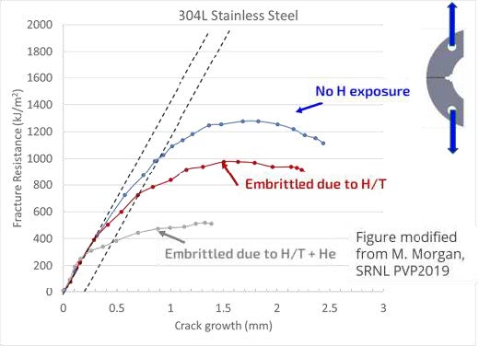
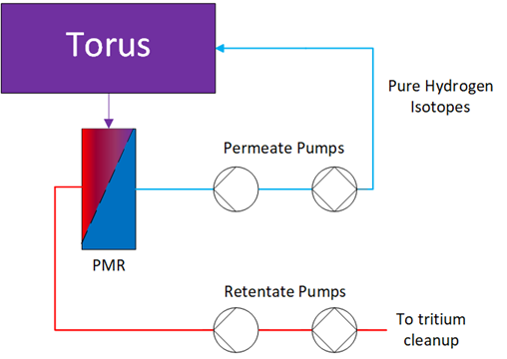
Leveraging FES Program Funding to Advance Technologies and Materials
Advanced Pd Alloys for Impurity Reaction & Removal
Advanced Getters for Tritium Removal from Coolant Loops
Characterizing and Mitigating Tritium Retention and Permeation
Fusion Nuclear Science Program
Fusion Nuclear Science Program
Fusion Materials Program
Develop, characterize, and test novel alloys for palladium membrane reactors (PMRs) that can react impurities and separate hydrogen isotopes for internal recycling
Lucas Angelette - PI
Characterize tritium and He degradation of structural materials for fusion and develop tritium permeation barriers and application methods for process components
Dale Hitchcock – PI
Characterize the use of advanced getter materials for the removal of tritium from secondary He cooling loops that can prevent unwanted release of tritium from the fuel cycle
George Larsen – PI

Slide 10
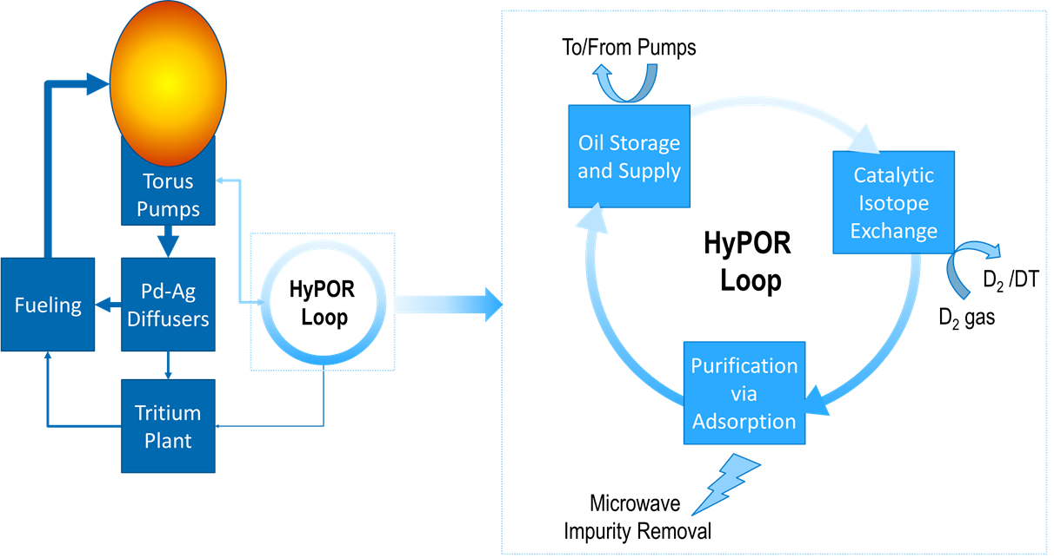
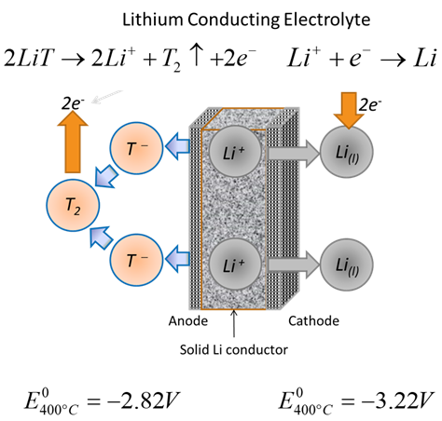
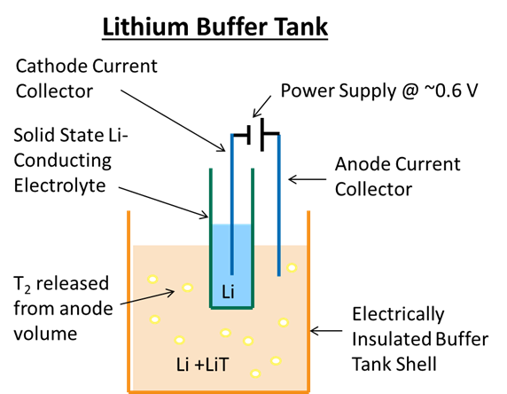


Technology Development and ARPA-e GAMOW and FES
Hydrocarbon Pump Oil Recycling (HyPOR) Loop
Goal: Selectively remove heavier H₂ isotopes from pump oil while also purifying the oil of radiation-induced damage
  > 4x reduction in tritium inventory
  > 10x reduction in pump electrical consumption
  > 50x reduction in costs
Direct LiT Electrolysis
Goal: Develop method to electrochemically extract tritium directly from a PbLi blanket for reduction of tritium concentrations below vacuum extraction
  >50% reduction in capital cost compared to Maroni process
  Develop durable electrolytes and electrodes
  Scale-up demonstration to 1 kg/hr processing rate

Slide 11
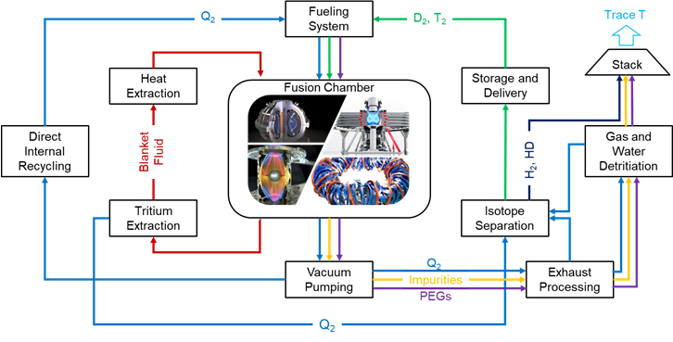
Fusion Fuel Cycle Modeling
The fusion fuel cycle includes the
  Fusion Device/Engine
  A series of sub-systems necessary for processing, moving, handling, and breeding tritium
  Several sub-systems that will need to undergo tritium extraction
Tritium will need to be accounted for and minimized
  A maximum tritium inventory in the system will be expected for environmental and safety regulations
  Accountancy is the accurate measuring and reporting of the amount of tritium within a facility.
  Technology selection and fuel cycle designs will be explored to minimize in-process tritium inventory

Slide 12
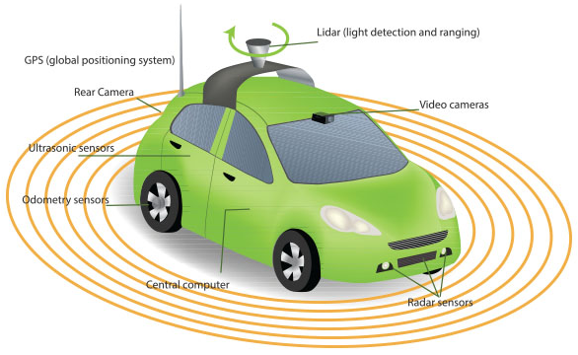
Real Time Tritium Accountancy
Commercial fusion systems will be closed
  Sensors will be used to monitor the in-process tritium inventory
  Sensors are noisy and are expected to accumulate system uncertainties.
  This makes measuring the ‘true inventory’ difficult
By harnessing algorithms used in self-driving cars, SRNL reduced errors in tritium measurements from 64% to 0.001%, which is critical for fusion safety and licensing
Demonstrated the capability of the Kalman Filter for real-time accountancy
1.) Flynn, H. B., and George Larsen. "Investigating the application of Kalman Filters for real-time accountancy in fusion fuel cycles." Fusion Engineering and Design 176 (2022): 113037.

Slide 13
In-Process Tritium Inventory Reduction
Investigated In-Process Tritium Inventory Reduction using the discrete time model
  Simulated improvements and changes to the fuel cycle by adjusting the processing time and fractional flows of sub-systems.
  Continuous pumping, Direct Internal Recycling (DIR), and improvement in Isotope Separation
  In-process inventory was shown to be reduced > 50% with a maximum reduction of ~71%.
2.) Flynn, Holly B., and George Larsen. "Fusion Fuel Cycle Inventory Reduction Studies Using a Processing-Time–Based Discrete-Time Interval Model." Fusion Science and Technology 79.1 (2023): 60-68.

Slide 14
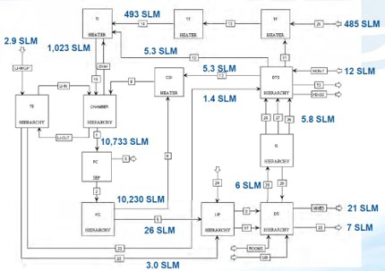
Process Modeling
Develop overall process models of a fusion pilot plant design to facilitate answering questions in the areas of:
  Technology and process sizing
  Tritium accountancy analysis points
  Cost, power consumption, and power production simulations and reporting
  Model integration and collaboration
SRNL has Subject Matter Experts (SMEs) in using Aspen for process modeling and simulation
Different models can be used to address different questions.
Aspen Plus® Fuel Cycle simulation​

Slide 15
SRNL Notable Mentions
SRNL is working with DOE and NRC on Tritium Subject Matter Experts for Fusion Regulation, D&D, and Non-Proliferation
Energy Justice Considerations and The Tritium Fuel Cycle
2023 Fuel Cycle Workshop
SRNL is Leading the Design, Procurement, and Fabrication of the ITER TEP System

